Slide 1



©2023 Otsuka Pharmaceutical Development & Commercialization, Inc. All rights reserved. October 2023 00US23EUA0008
©2023 Otsuka Pharmaceutical Development & Commercialization, Inc. All rights reserved. December 2023 00US23EUA0010
Notes:
©2023 Otsuka Pharmaceutical Development & Commercialization, Inc. All rights reserved. December 2023 00US23EUA0010

Slide 2
Table Of Contents
Executive Summary
State Medicaid Coverage, By % Of Population, National Summary, 2011-2022
State Medicaid Enrollment, % By Program, National Summary, 2017-2022
At-A-Glance: Medicaid Enrollment By Coverage Type, 2017-2022
Types Of State Medicaid Behavioral Health Carve-Out Financial Models: Overview
State Medicaid Behavioral Health Carve-Out Financial Models By Number Of State Medicaid Programs: At-A-Glance, 2017-2022
State Medicaid Behavioral Health Financing & Management Models: By Number Of State Medicaid Programs, 2011-2022
States With At-Risk Capitated Health Plan Medicaid Contracts In 2022
States With At-Risk Capitated Medicaid Contracts Plus Alternative Payment Model Requirements For Health Plans In 2022
States With Medicaid MCO Contract Requirement To Meet A Specific Target % Of Provider Contracts In APM In 2022
Tracking State Innovations in Medicaid Behavioral Health, 2017-2022
Appendix: State Medicaid Enrollment By Coverage Type, 2017-2022, By State
Notes:
©2023 Otsuka Pharmaceutical Development & Commercialization, Inc. All rights reserved. December 2023 00US23EUA0010

Slide 3
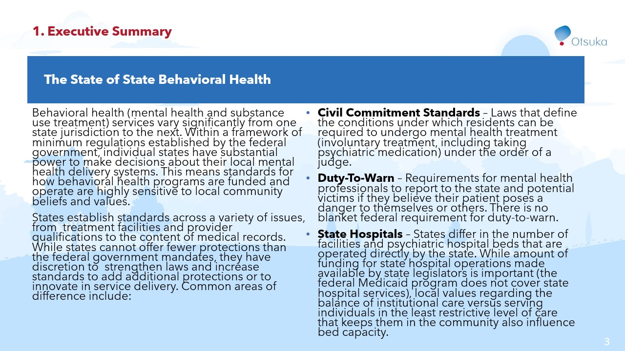

Slide 4
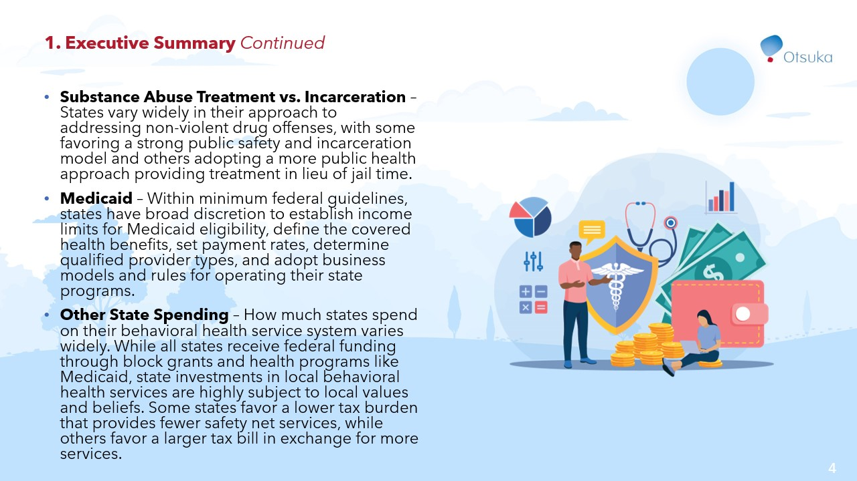

Slide 5
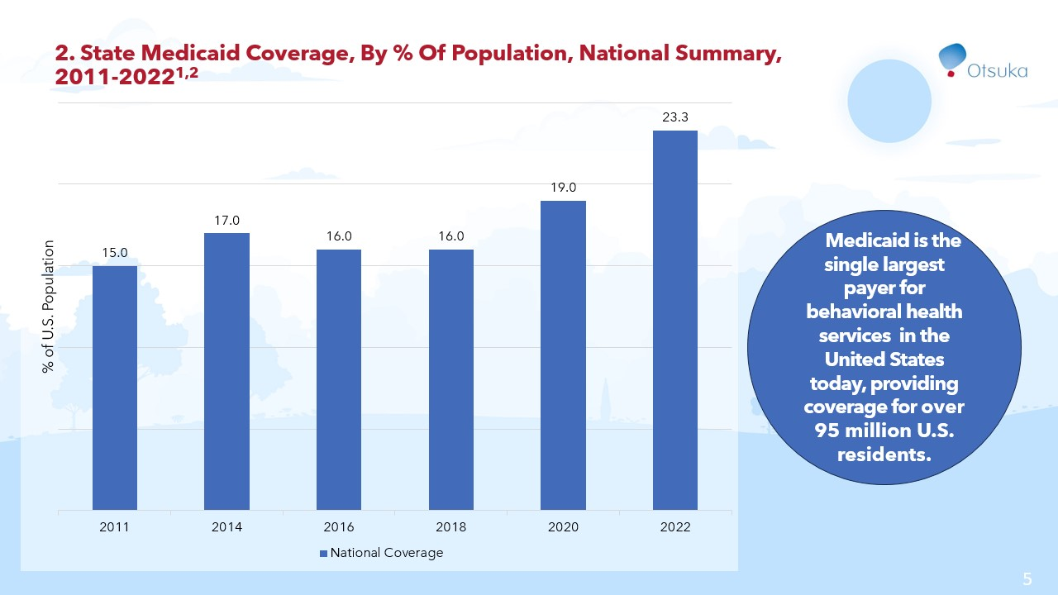

Slide 6
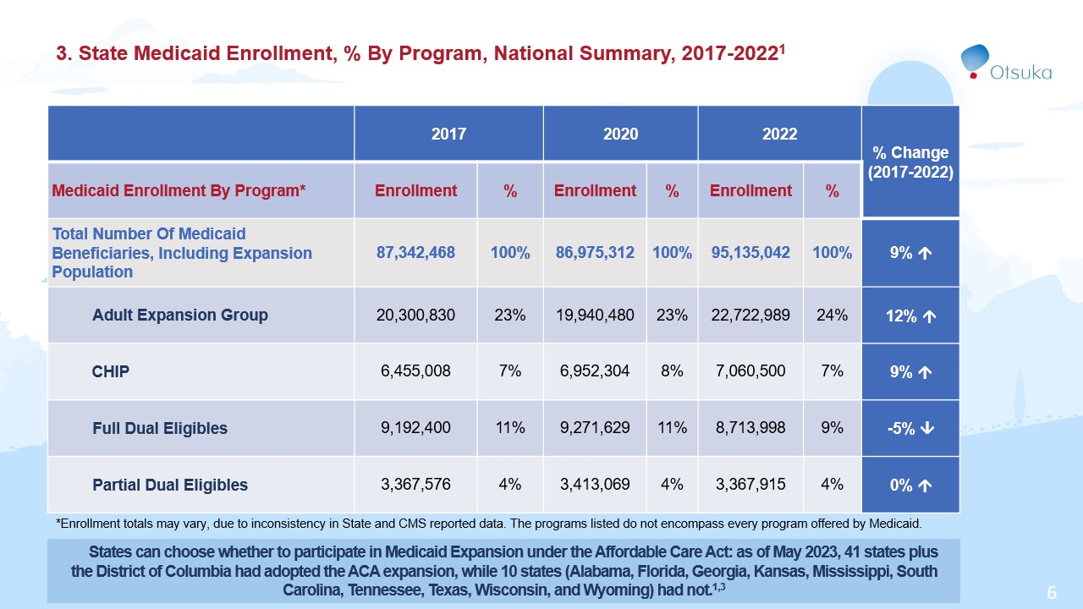

Slide 7
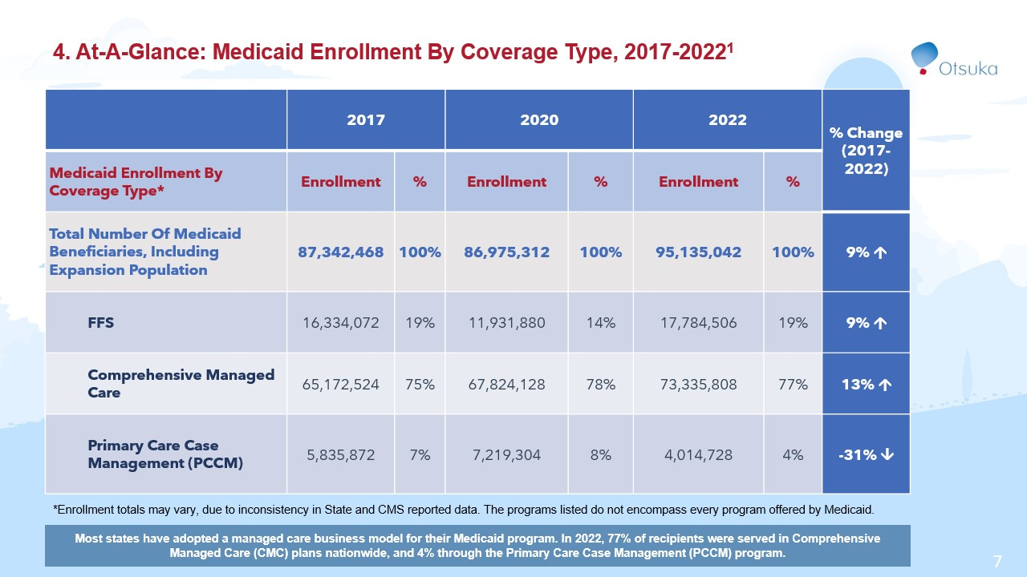

Slide 8
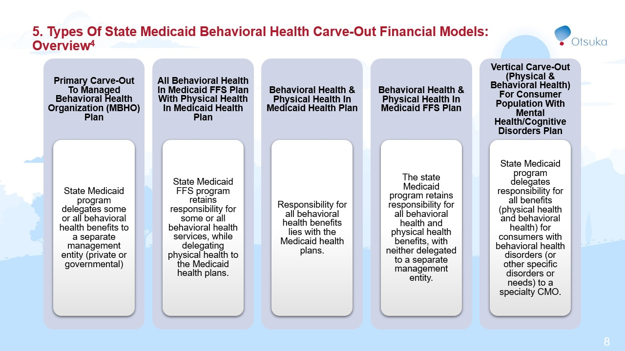

Slide 9
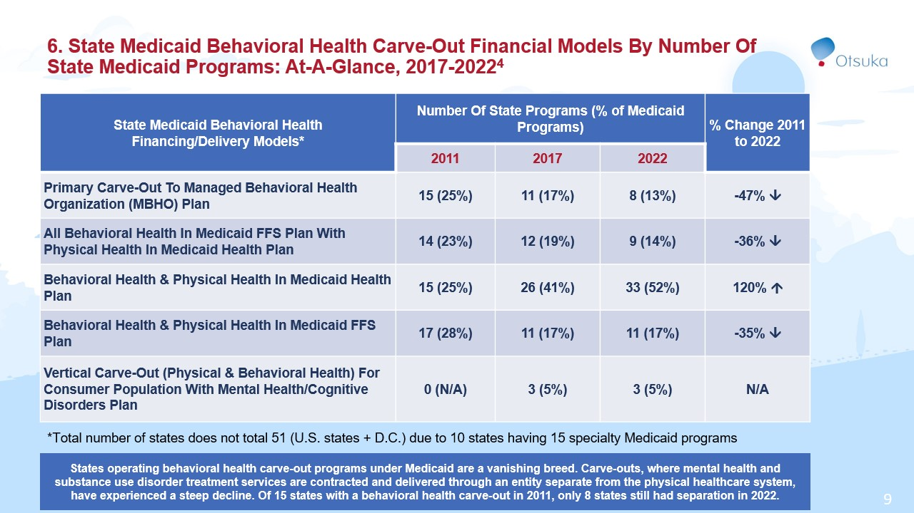

Slide 10
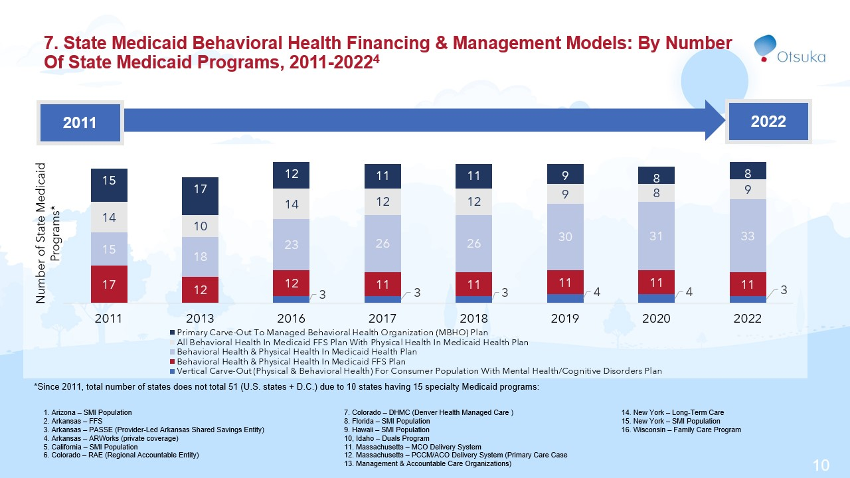

Slide 11
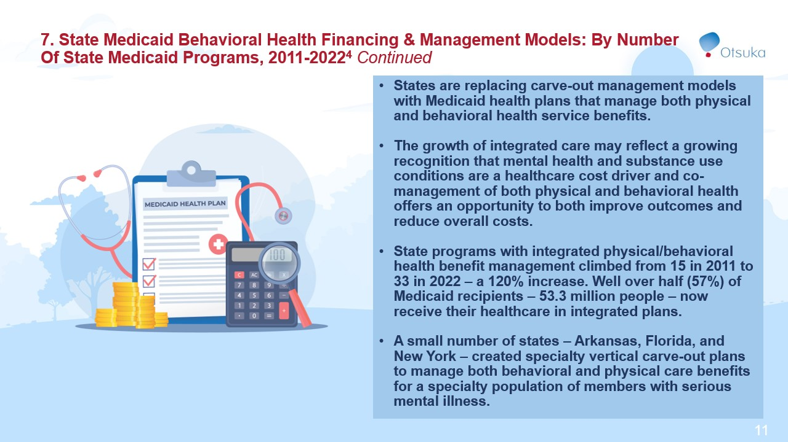

Slide 12
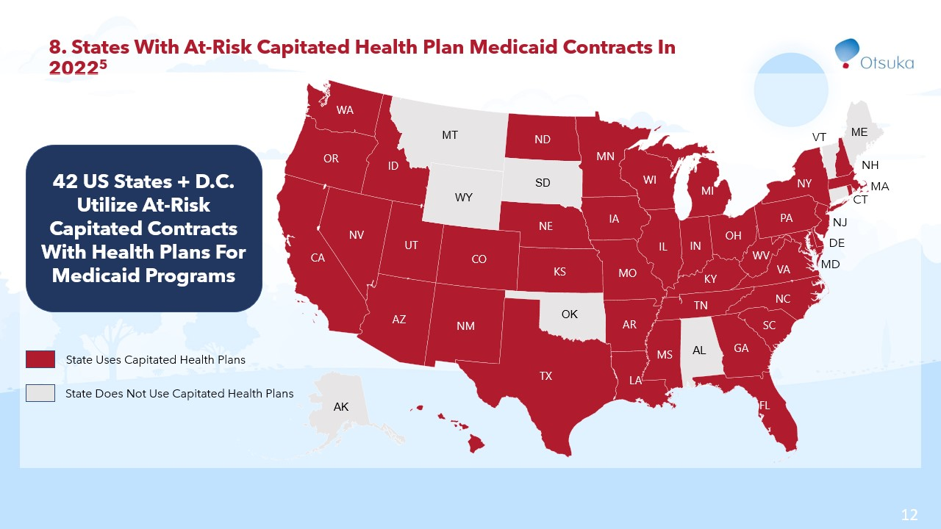

Slide 13
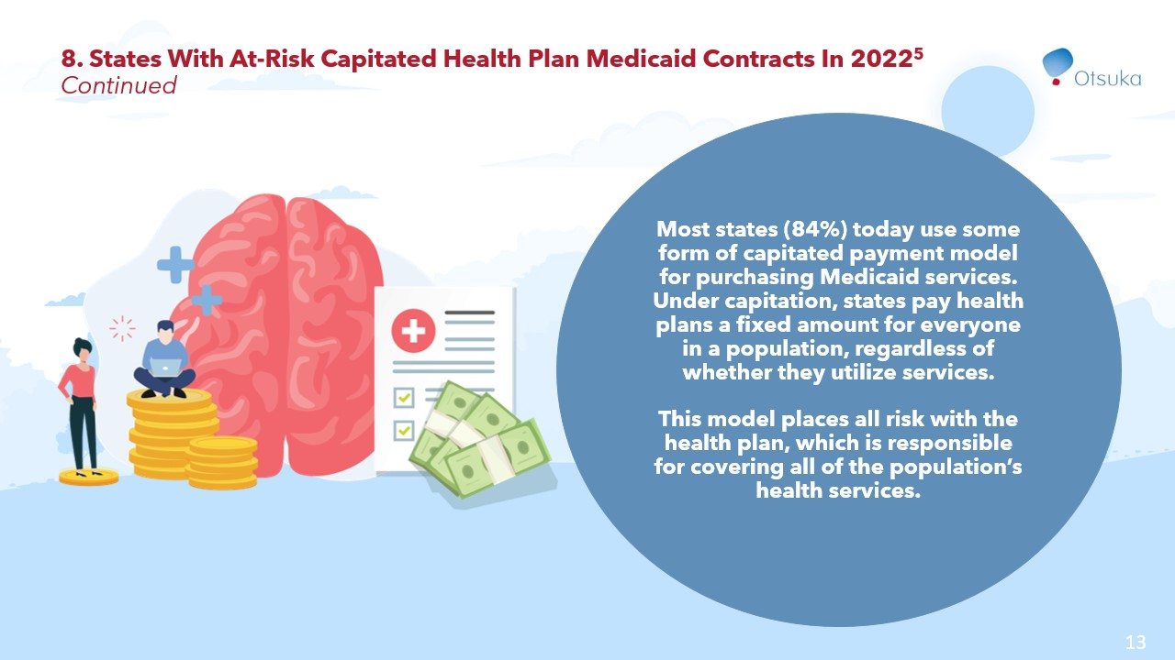

Slide 14
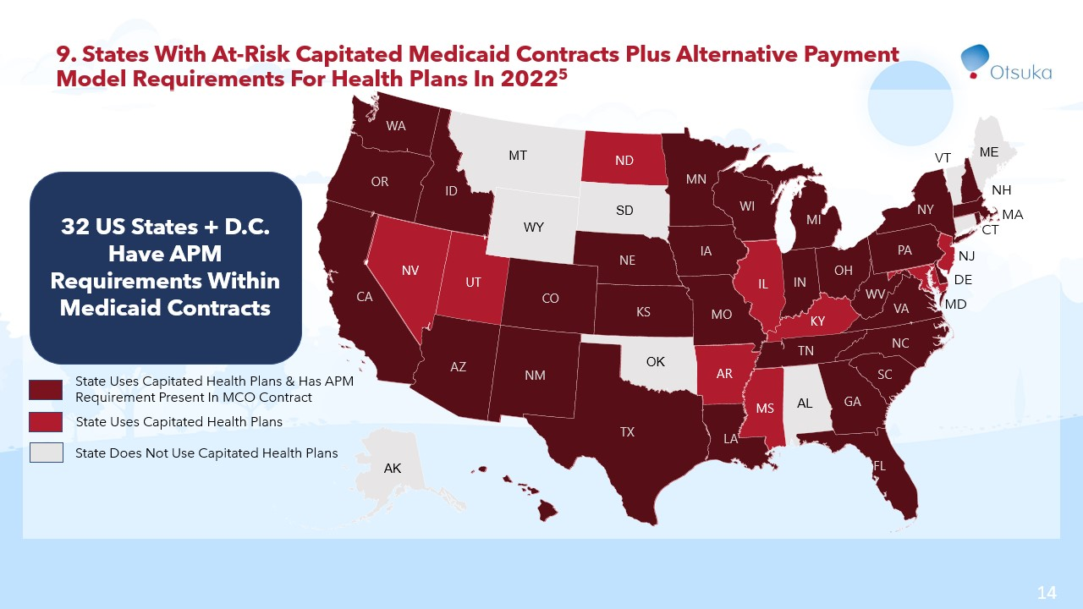

Slide 15
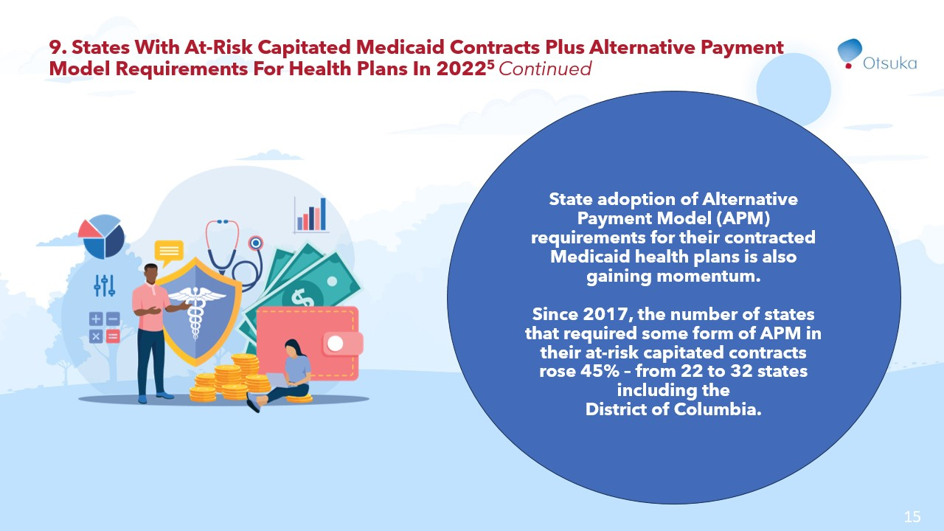

Slide 16
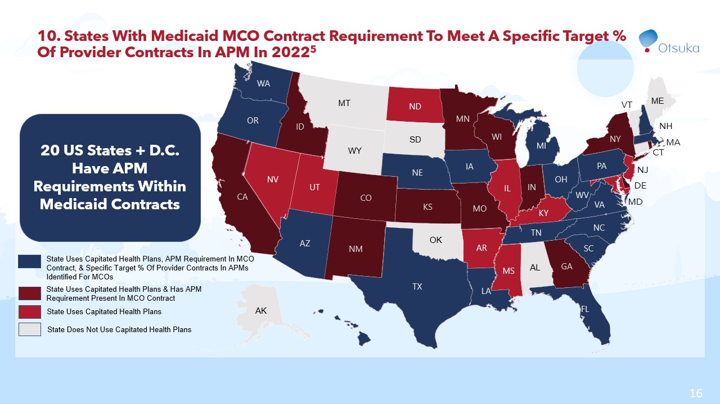

Slide 17
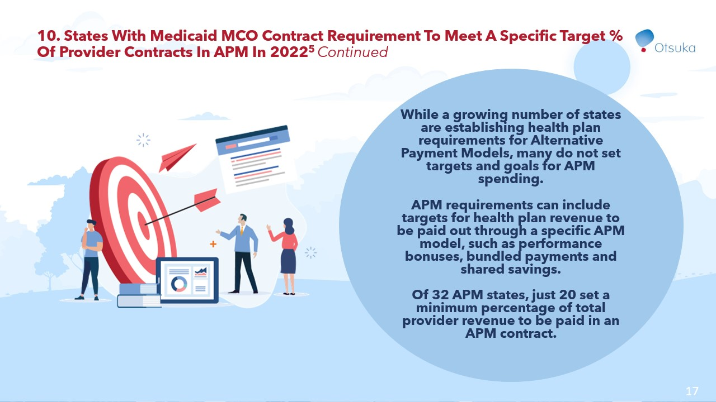

Slide 18
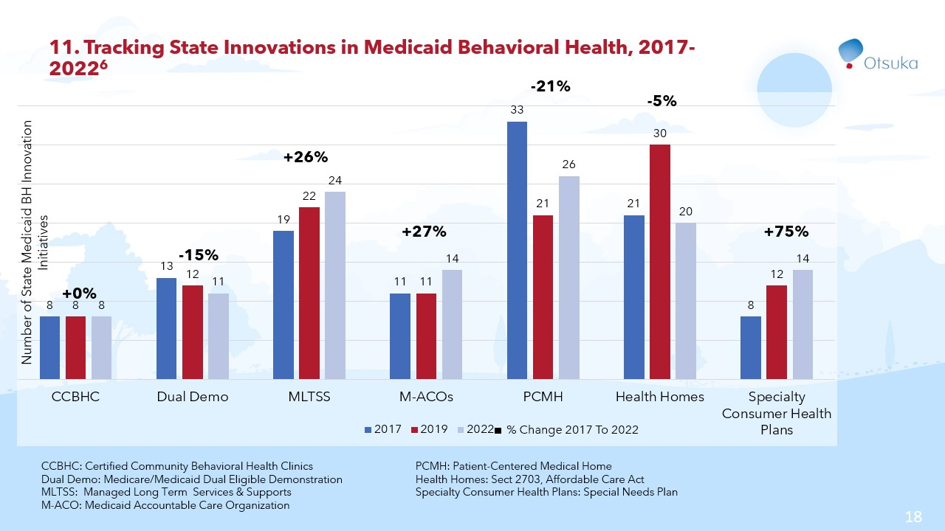

Slide 19
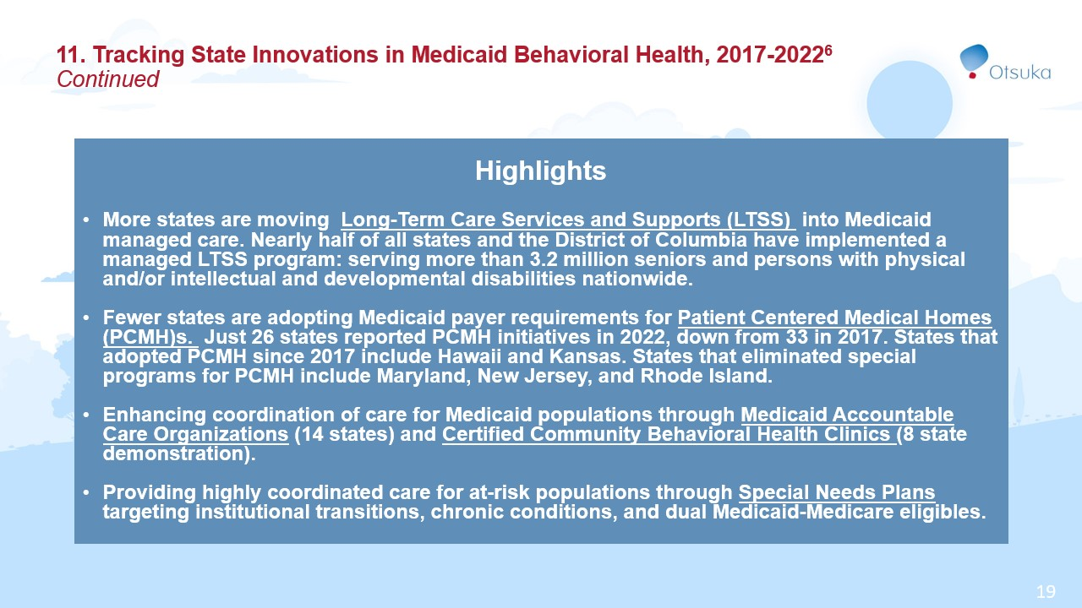

Slide 20
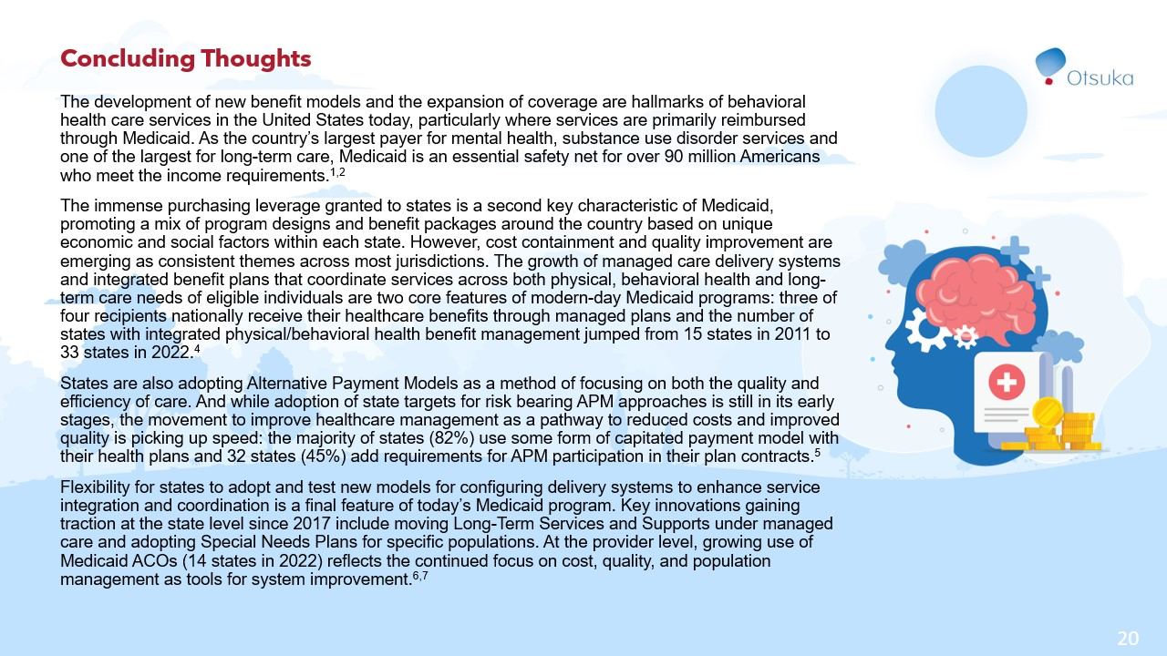

Slide 21
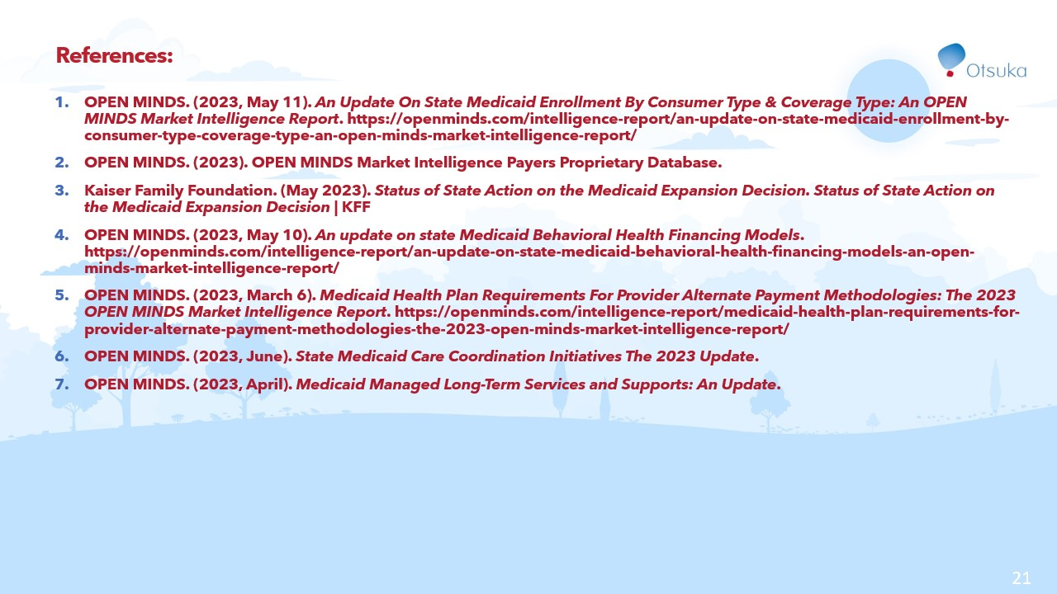

Slide 22
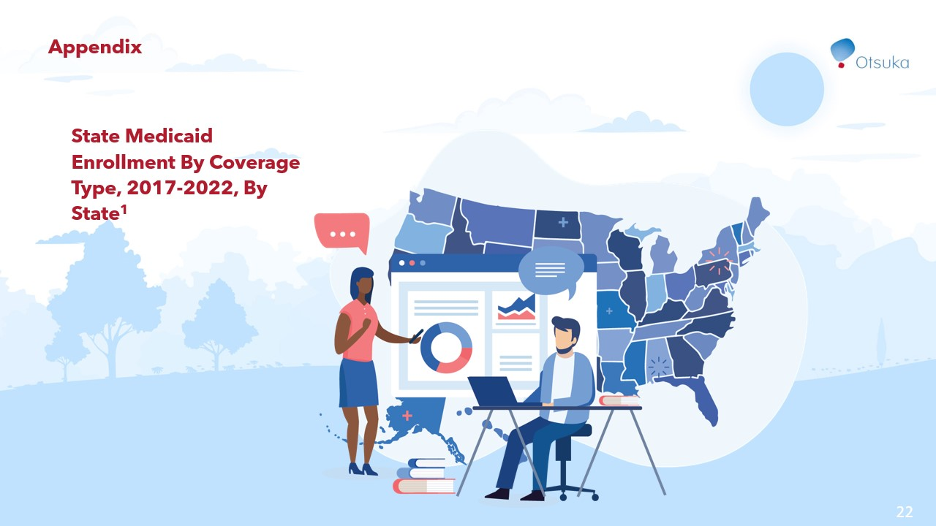

Slide 23
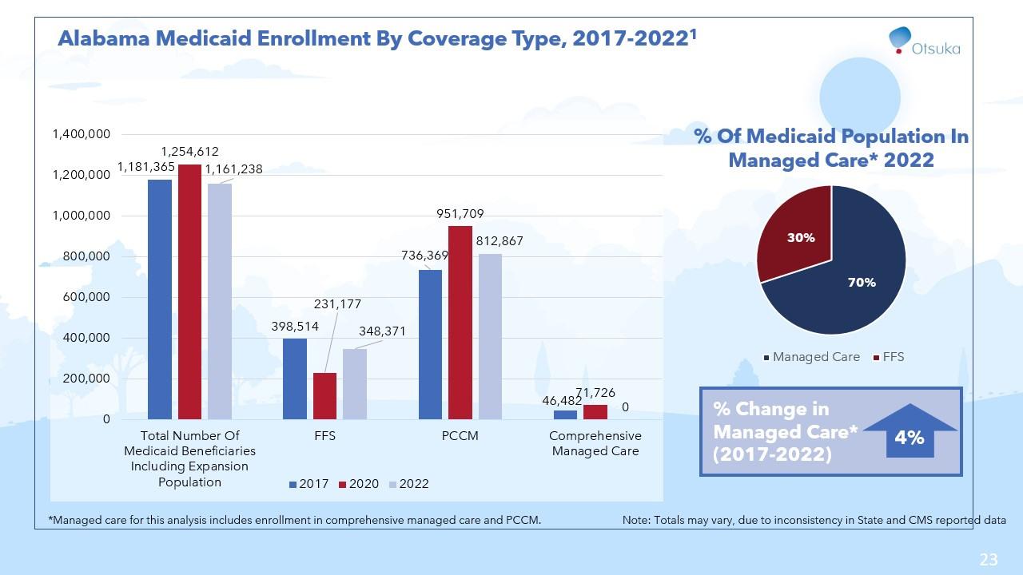

Slide 24
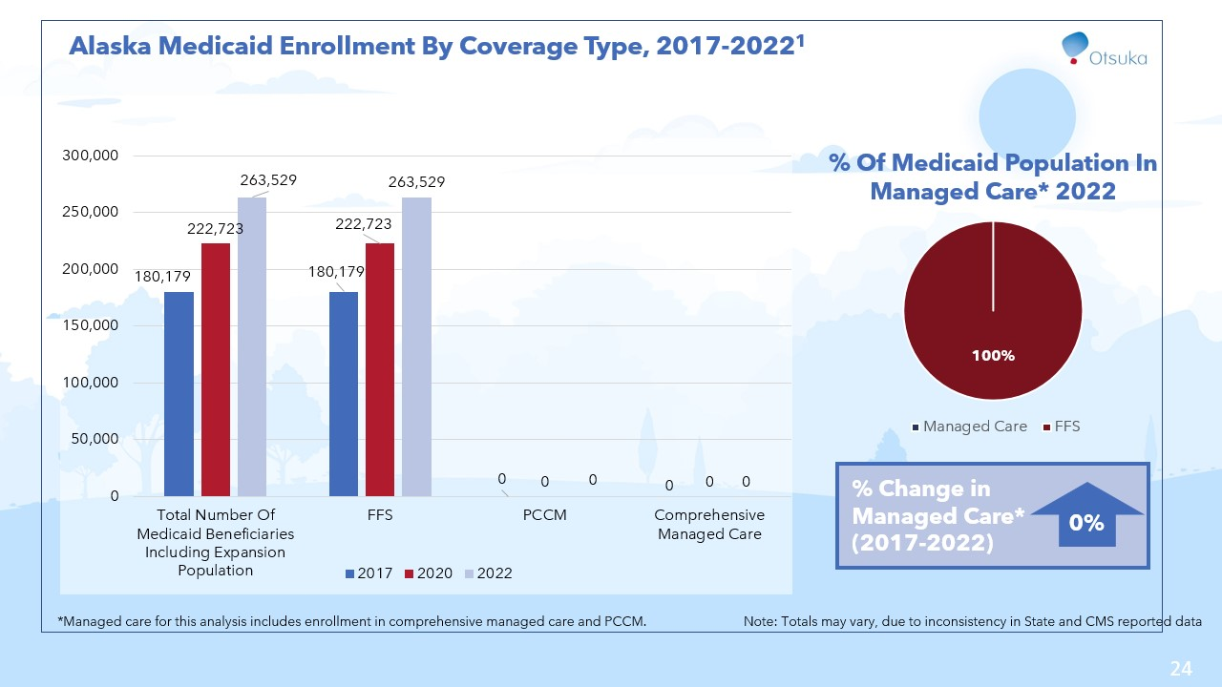

Slide 25
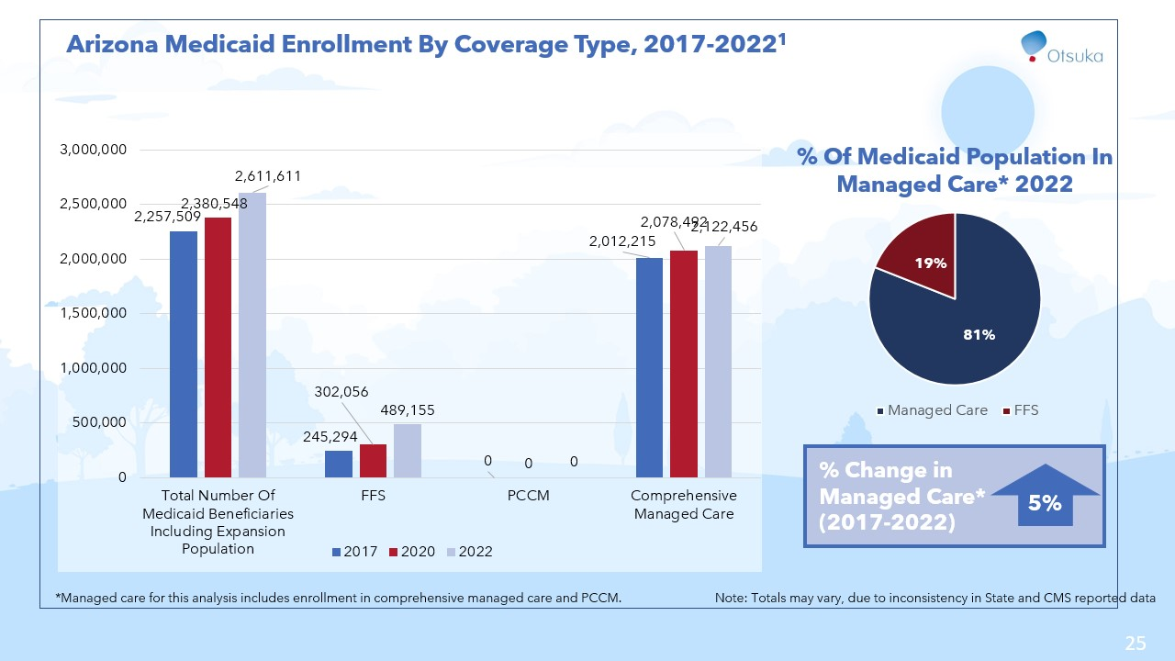

Slide 26
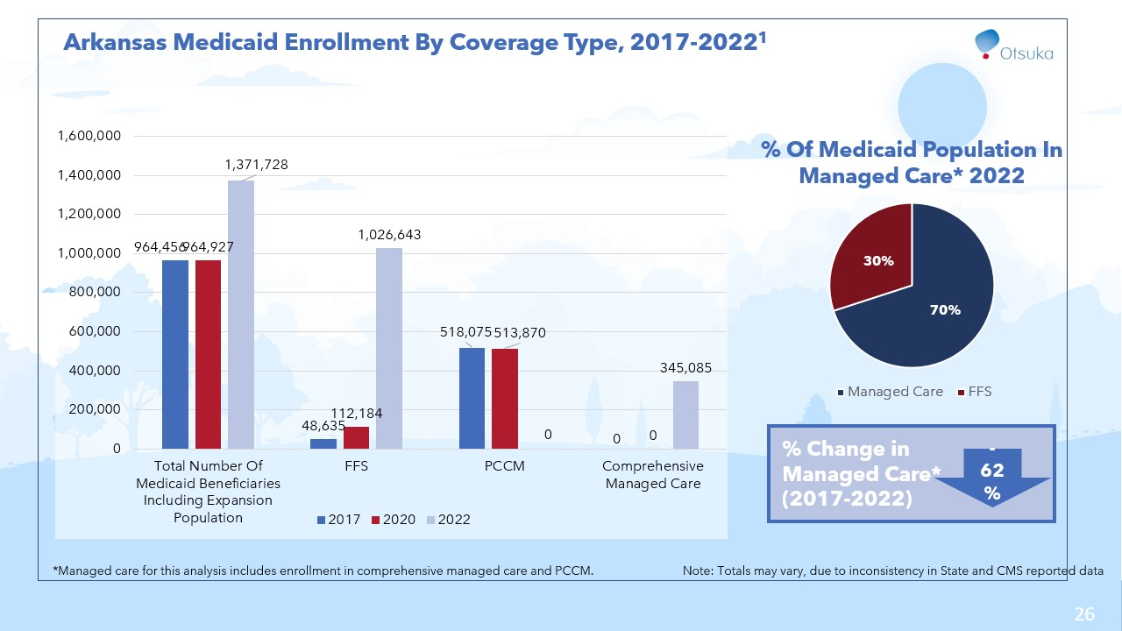

Slide 27
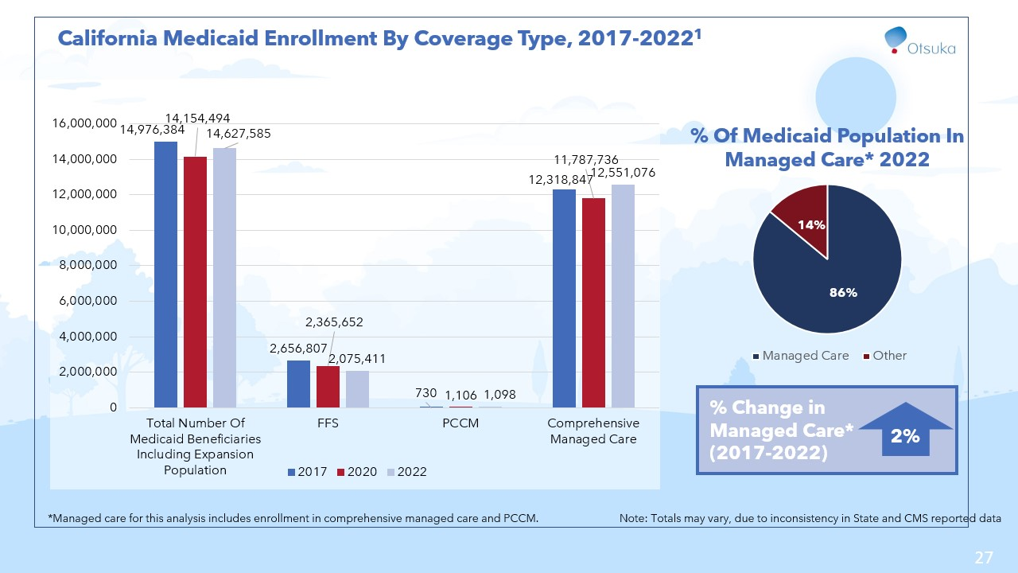

Slide 28
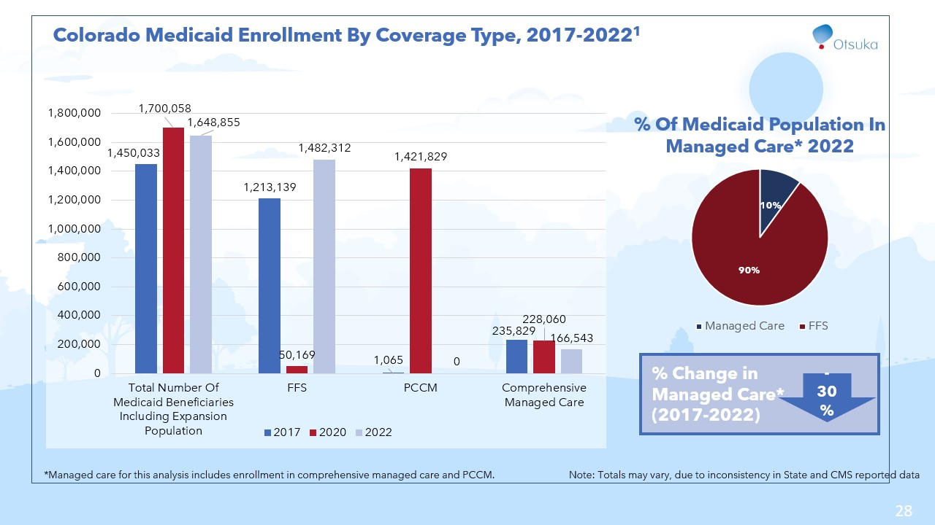

Slide 29
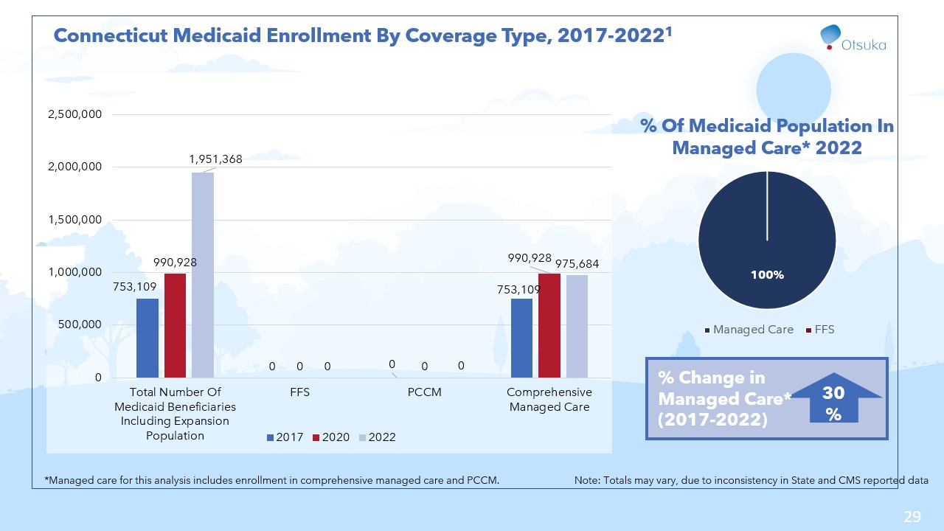

Slide 30
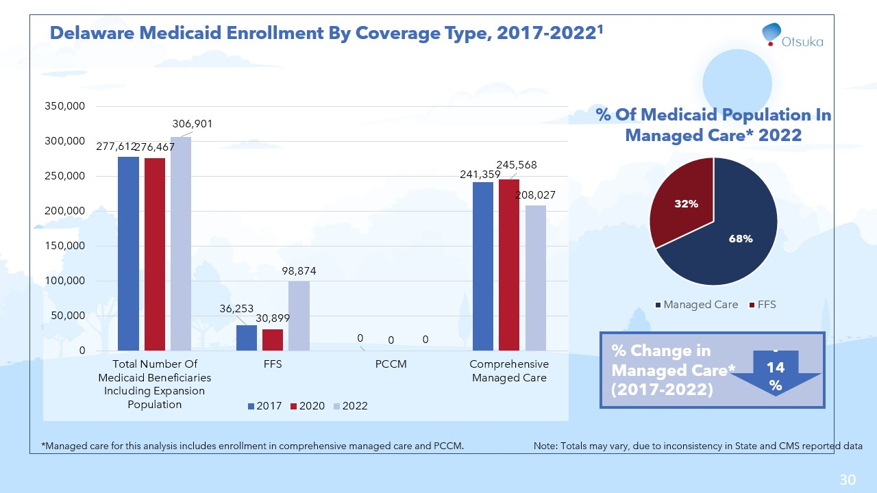

Slide 31
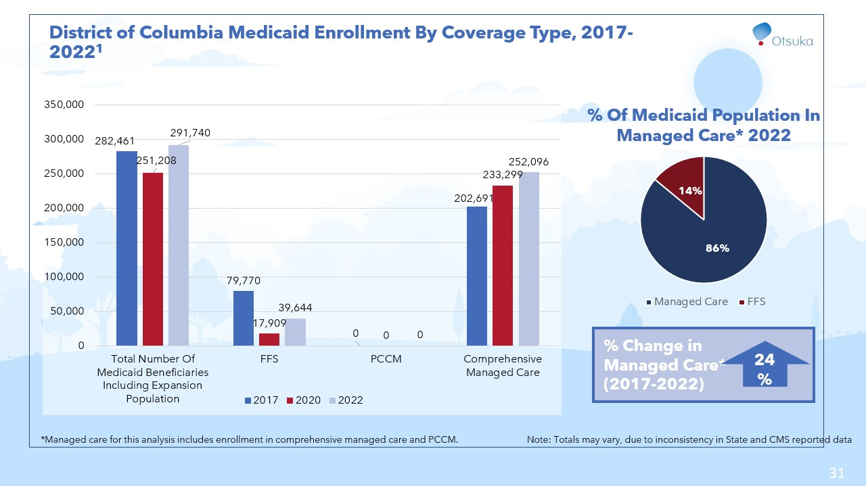

Slide 32
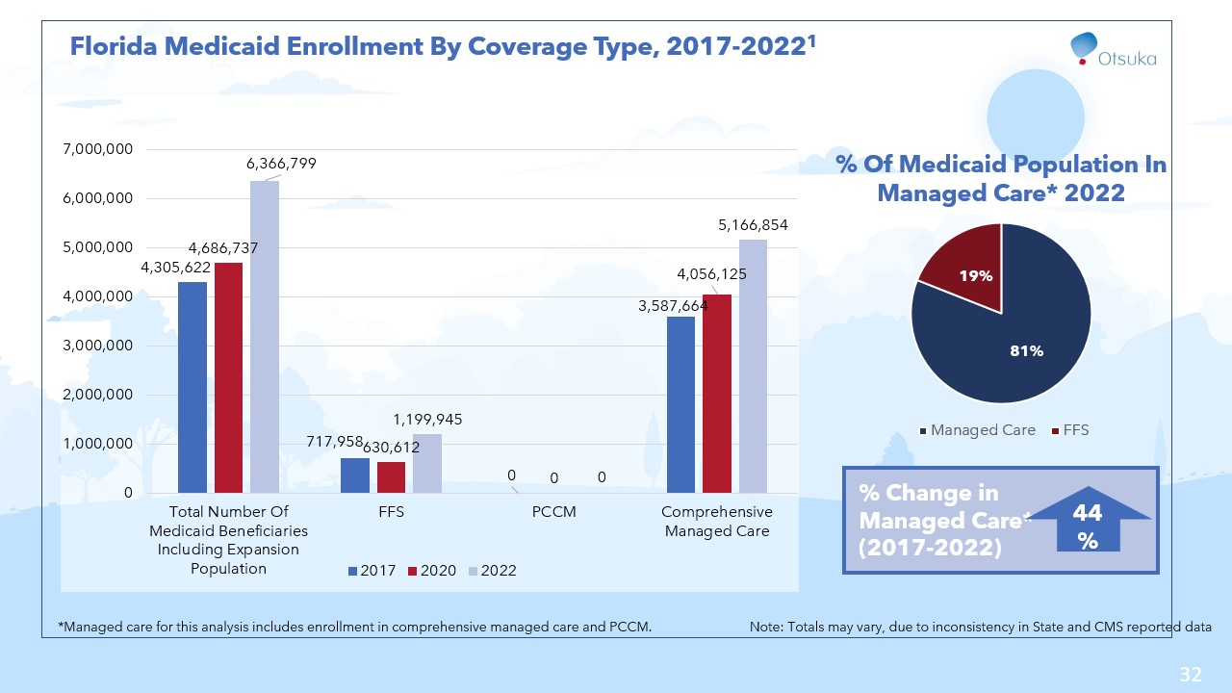

Slide 33
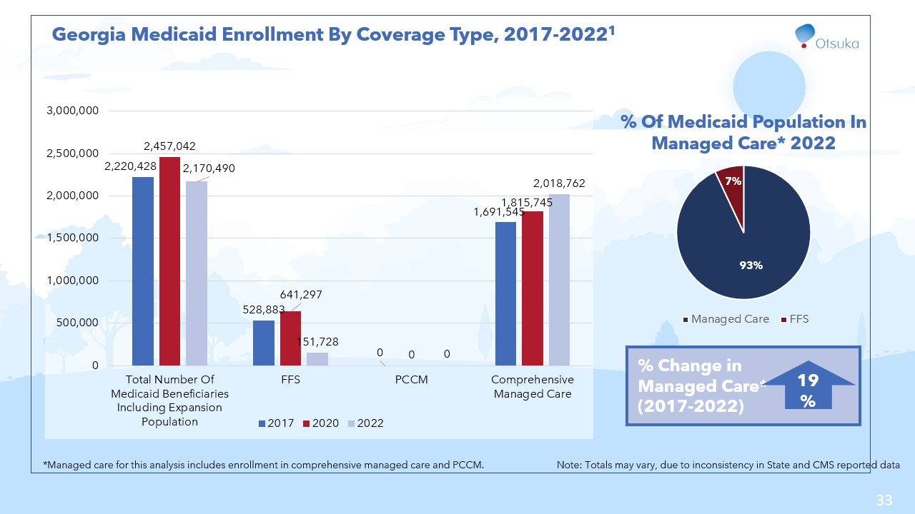

Slide 34
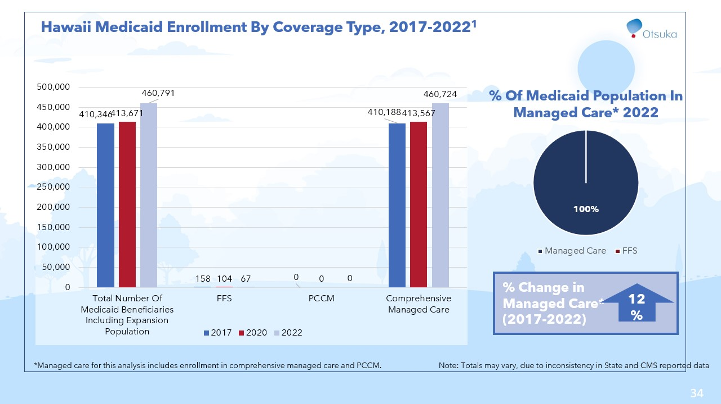

Slide 35
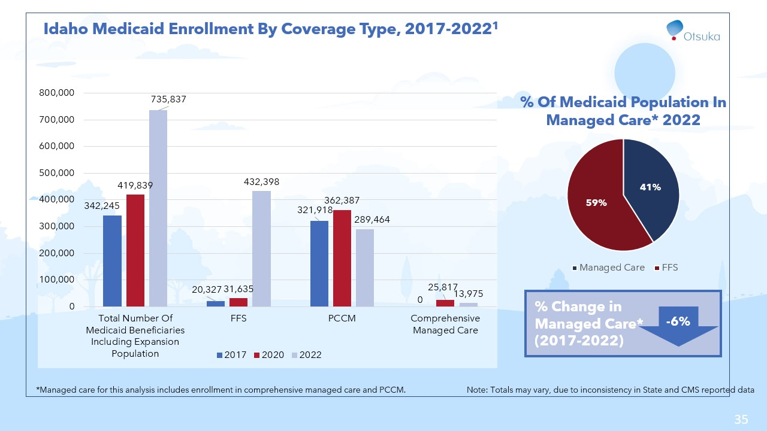

Slide 36
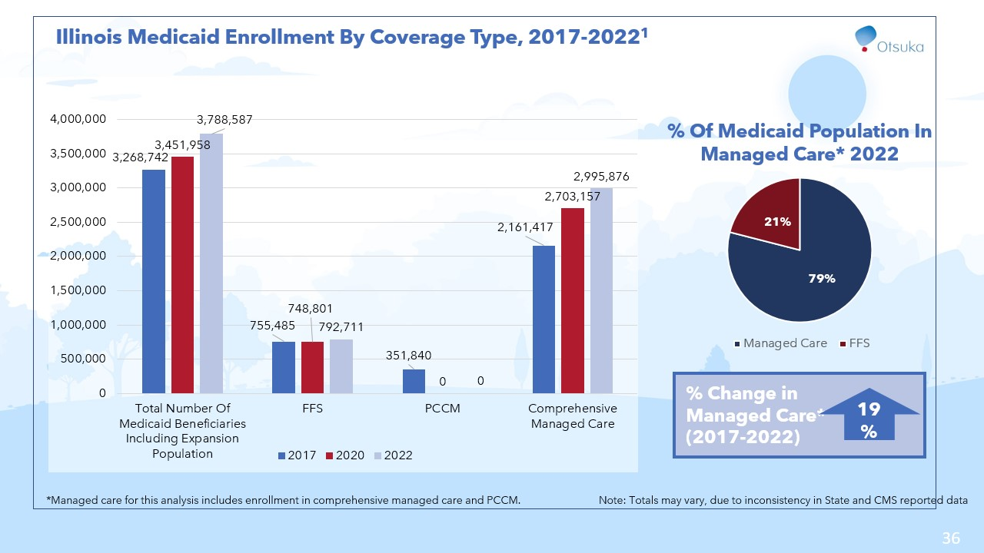

Slide 37
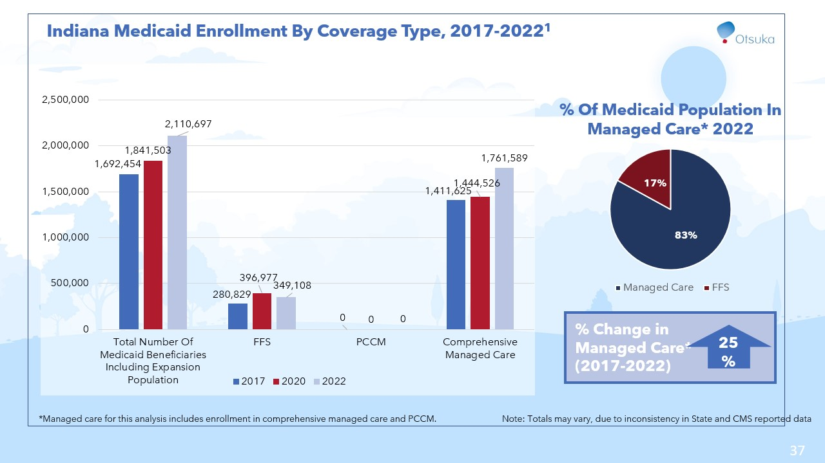

Slide 38


Slide 39
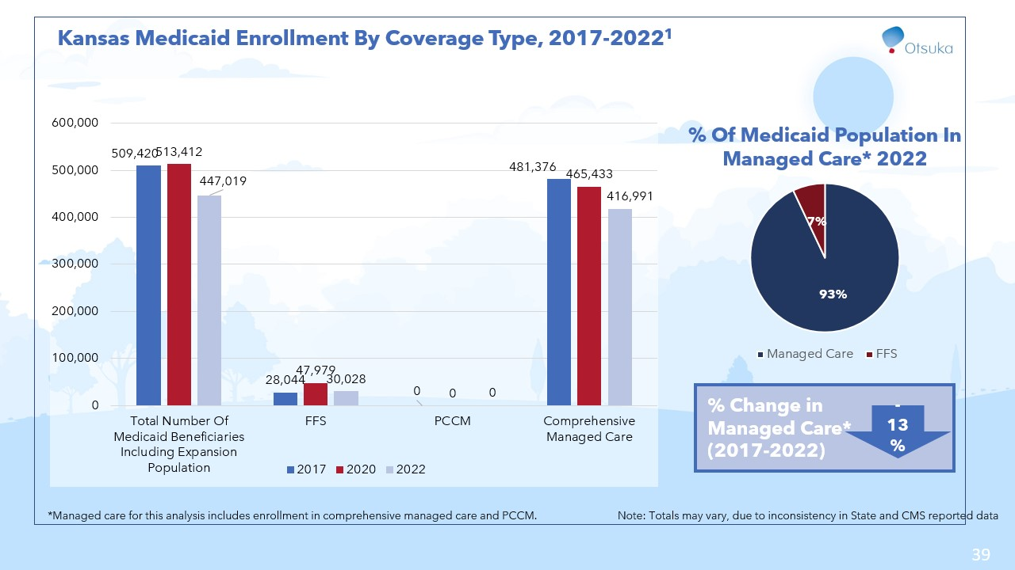

Slide 40


Slide 41
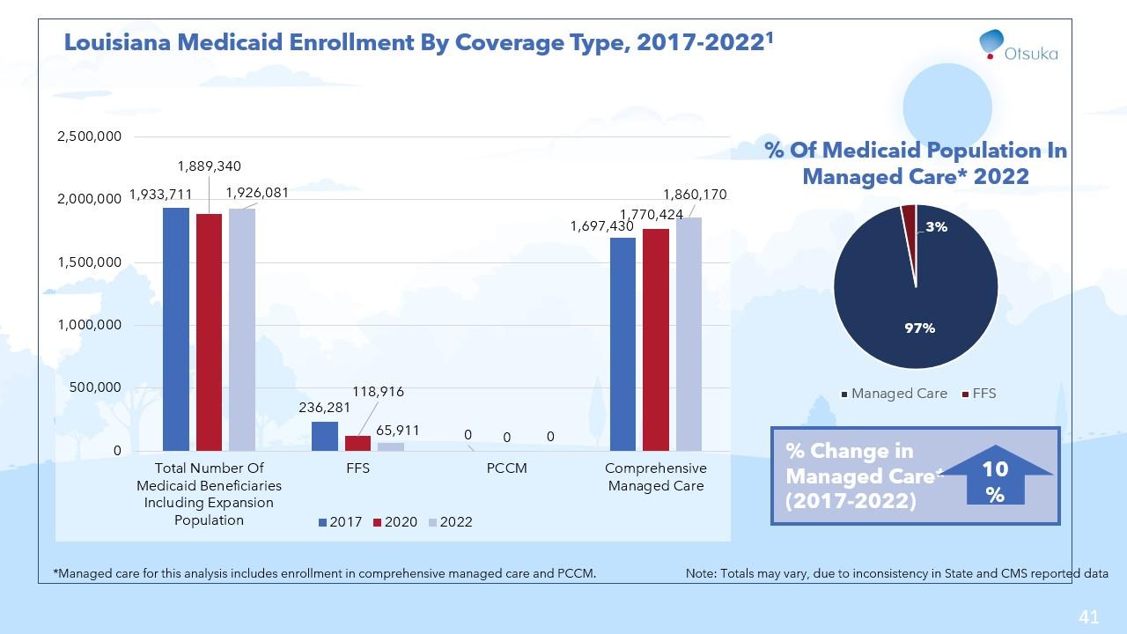

Slide 42
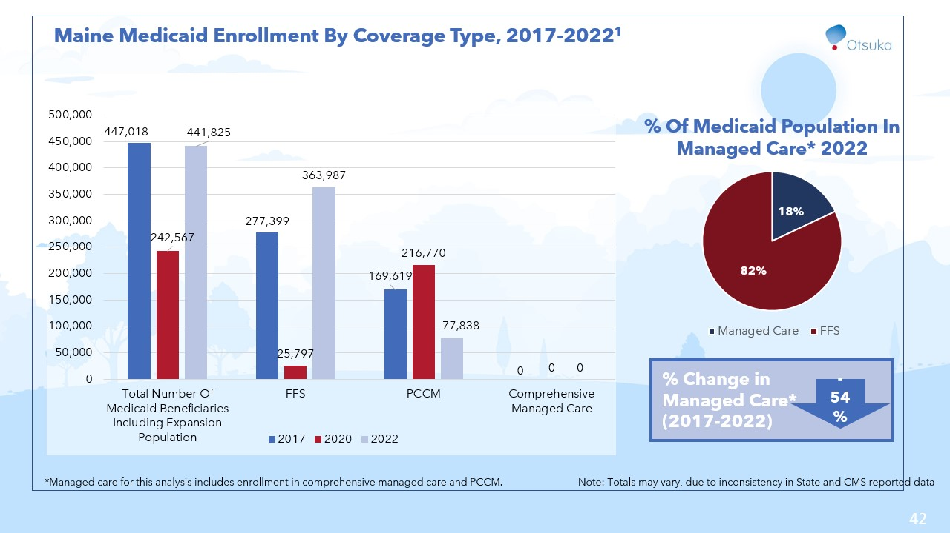

Slide 43
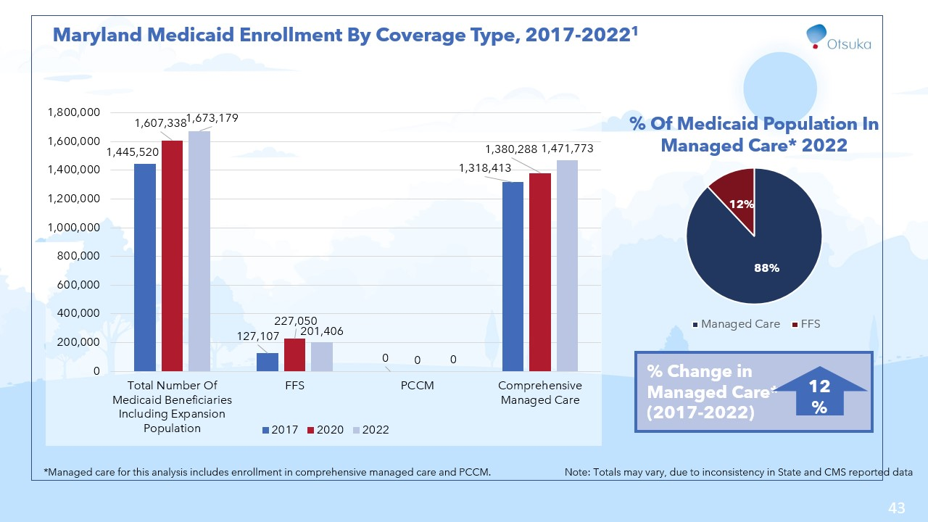

Slide 44
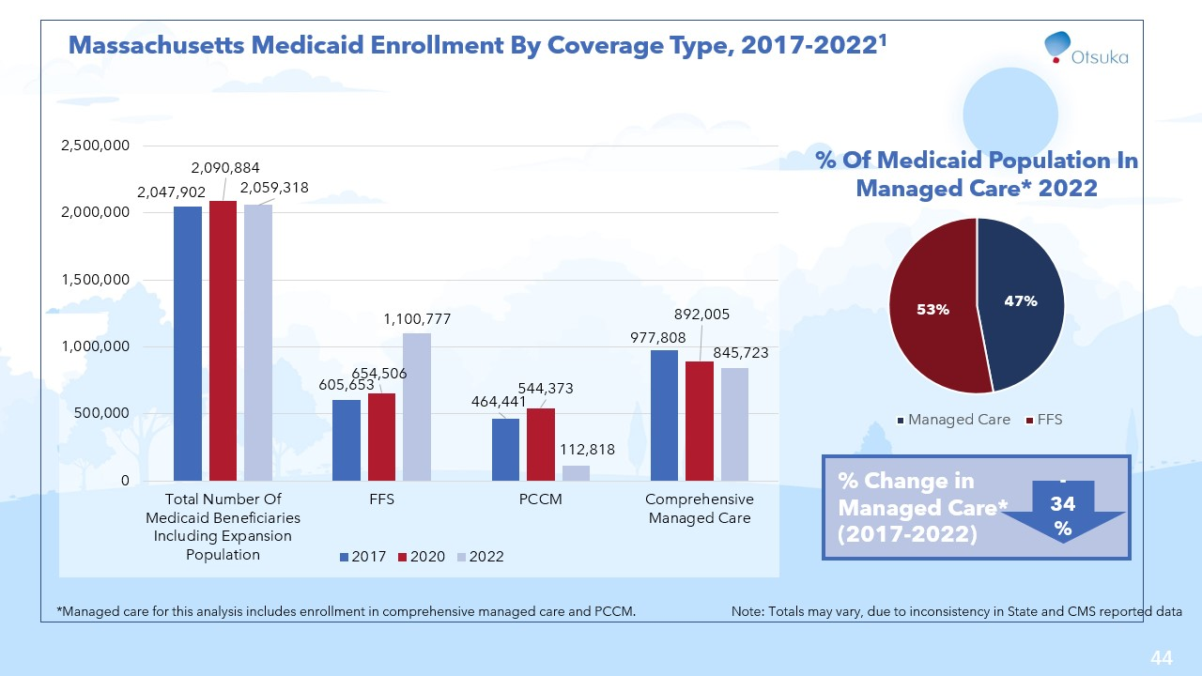

Slide 45
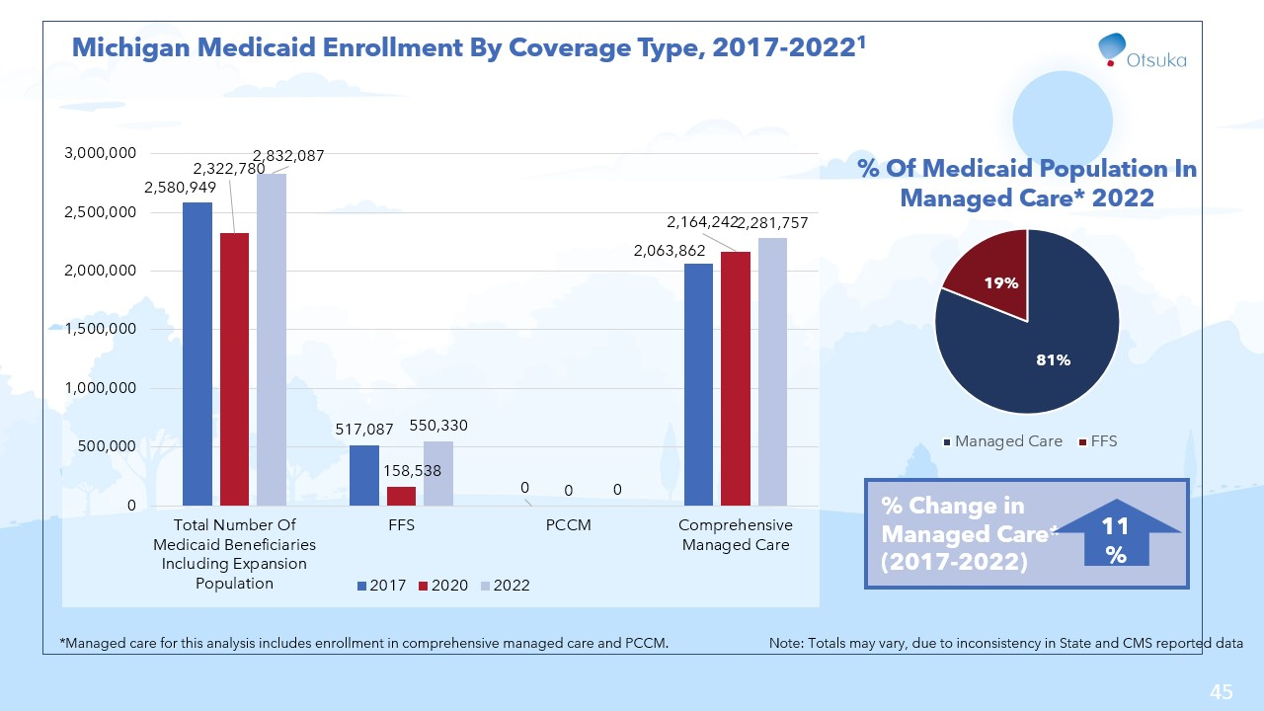

Slide 46
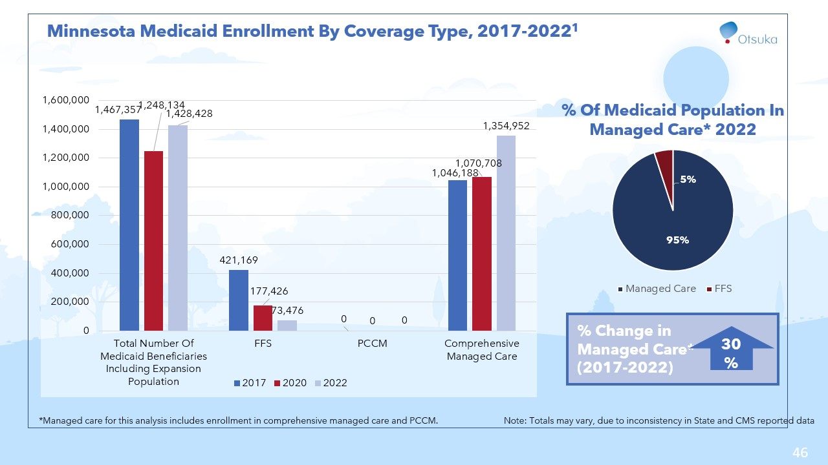

Slide 47
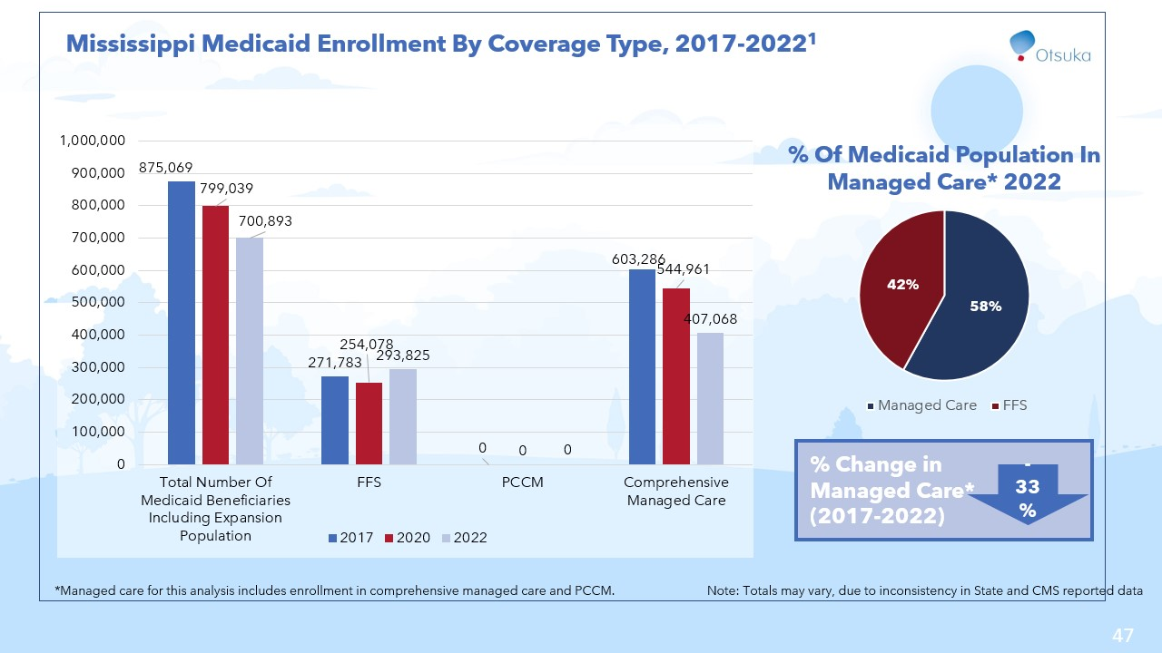

Slide 48
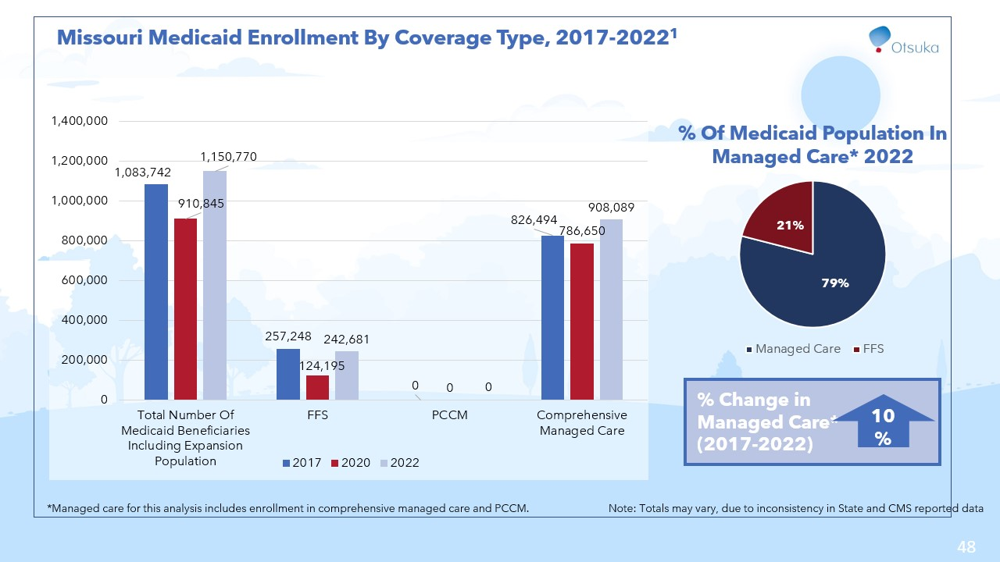

Slide 49
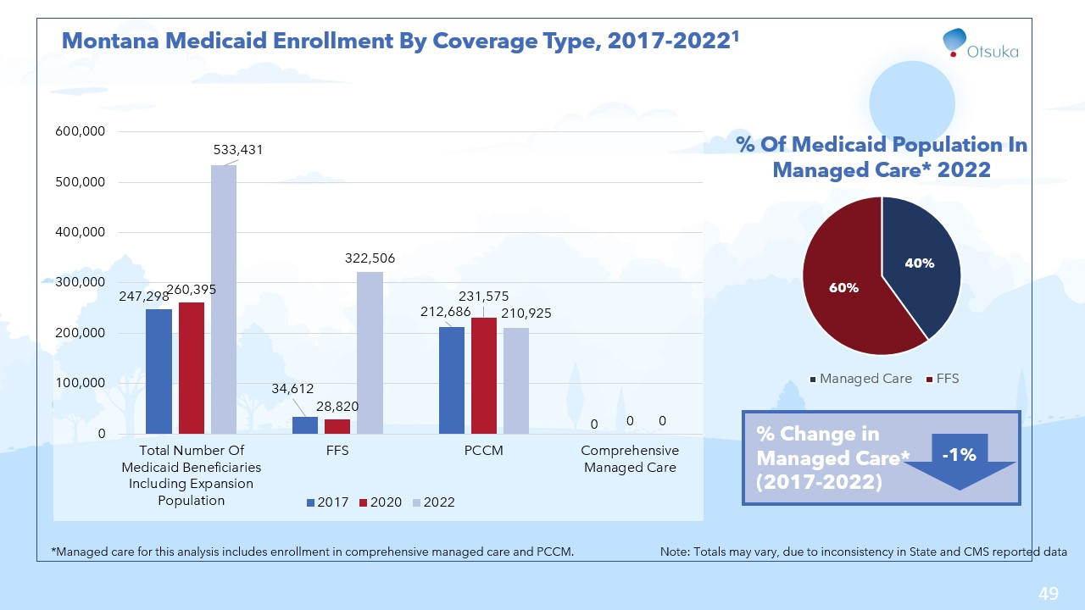

Slide 50
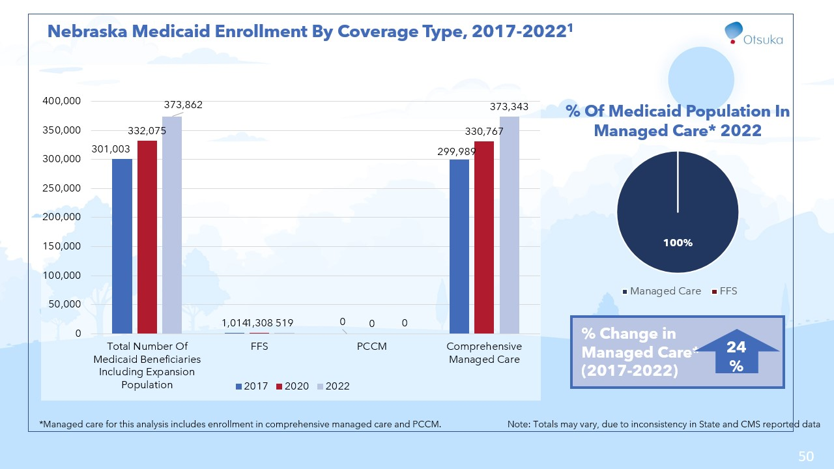

Slide 51
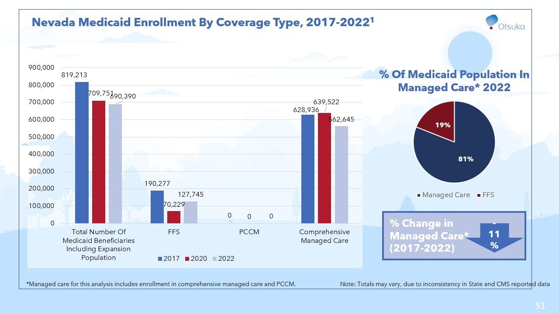

Slide 52
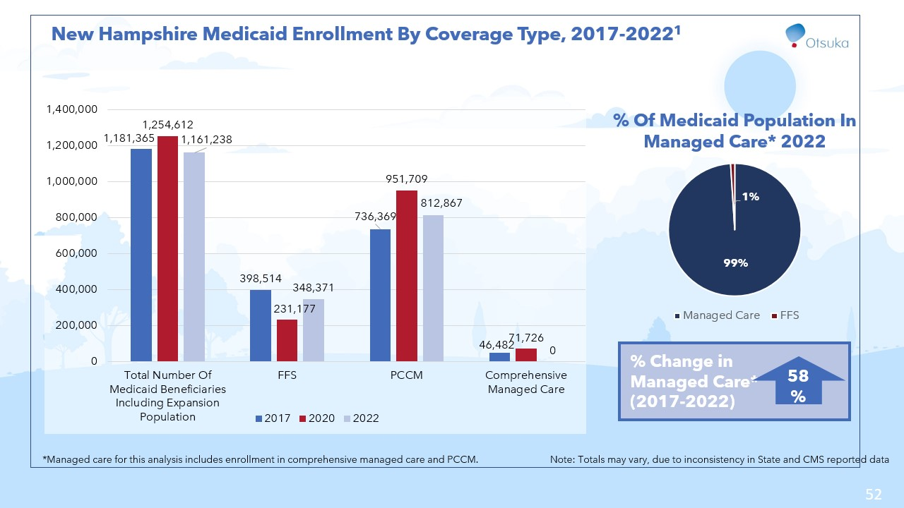

Slide 53


Slide 54
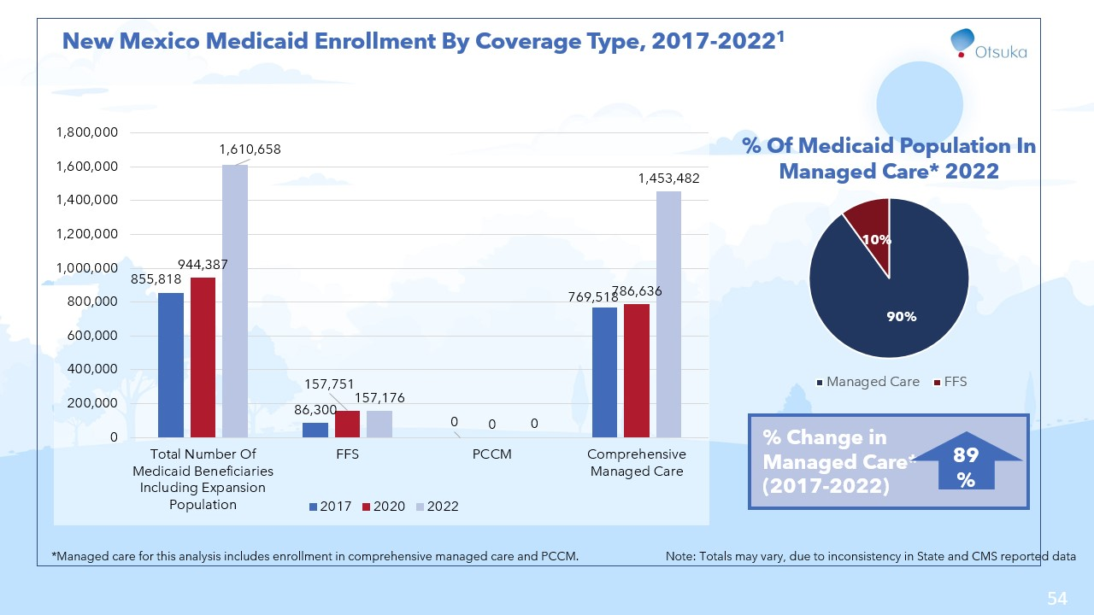

Slide 55
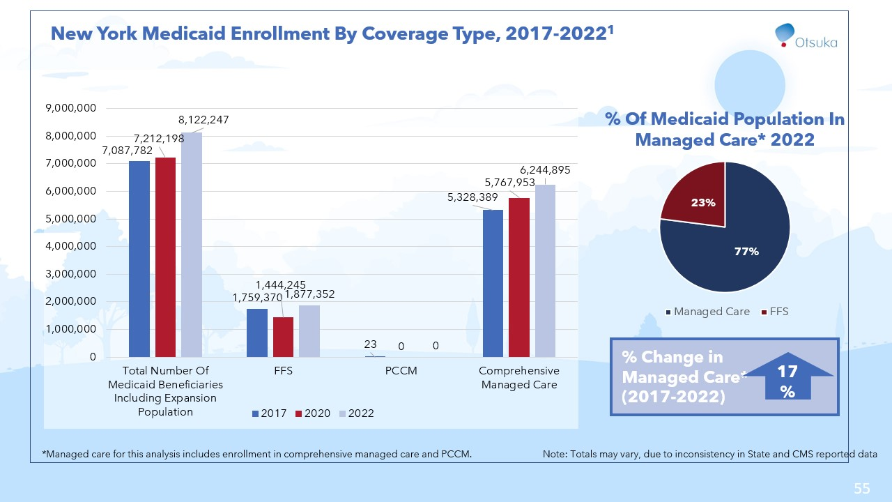

Slide 56


Slide 57


Slide 58


Slide 59


Slide 60


Slide 61


Slide 62


Slide 63


Slide 64


Slide 65


Slide 66


Slide 67


Slide 68


Slide 69


Slide 70


Slide 71


Slide 72


Slide 73


Slide 74


