Slide 1


Slide 2
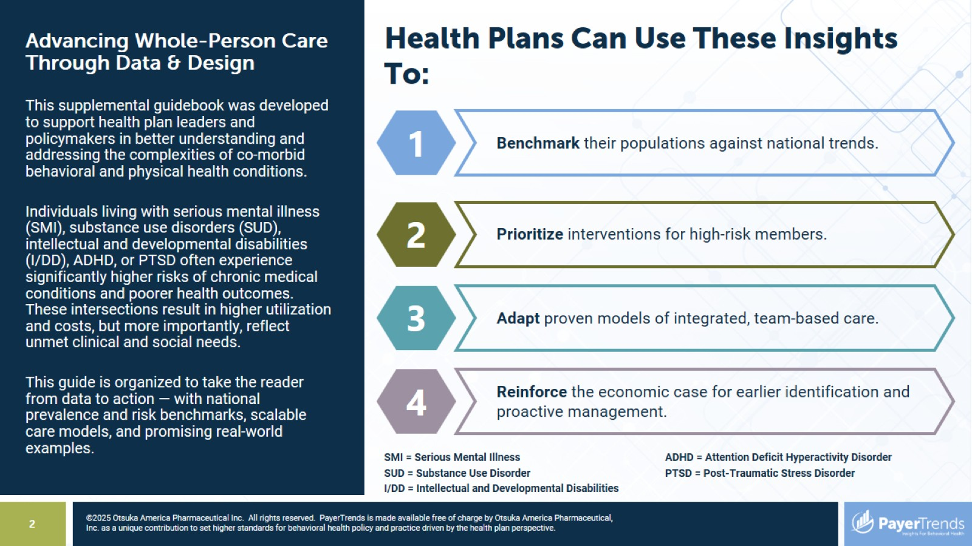
Health Plans Can Use These Insights To:

Slide 3
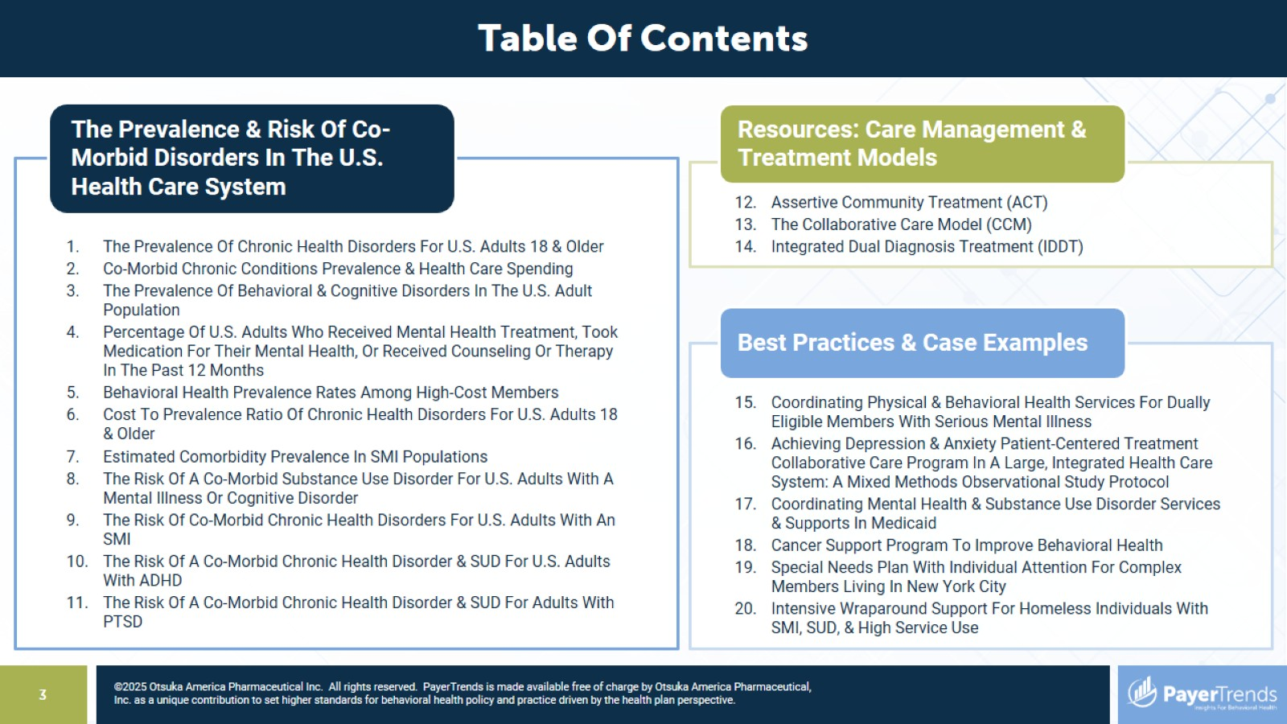

Slide 4


Slide 5
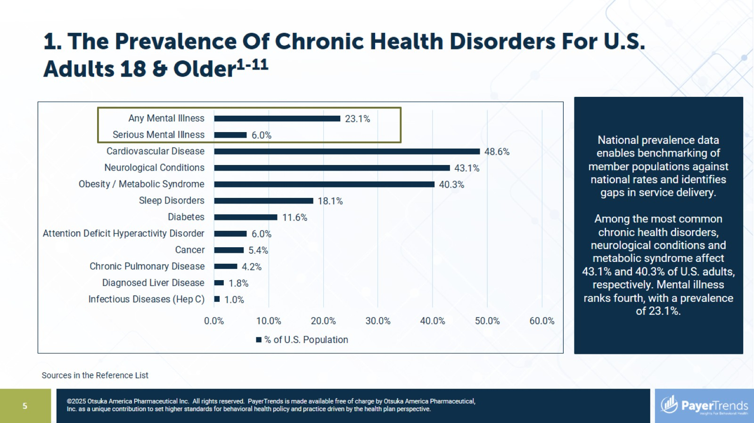
1. The Prevalence Of Chronic Health Disorders For U.S. Adults 18 & Older¹⁻¹¹

Slide 6
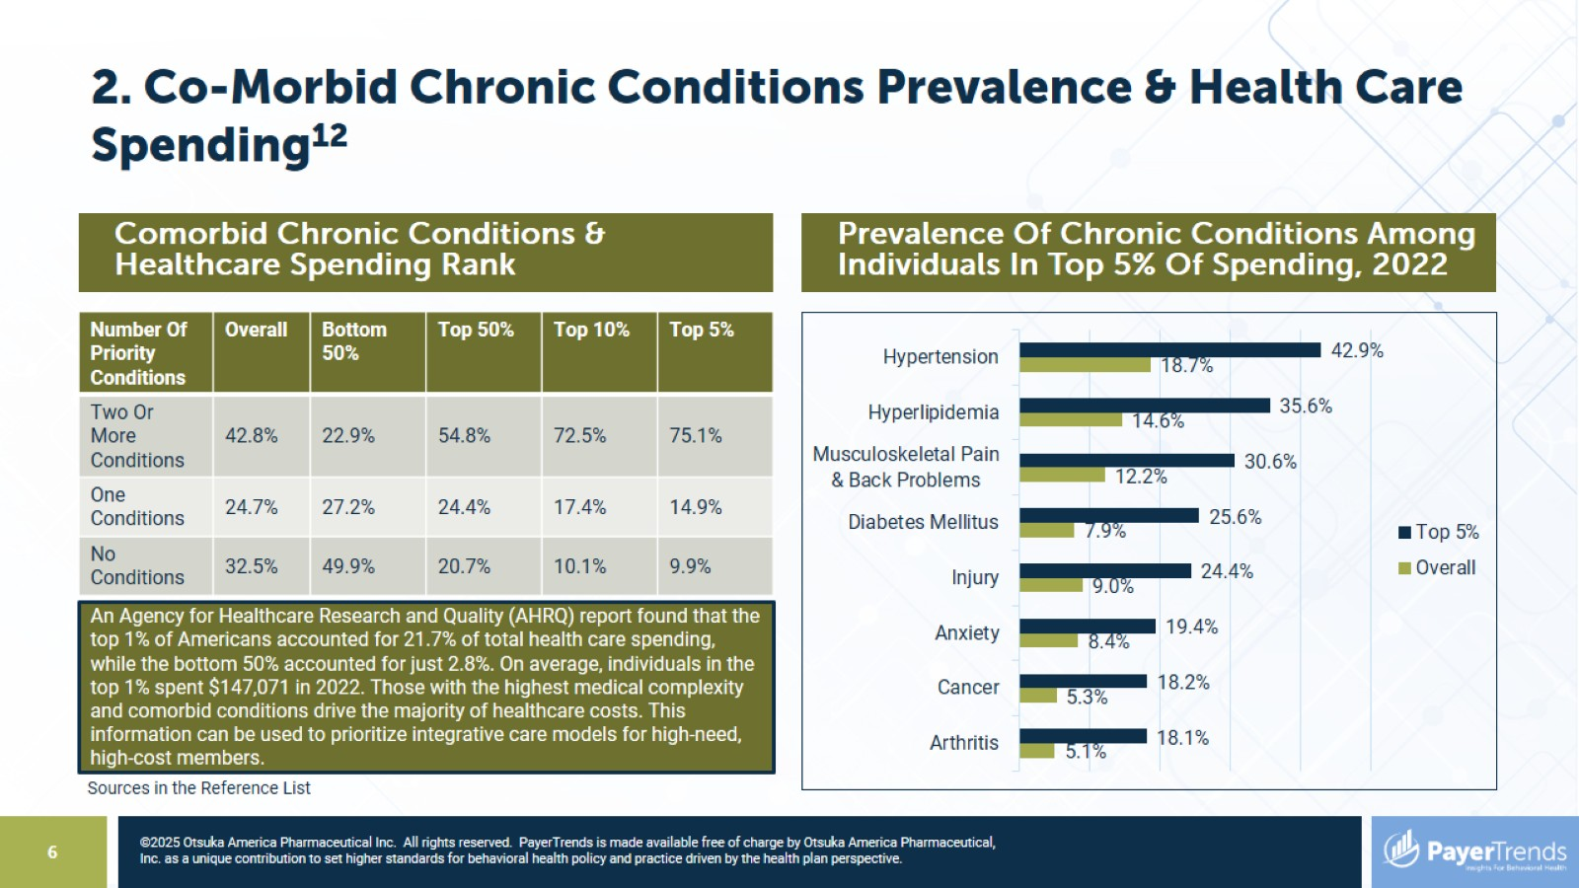
2. Co-Morbid Chronic Conditions Prevalence & Health Care Spending¹²

Slide 7
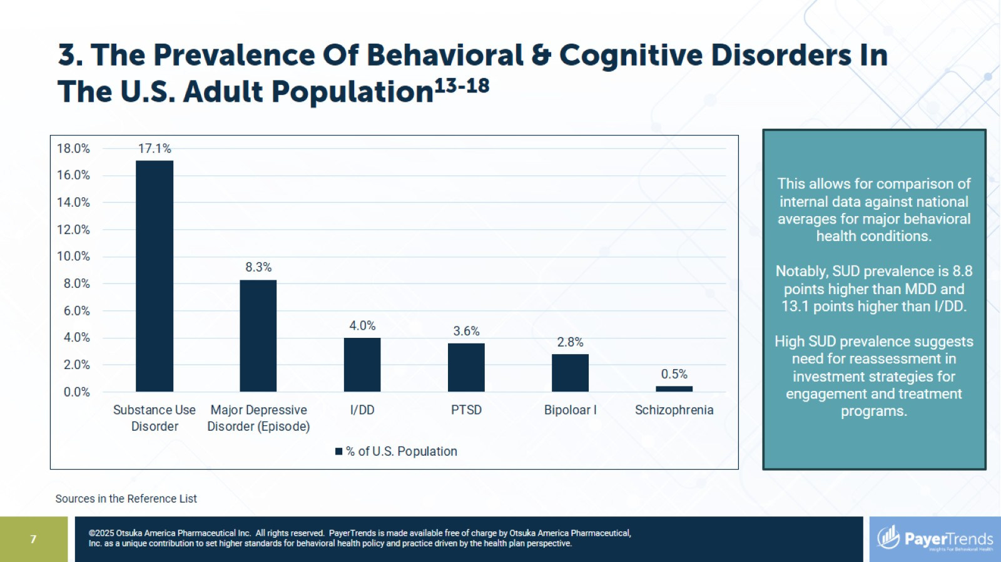
3. The Prevalence Of Behavioral & Cognitive Disorders In The U.S. Adult Population¹³⁻¹⁸

Slide 8
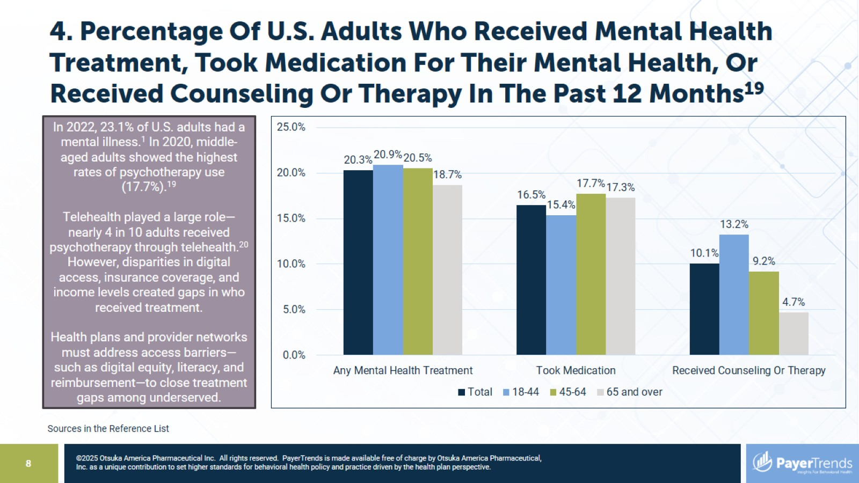
4. Percentage Of U.S. Adults Who Received Mental Health Treatment, Took Medication For Their Mental Health, Or Received Counseling Or Therapy In The Past 12 Months¹⁹

Slide 9
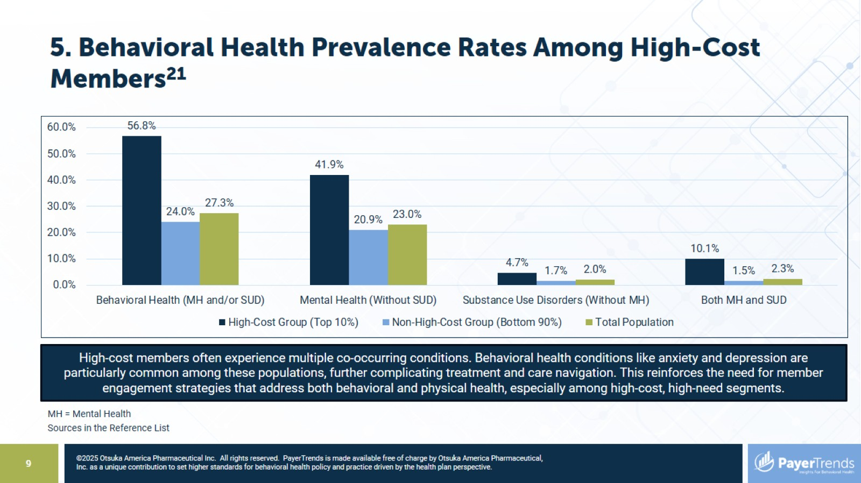
5. Behavioral Health Prevalence Rates Among High-Cost Members²¹

Slide 10
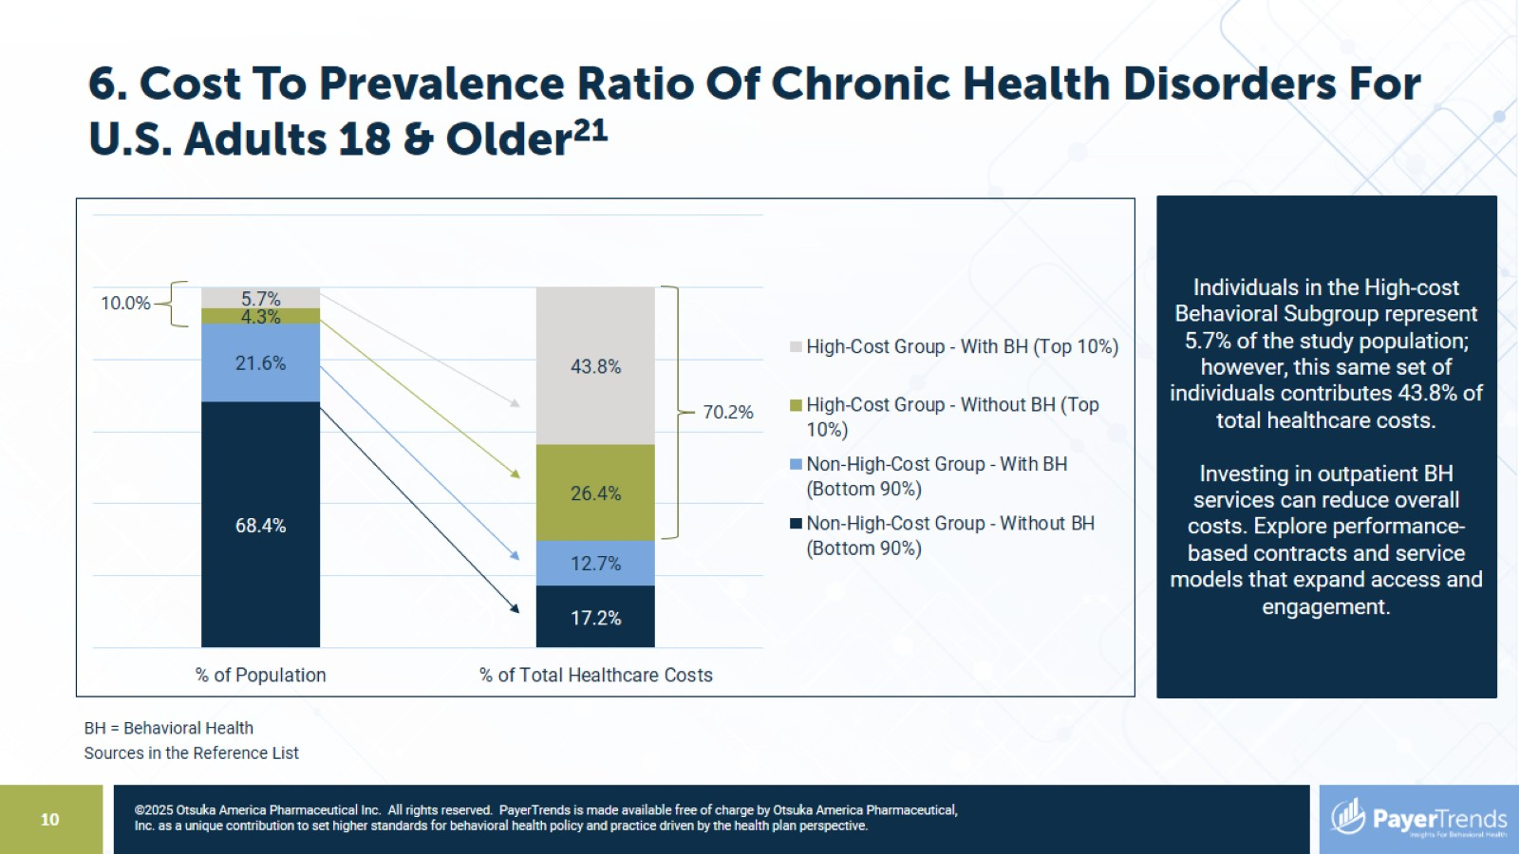
6. Cost To Prevalence Ratio Of Chronic Health Disorders For U.S. Adults 18 & Older²¹

Slide 11
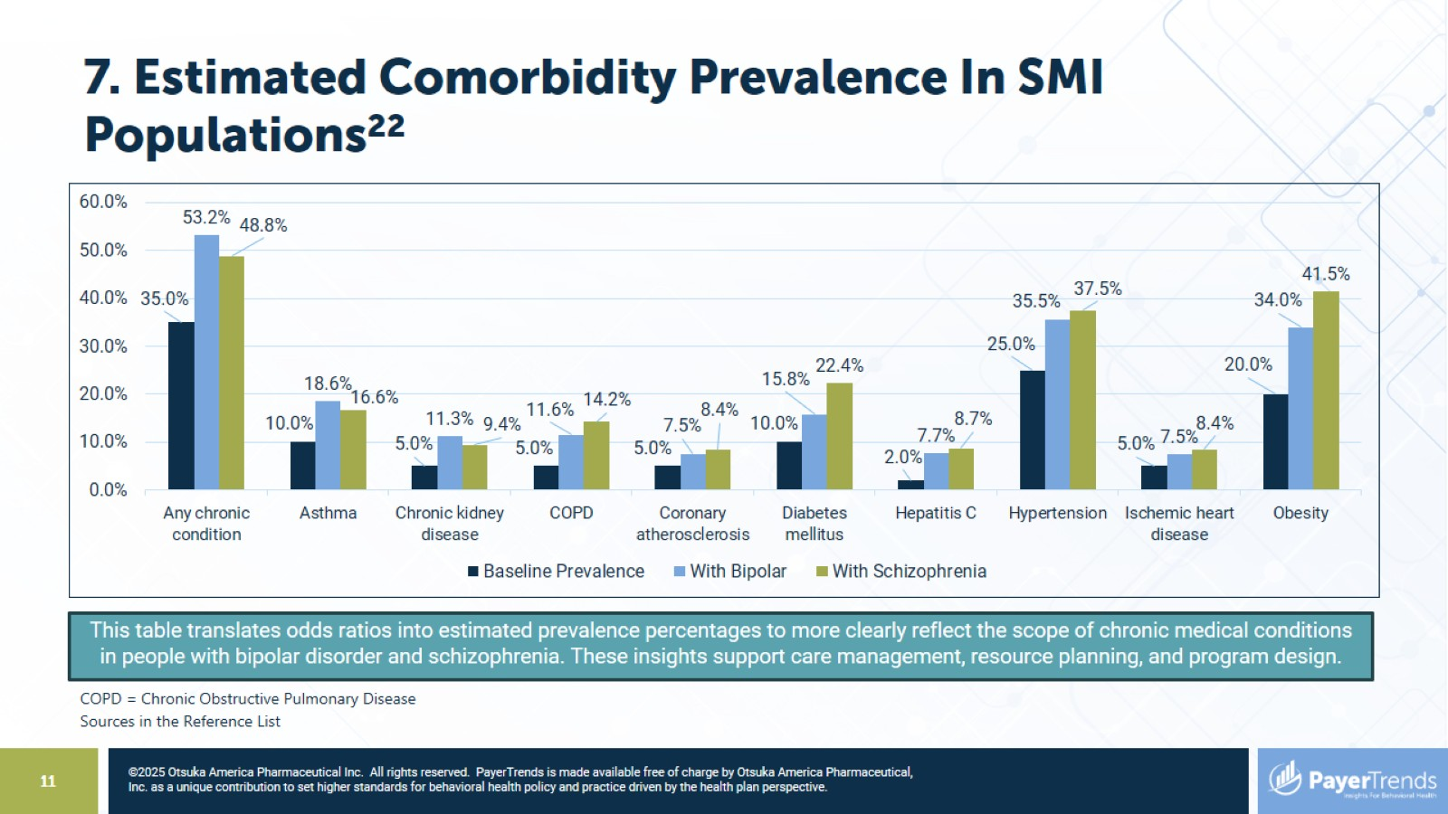
7. Estimated Comorbidity Prevalence In SMI Populations²²

Slide 12
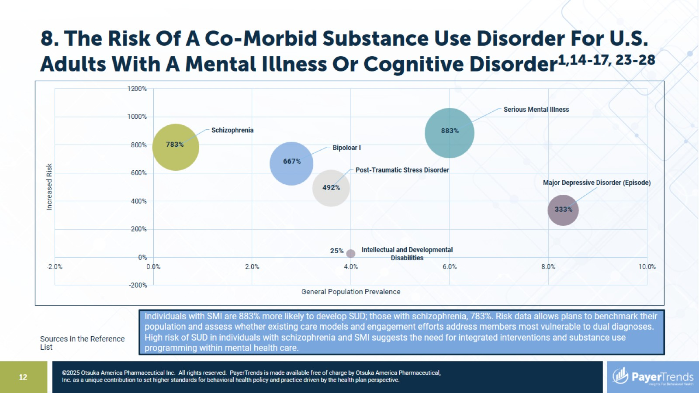
8. The Risk Of A Co-Morbid Substance Use Disorder For U.S. Adults With A Mental Illness Or Cognitive Disorder^{1,14-17, 23-28}

Slide 13
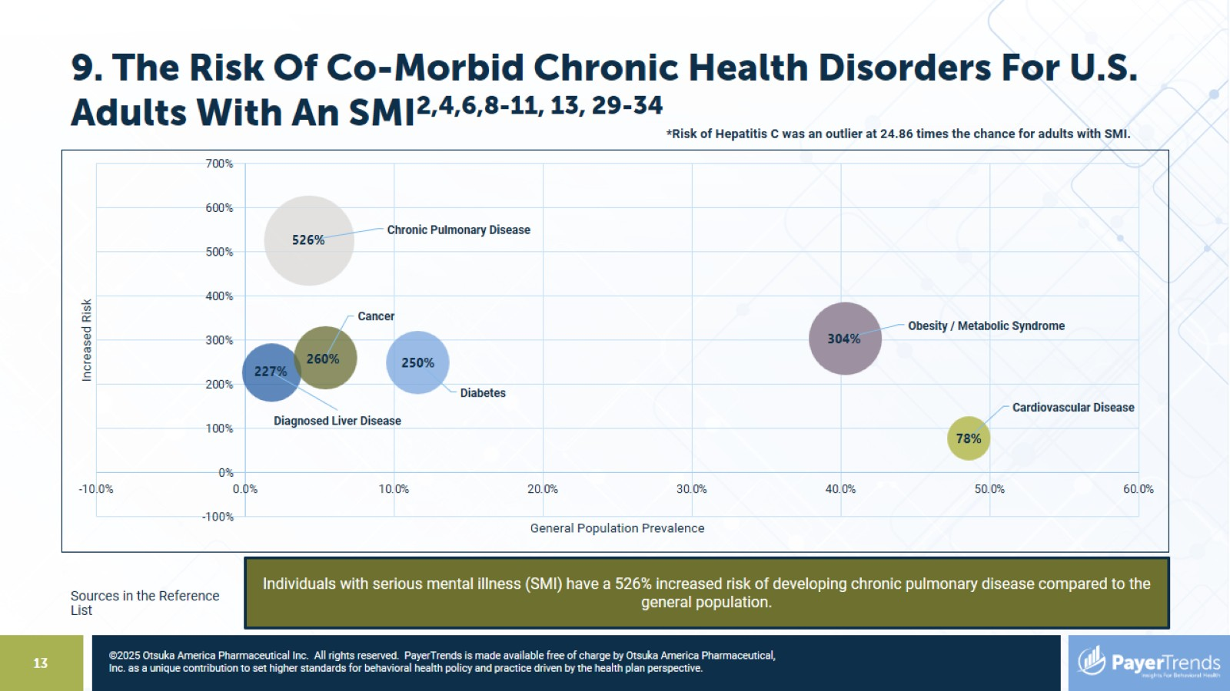
9. The Risk Of Co-Morbid Chronic Health Disorders For U.S. Adults With An SMI^{2,4,6,8-11, 13, 29-34}

Slide 14
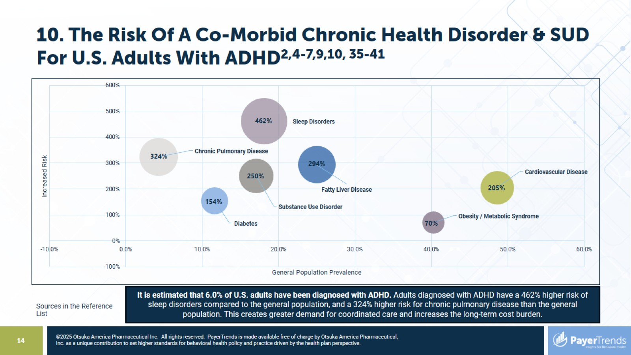
10. The Risk Of A Co-Morbid Chronic Health Disorder & SUD For U.S. Adults With ADHD^{2,4-7,9,10, 35-41}

Slide 15
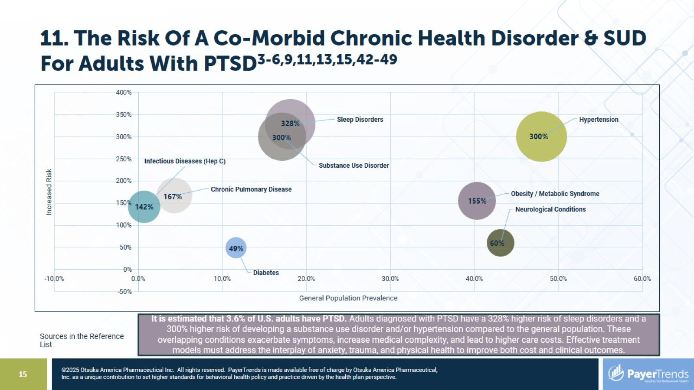
11. The Risk Of A Co-Morbid Chronic Health Disorder & SUD For Adults With PTSD^{3-6,9,11,13,15,42-49}

Slide 16


Slide 17
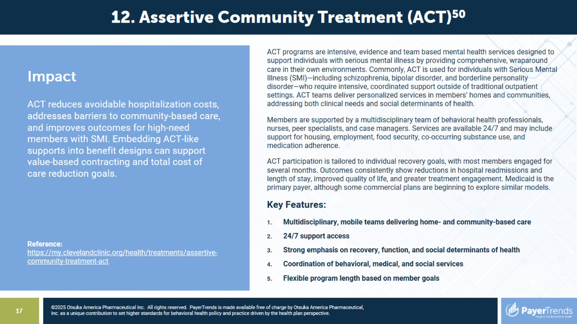

Slide 18
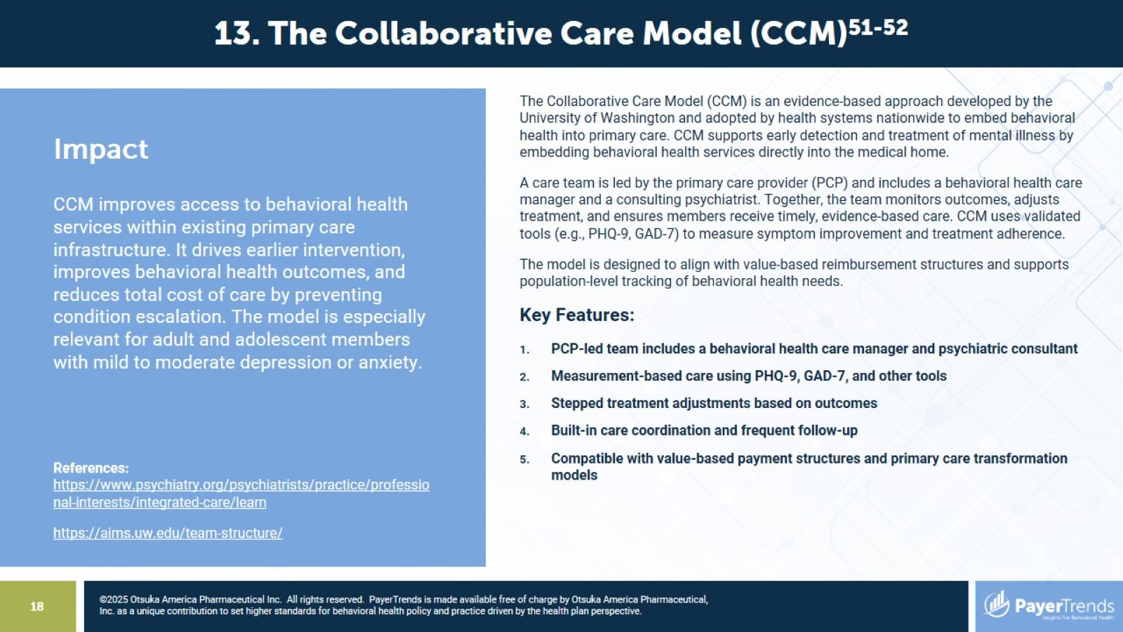

Slide 19
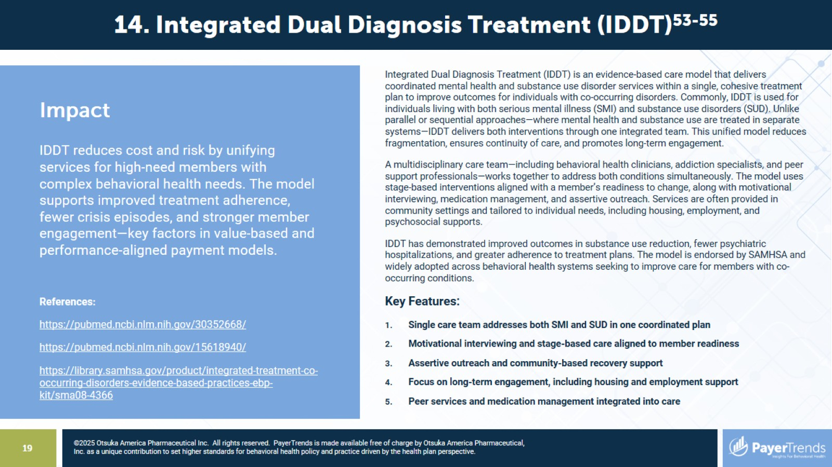

Slide 20


Slide 21
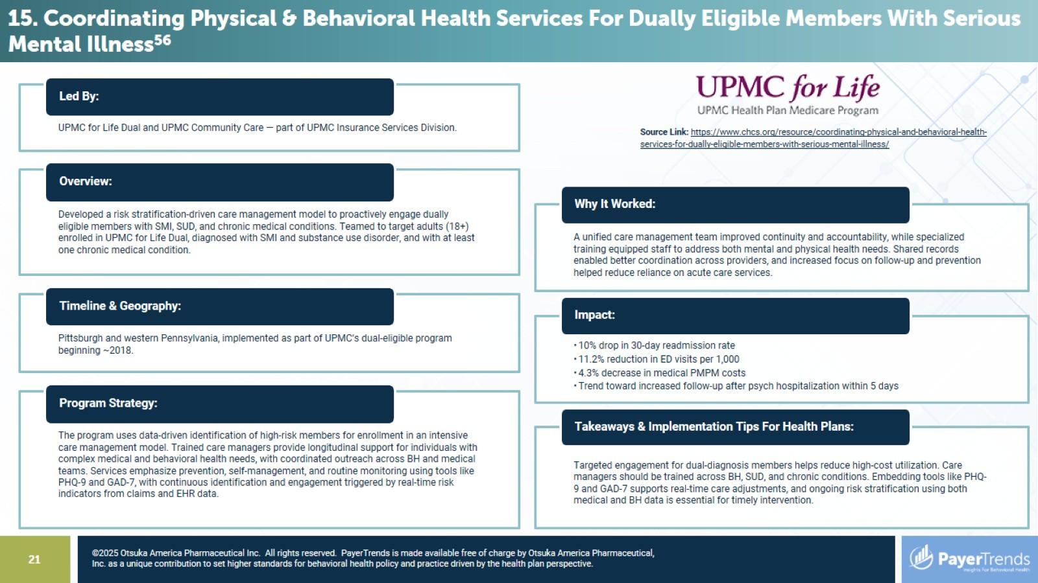

Slide 22
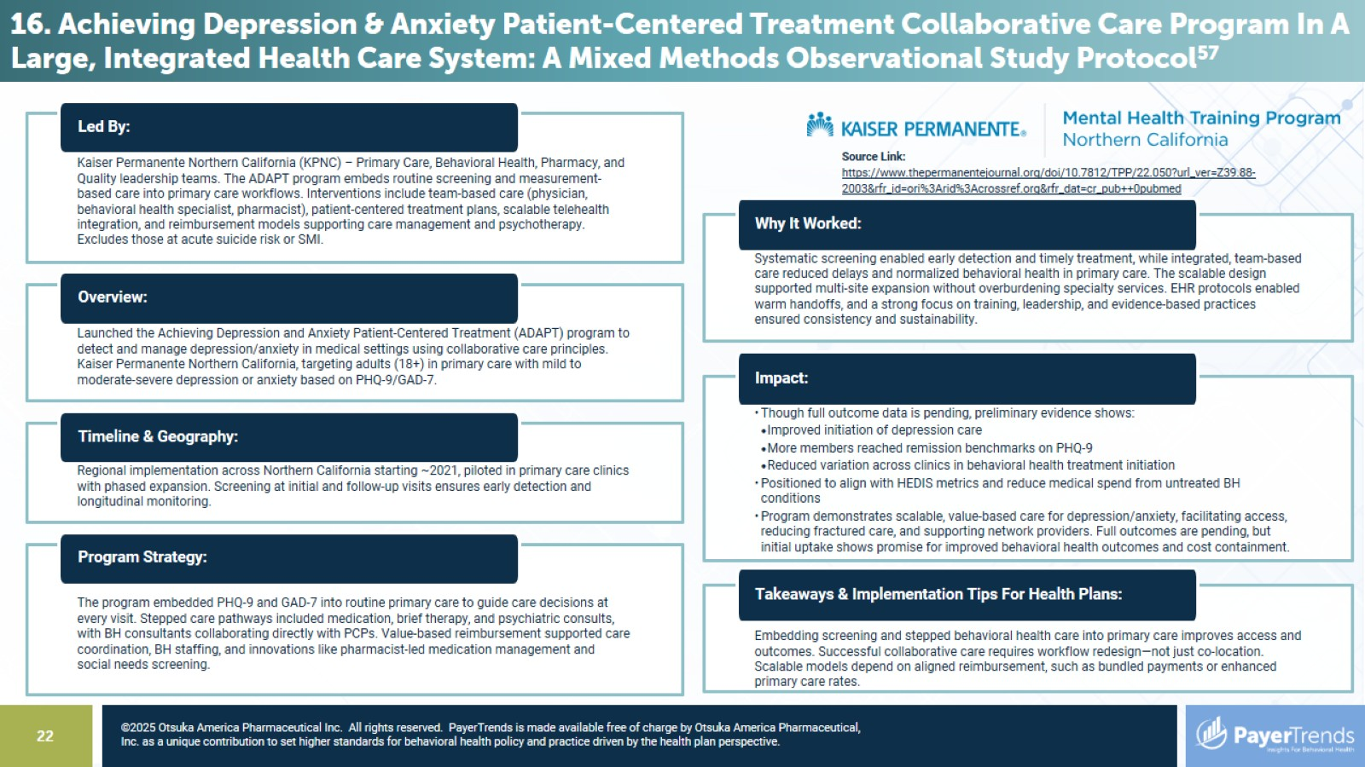

Slide 23
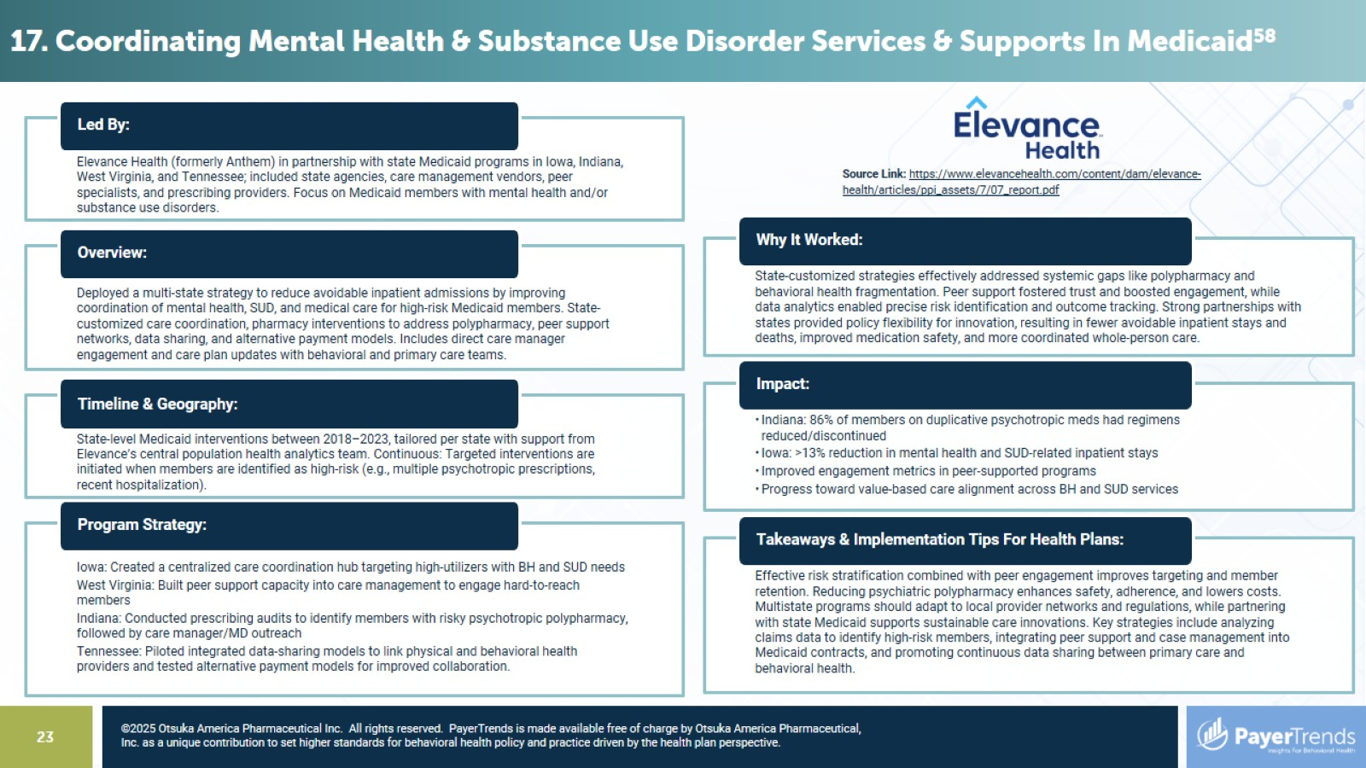

Slide 24
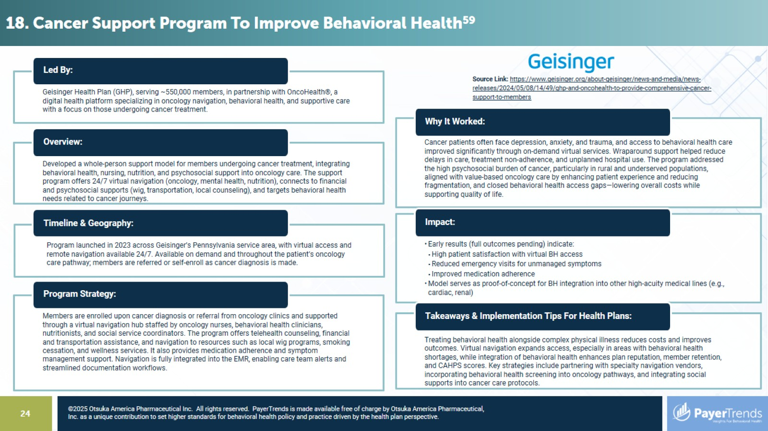

Slide 25
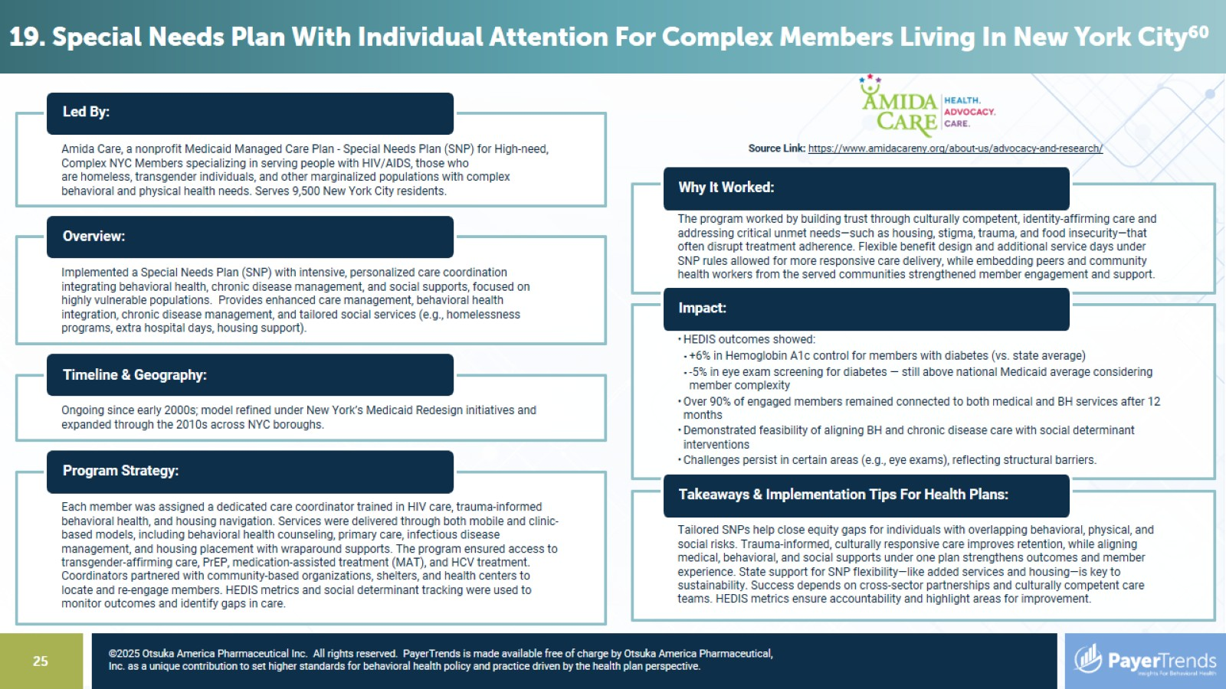

Slide 26
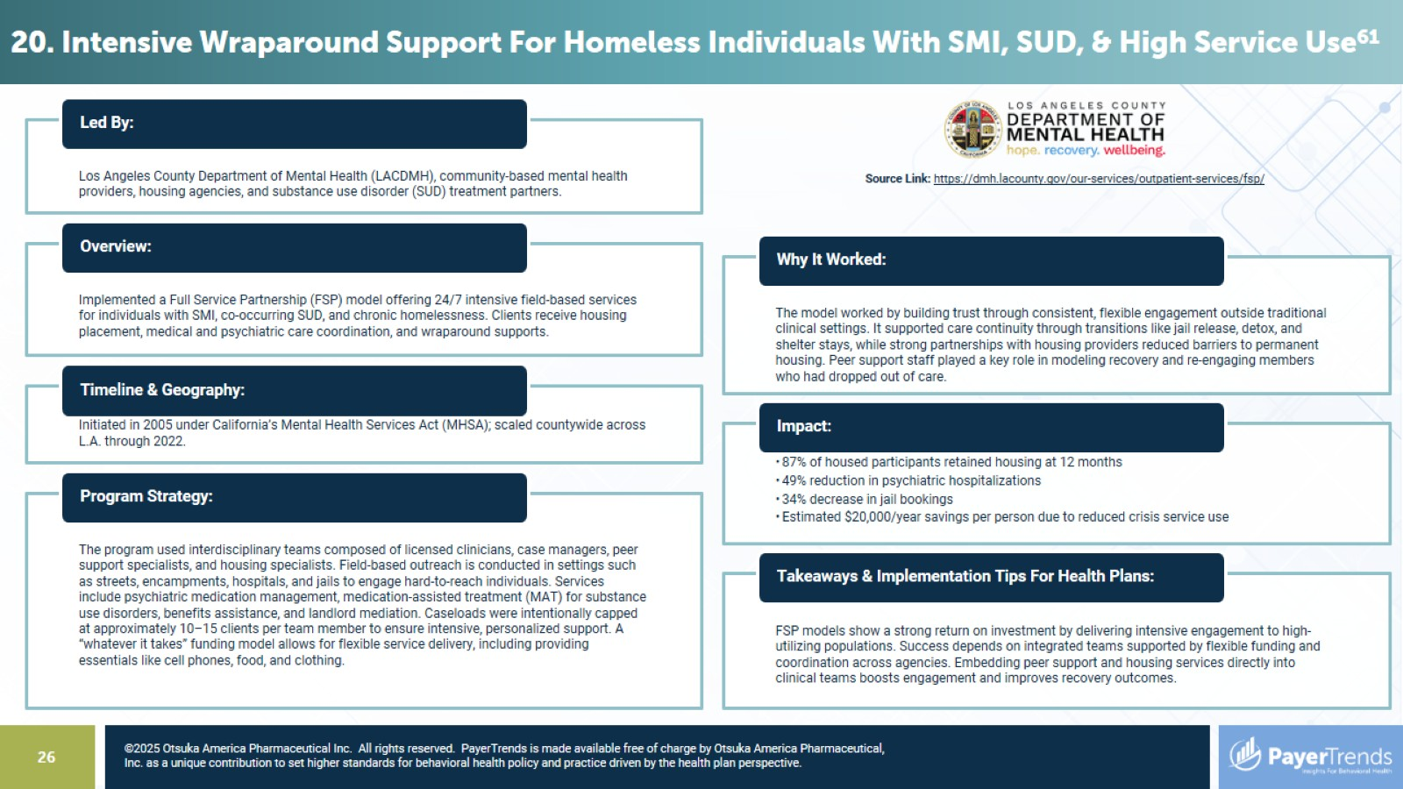

Slide 27


Slide 28
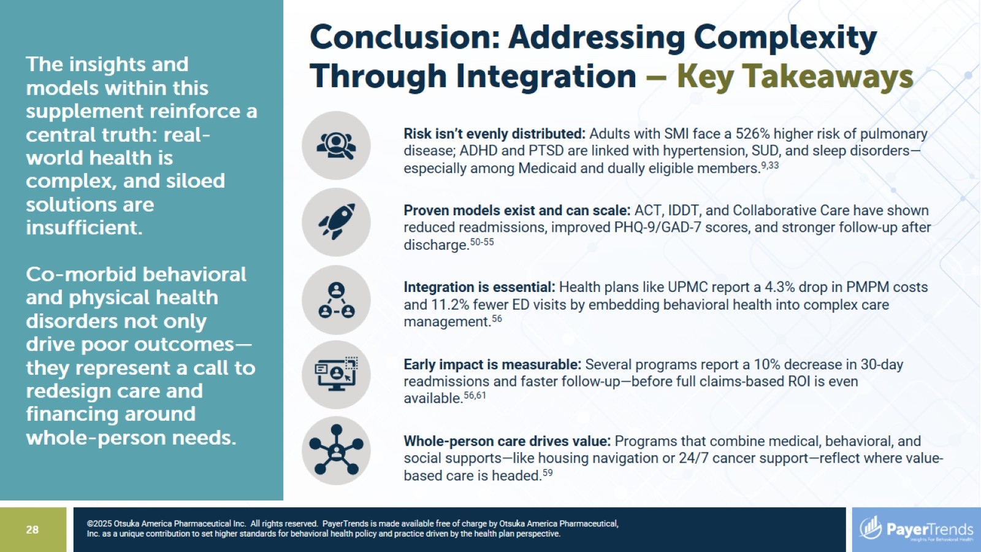
Conclusion: Addressing Complexity Through Integration – Key Takeaways

Slide 29
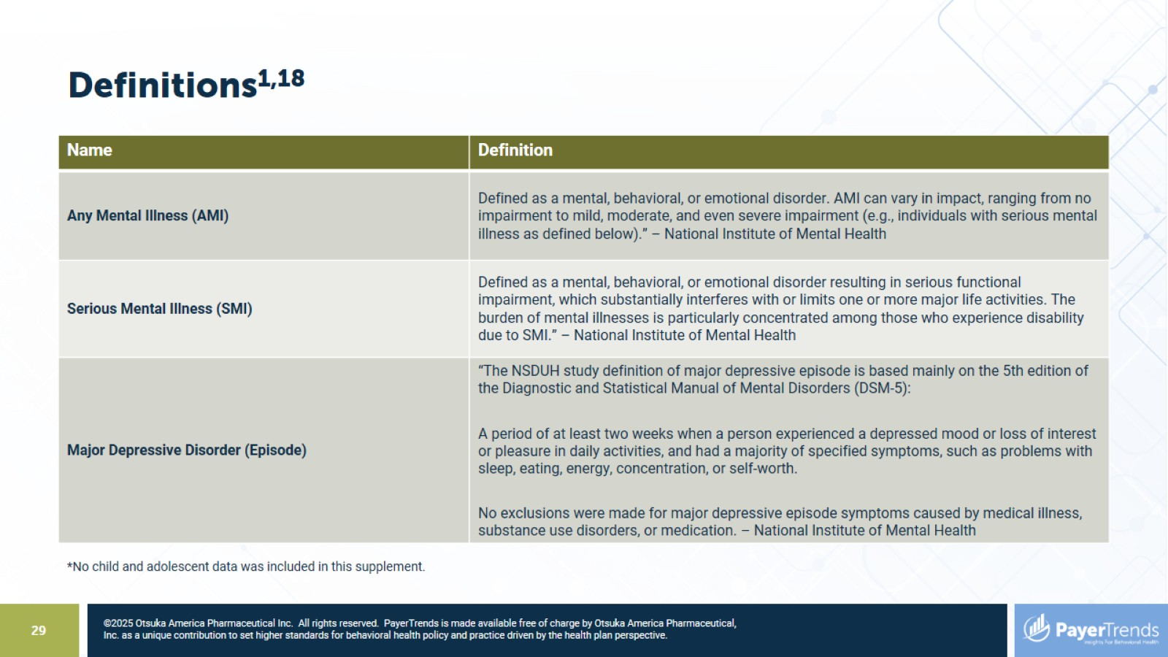
Definitions^{1,18}

Slide 30
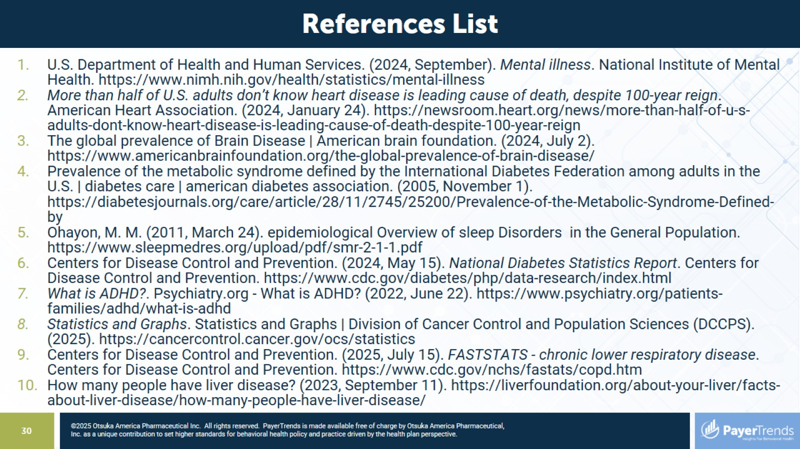

Slide 31
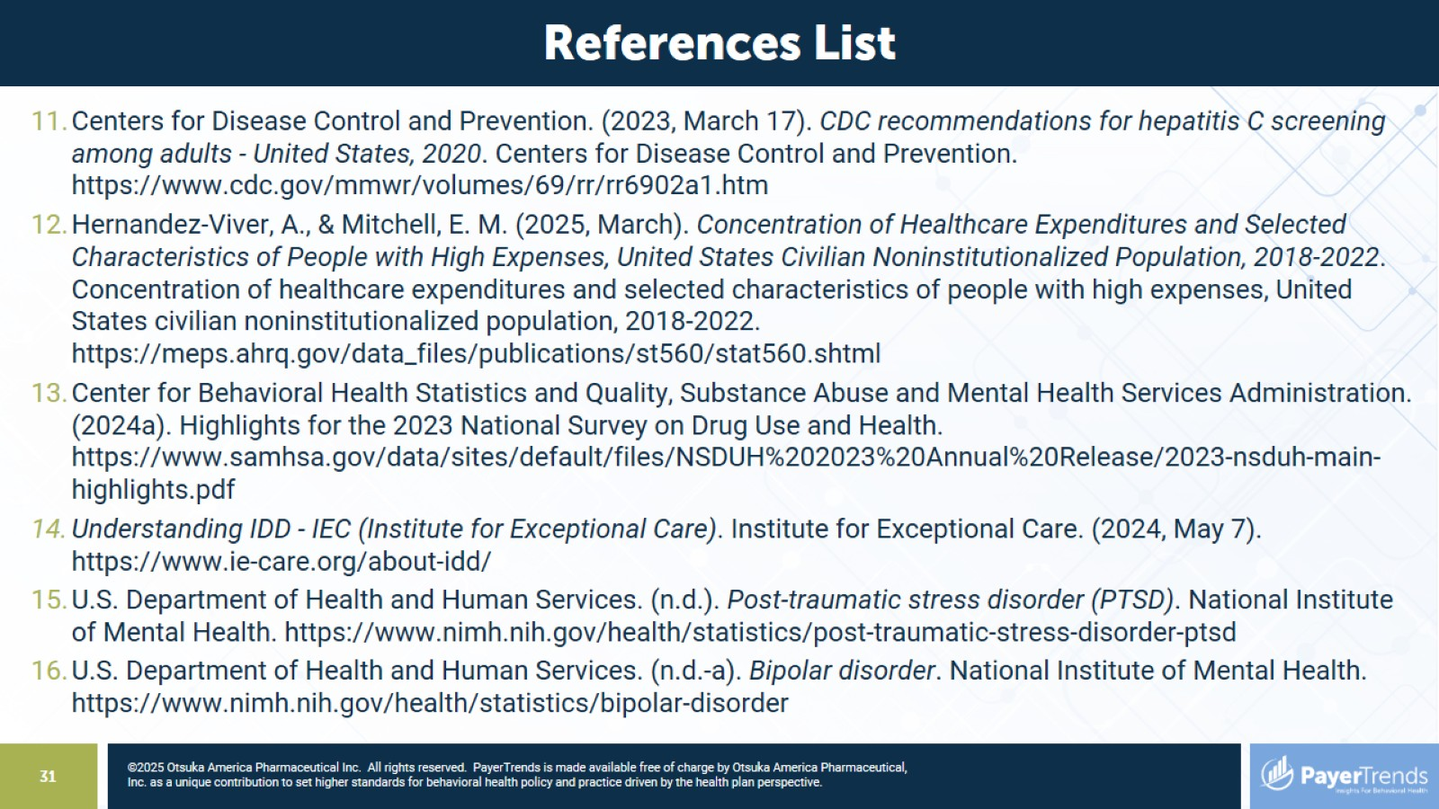

Slide 32
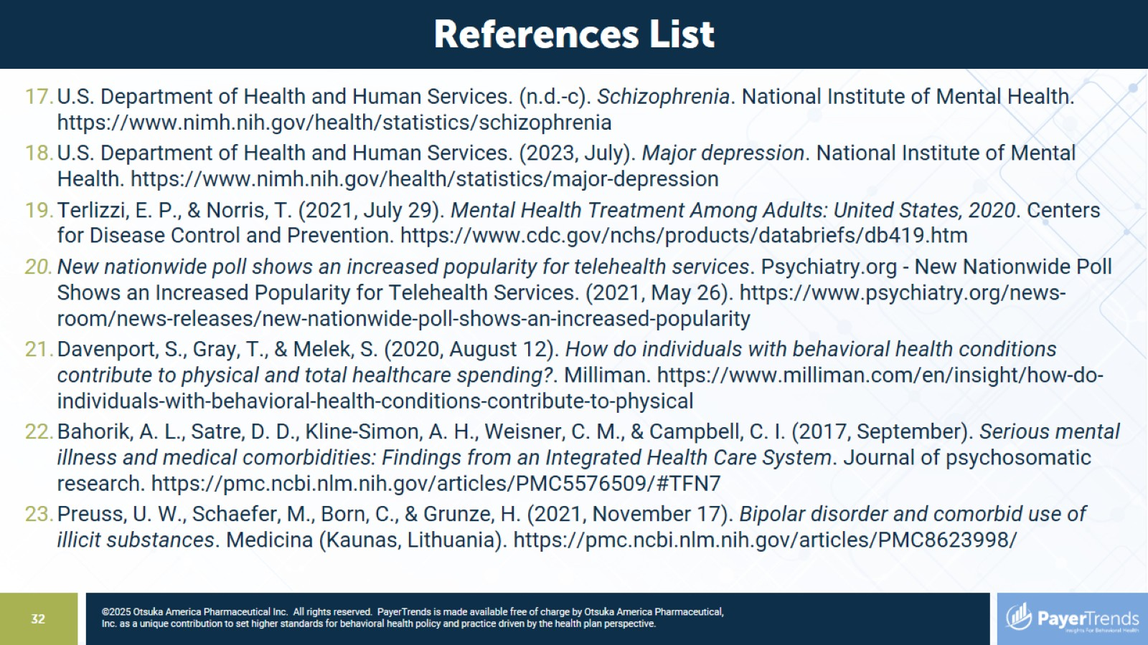

Slide 33
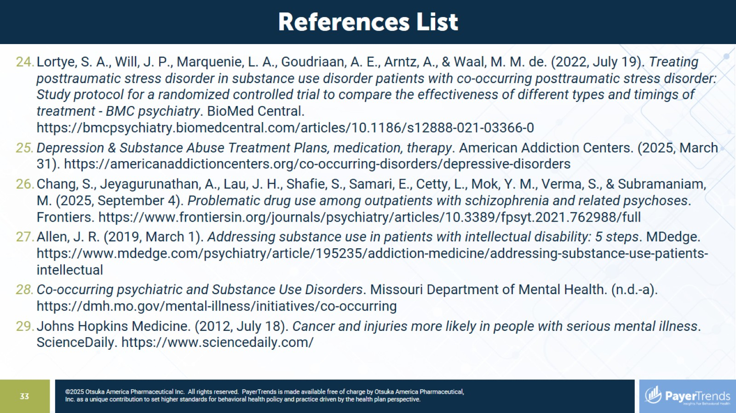

Slide 34
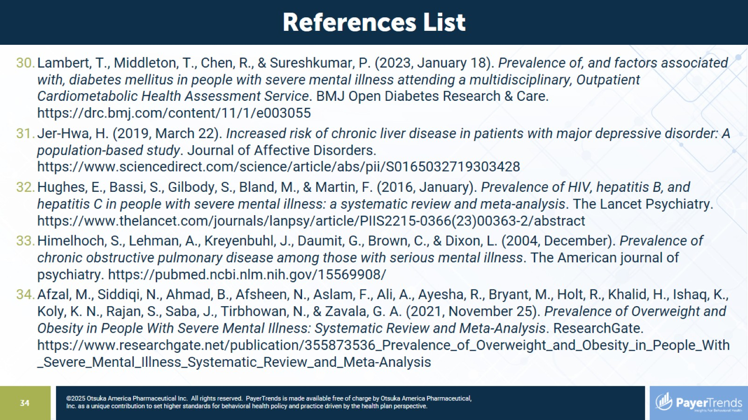

Slide 35
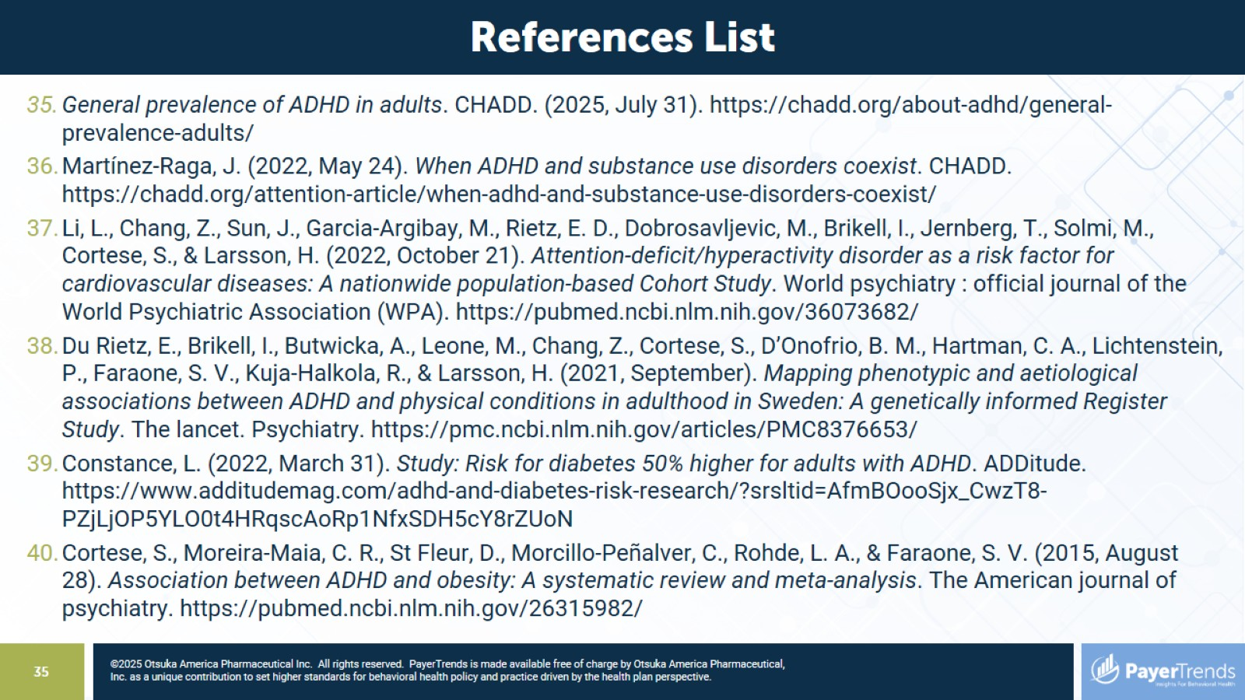

Slide 36
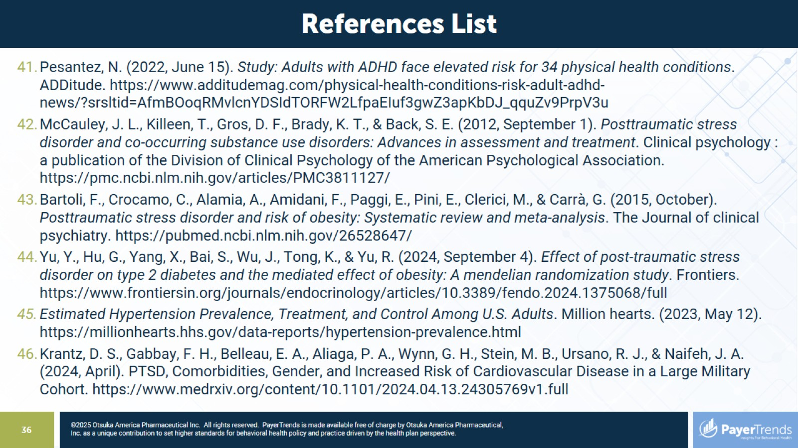

Slide 37
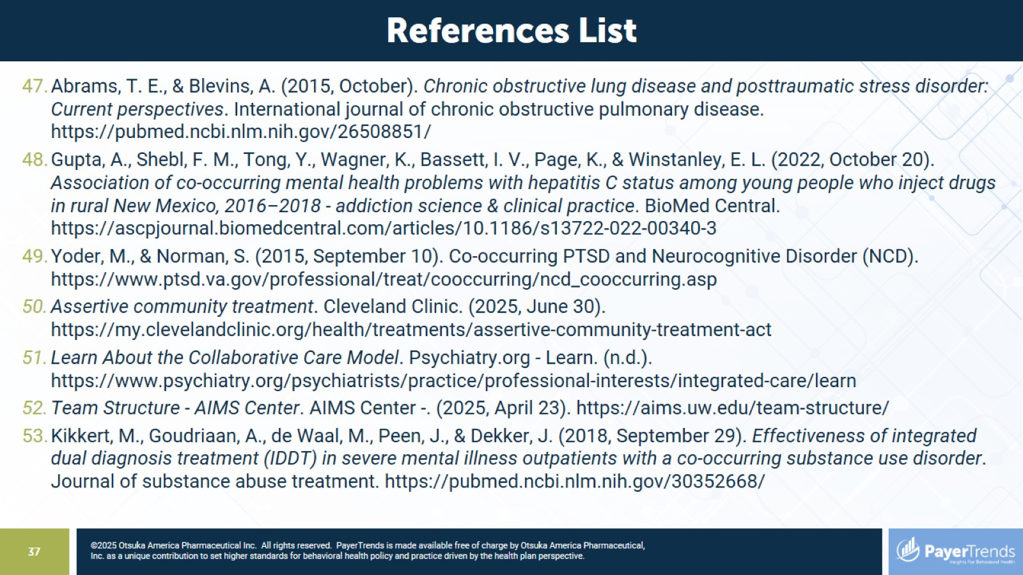

Slide 38
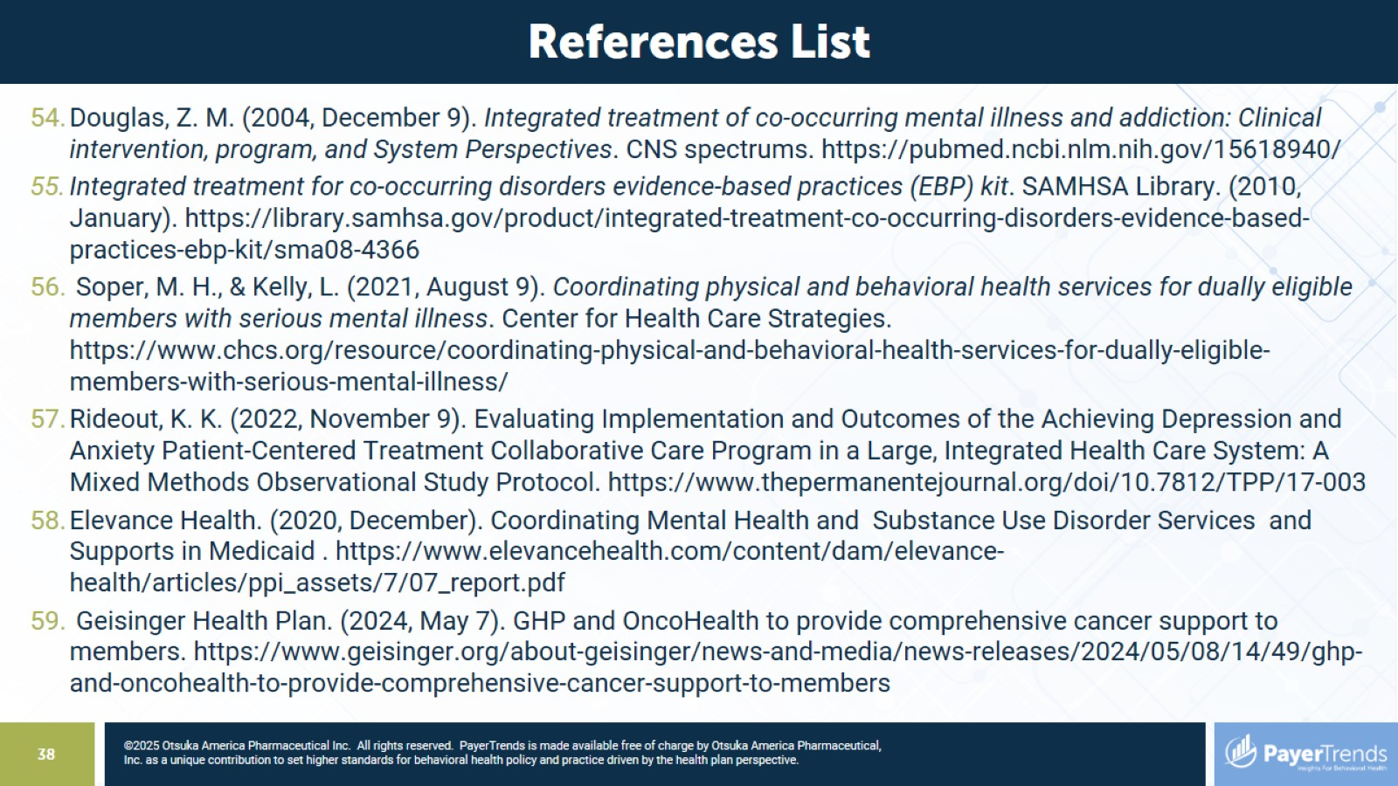

Slide 39
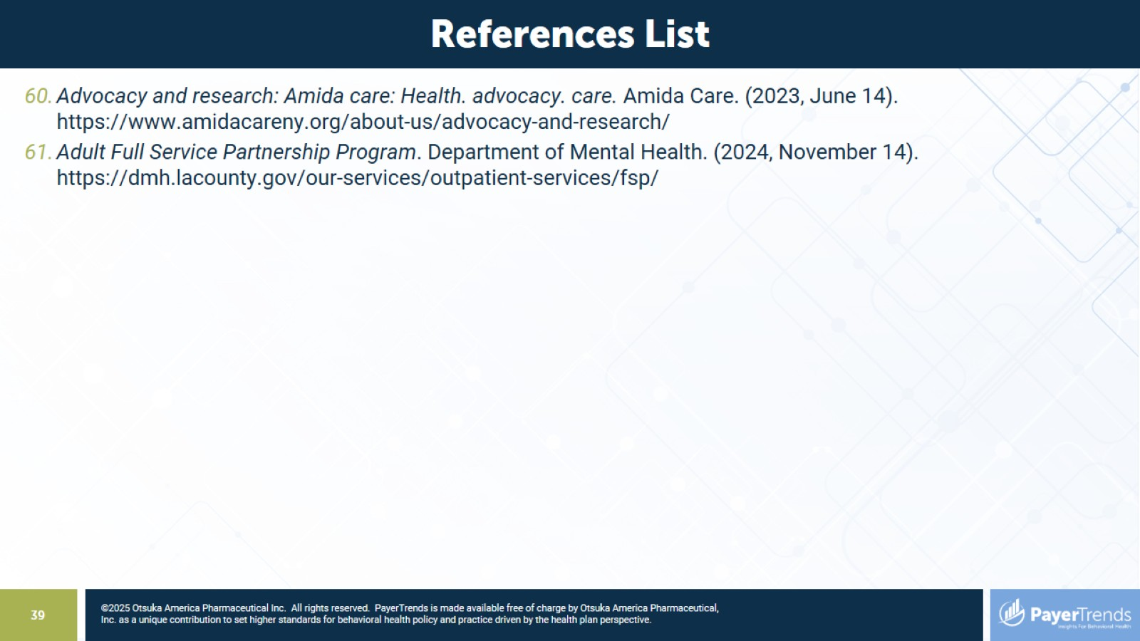

Slide 40


