Slide 1


Slide 2
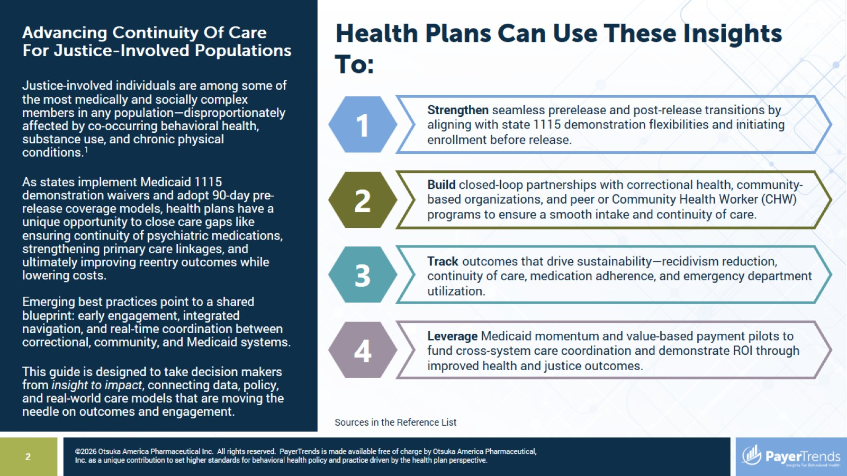
Health Plans Can Use These Insights To:

Slide 3
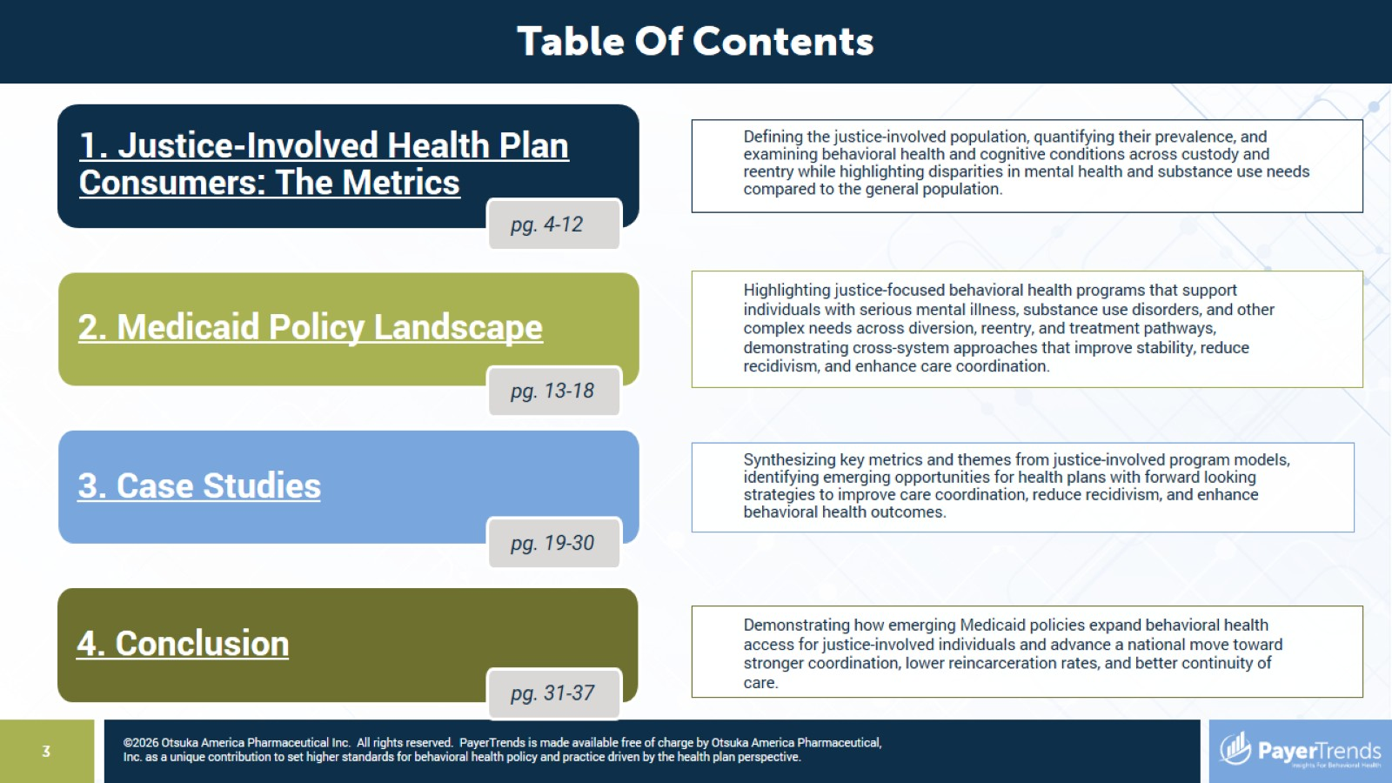

Slide 4


Slide 5
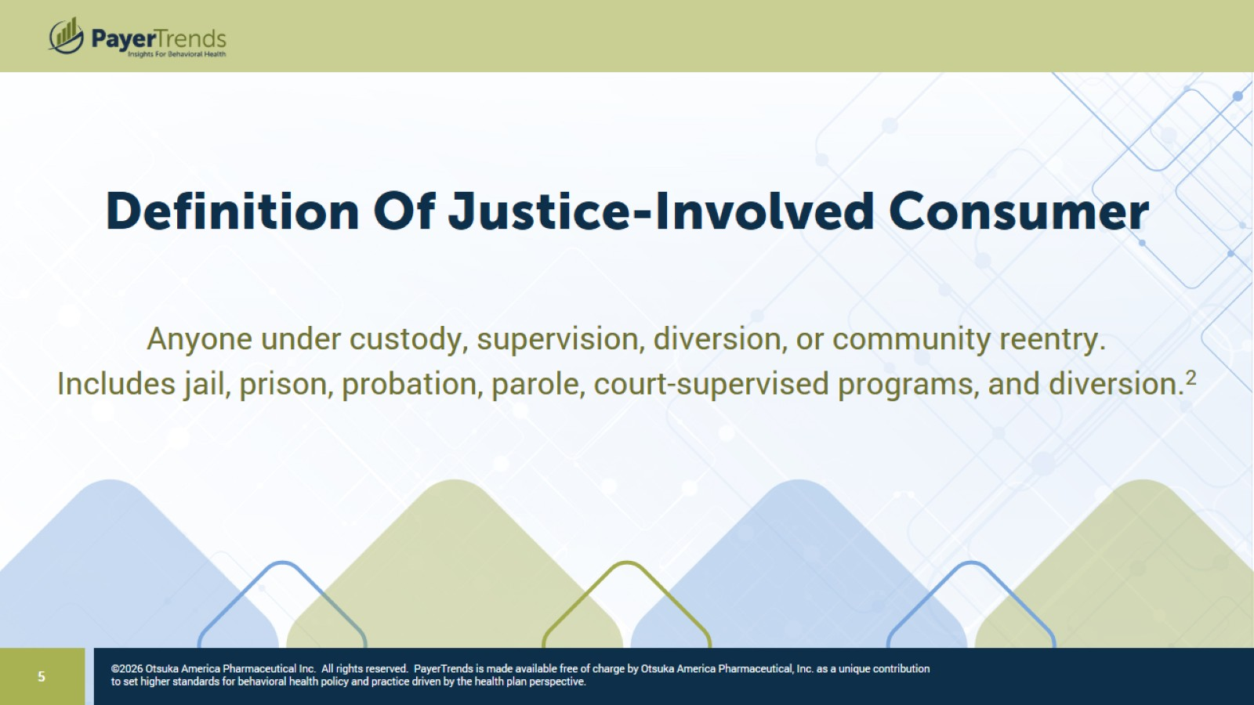

Slide 6
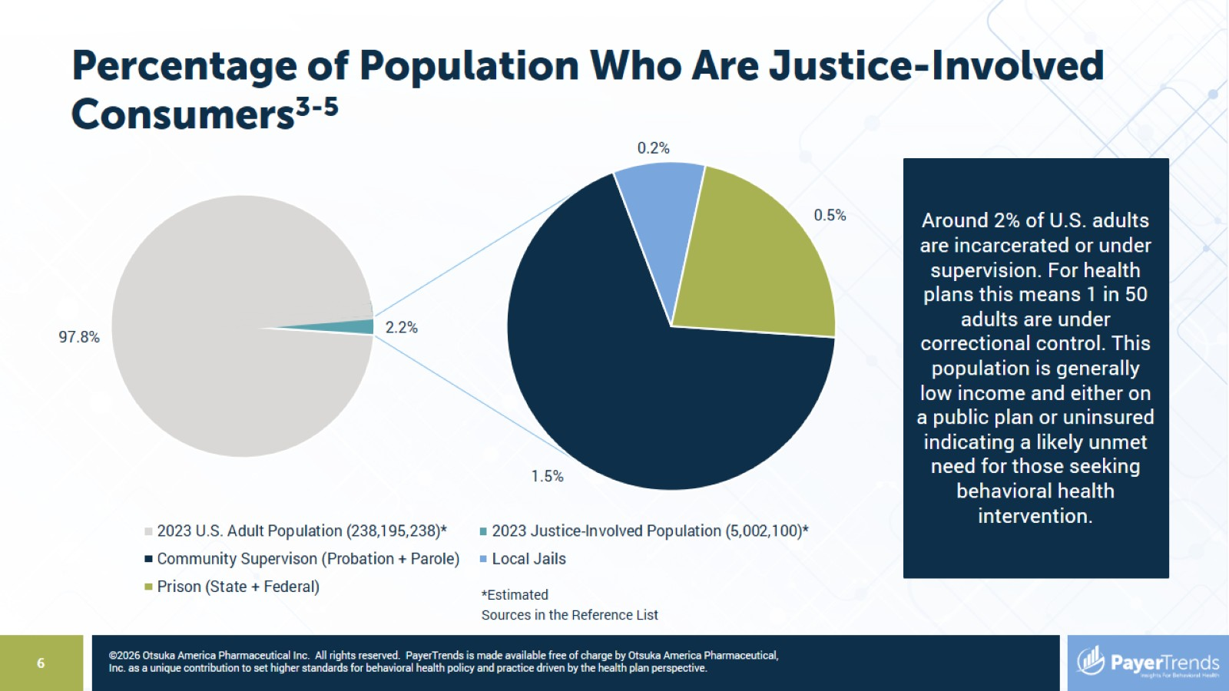
Percentage of Population Who Are Justice-Involved Consumers³⁻⁵

Slide 7
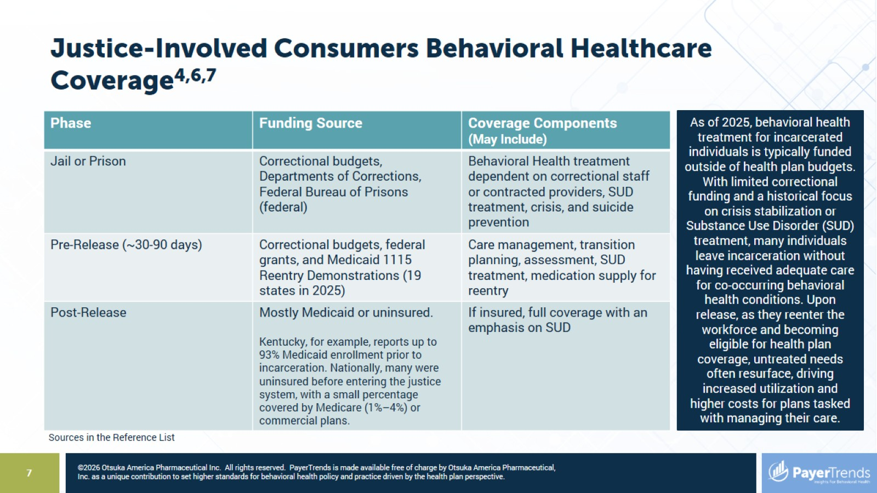
Justice-Involved Consumers Behavioral Healthcare Coverage^{4,6,7}

Slide 8
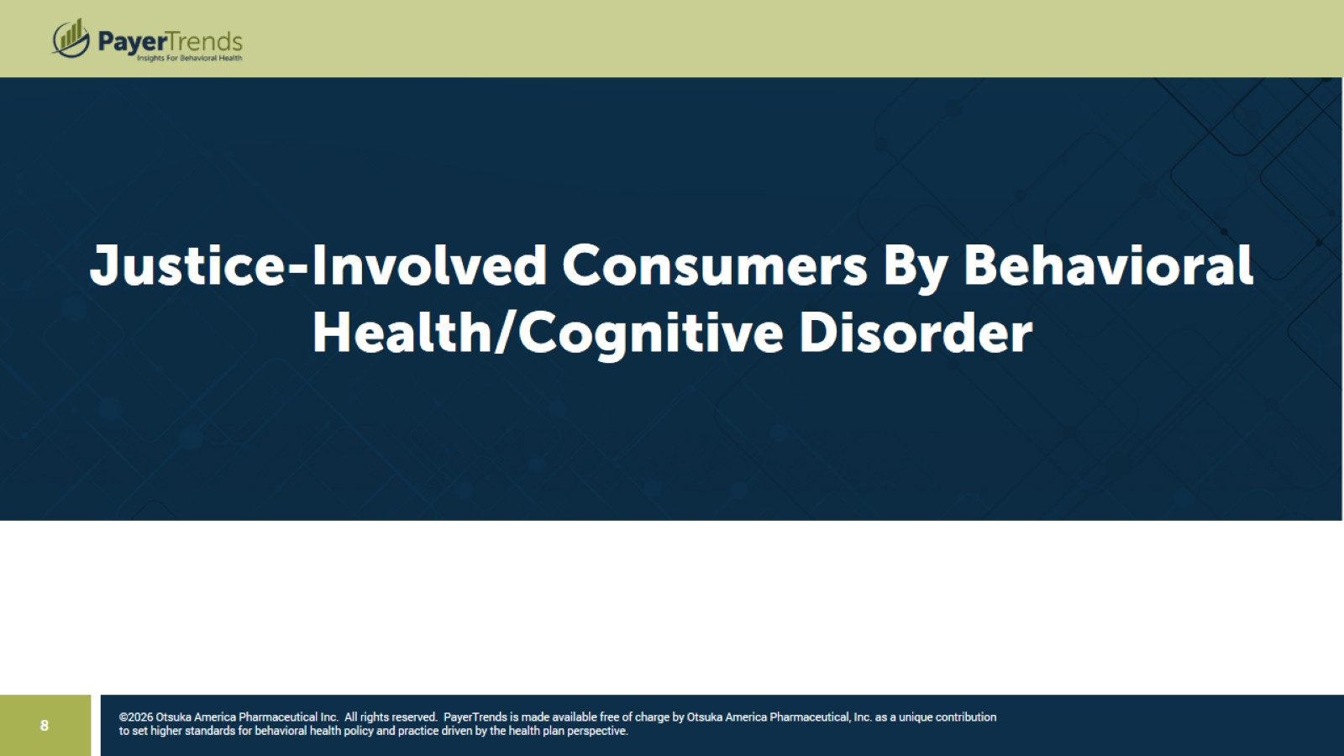

Slide 9
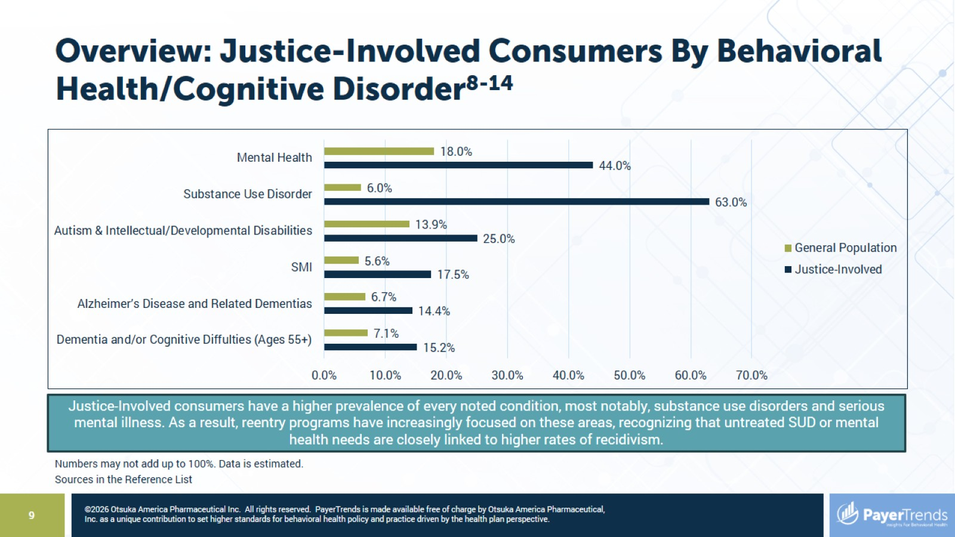
Overview: Justice-Involved Consumers By Behavioral Health/Cognitive Disorder⁸⁻¹⁴

Slide 10
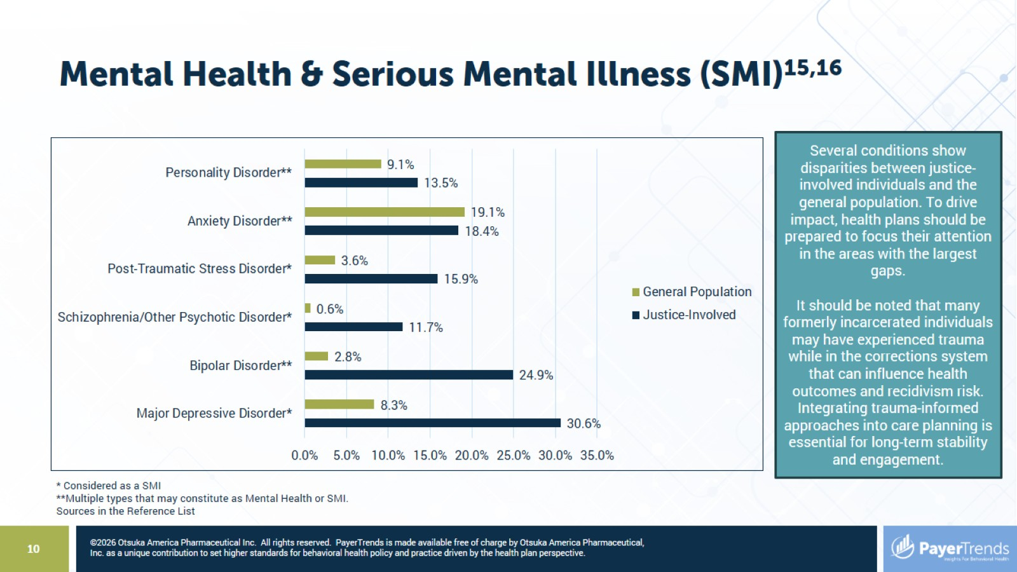
Mental Health & Serious Mental Illness (SMI)^{15,16}

Slide 11
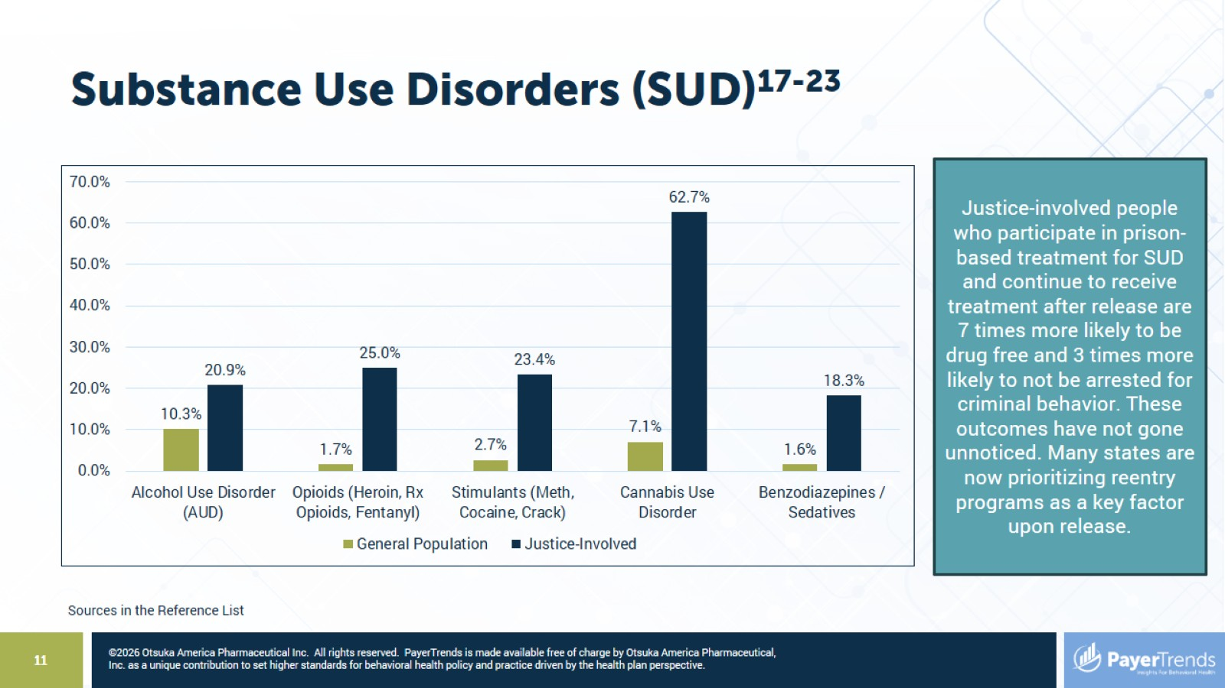
Substance Use Disorders (SUD)¹⁷⁻²³

Slide 12
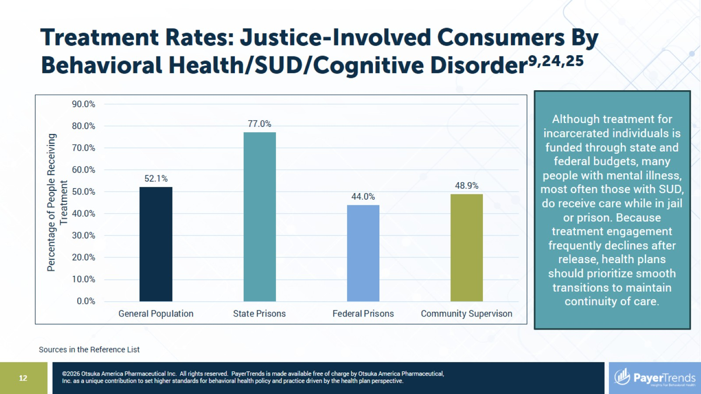
Treatment Rates: Justice-Involved Consumers By Behavioral Health/SUD/Cognitive Disorder^{9,24,25}

Slide 13


Slide 14
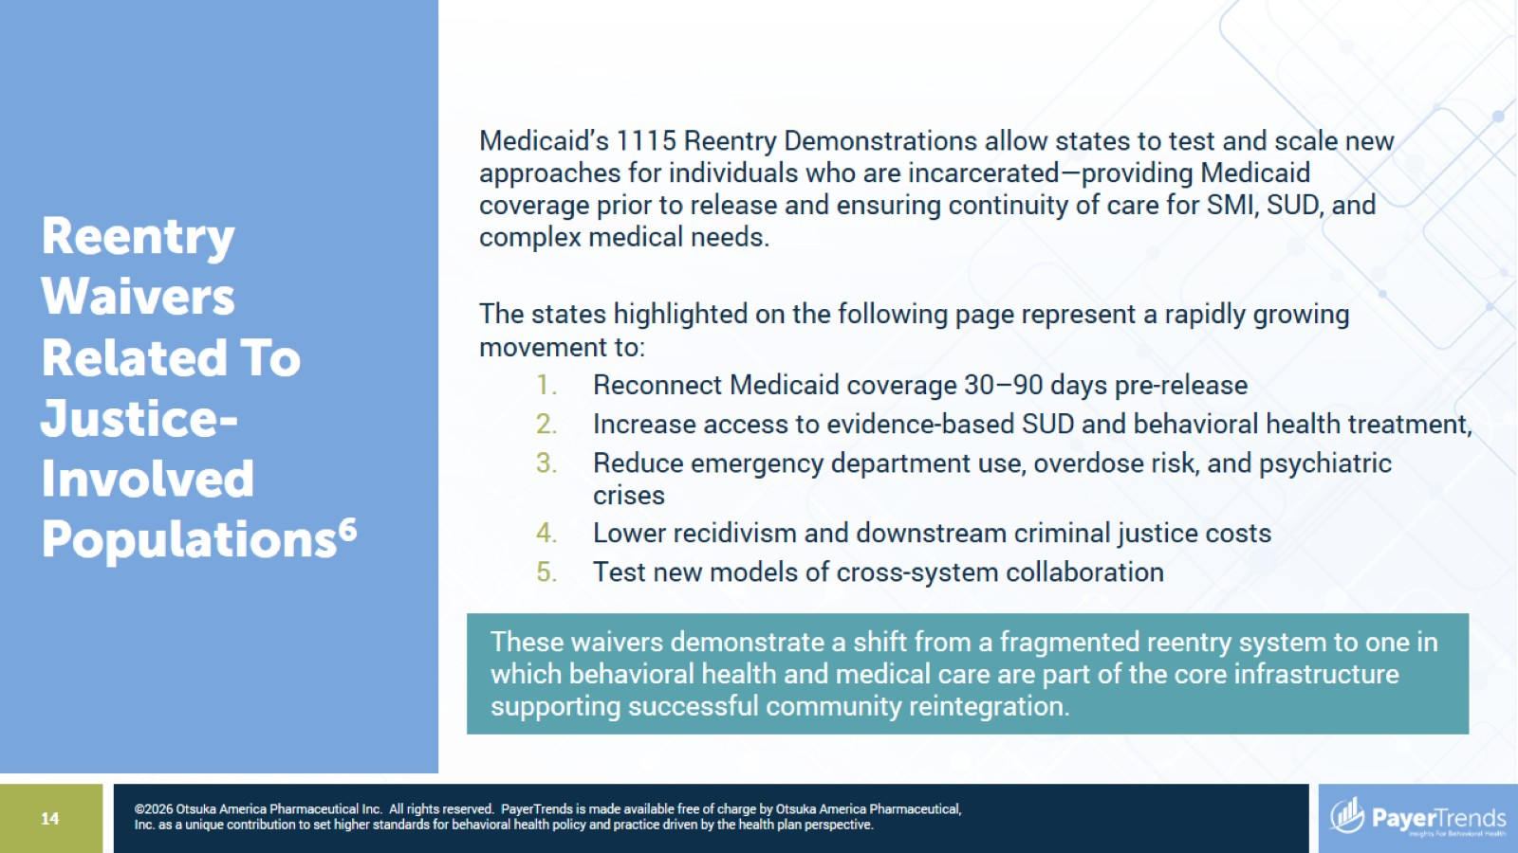

Slide 15
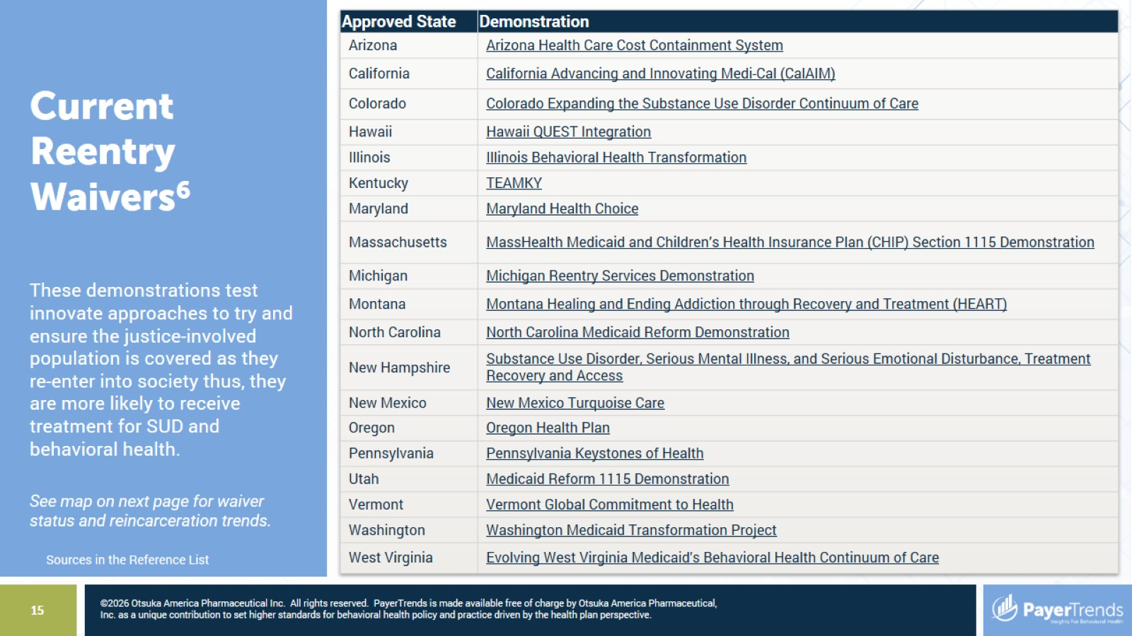

Slide 16
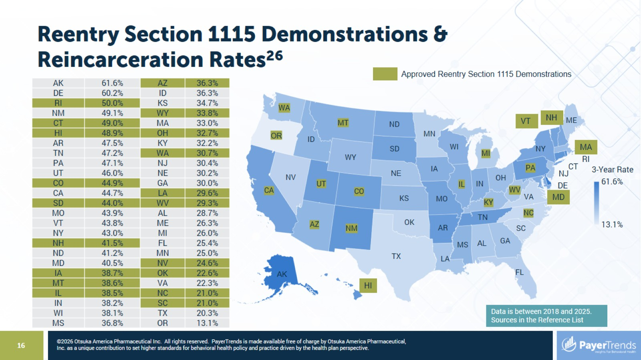
Reentry Section 1115 Demonstrations & Reincarceration Rates²⁶

Slide 17
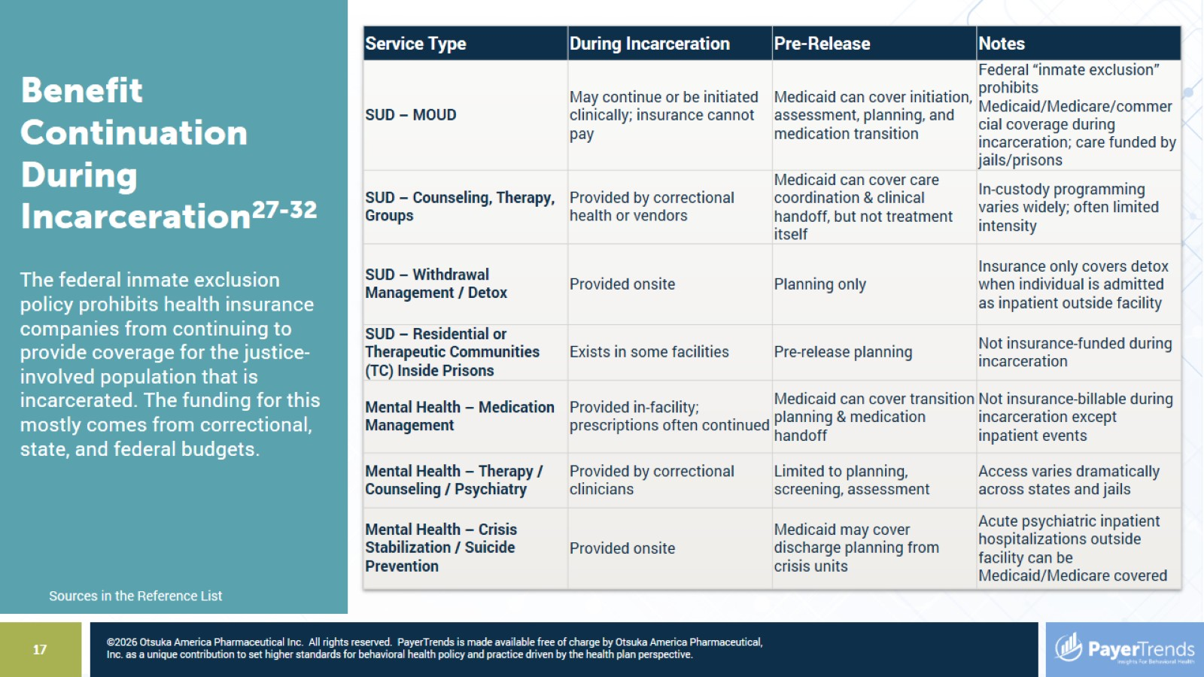

Slide 18
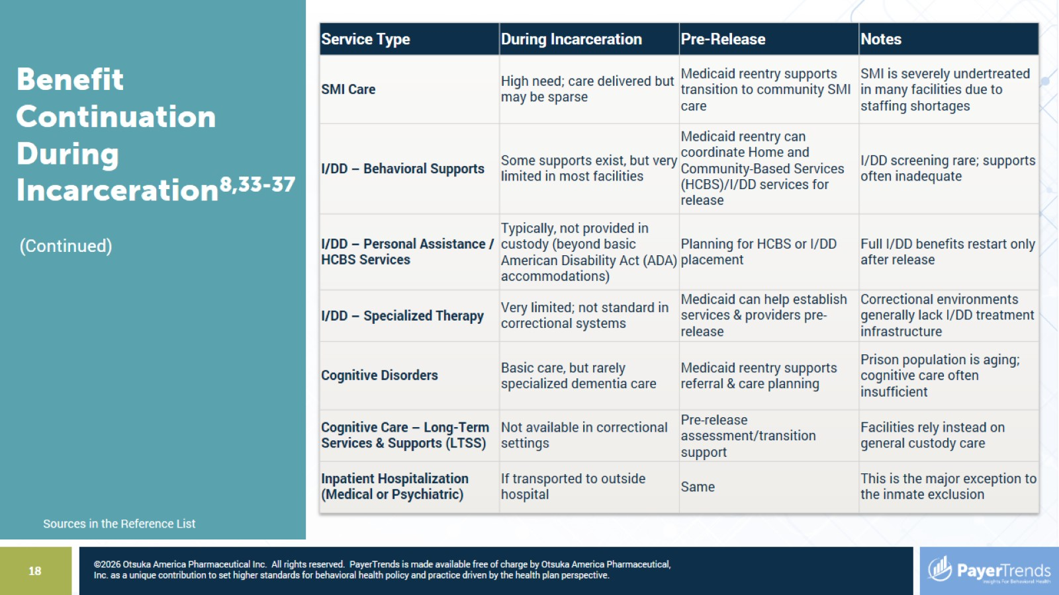

Slide 19


Slide 20
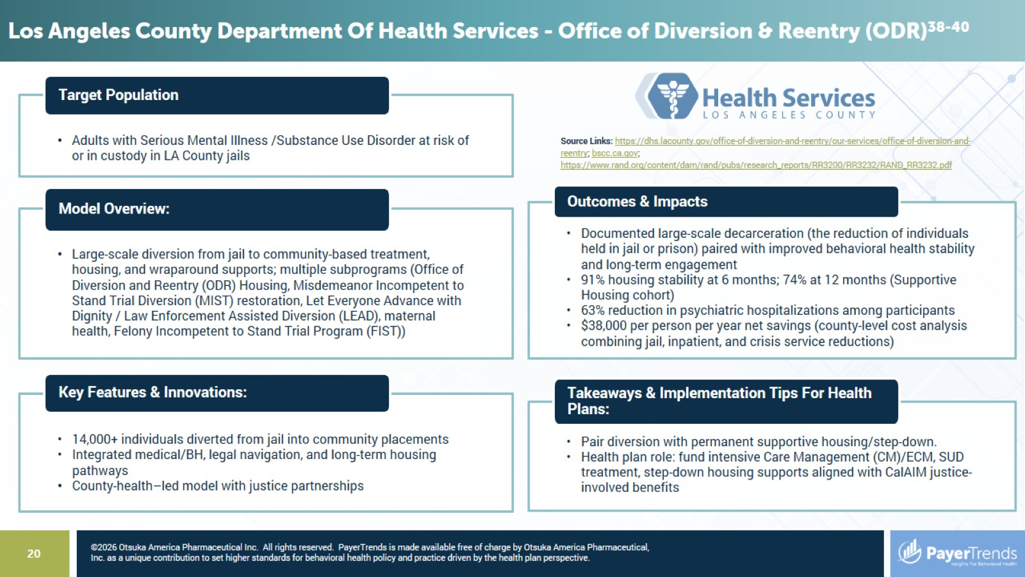

Slide 21
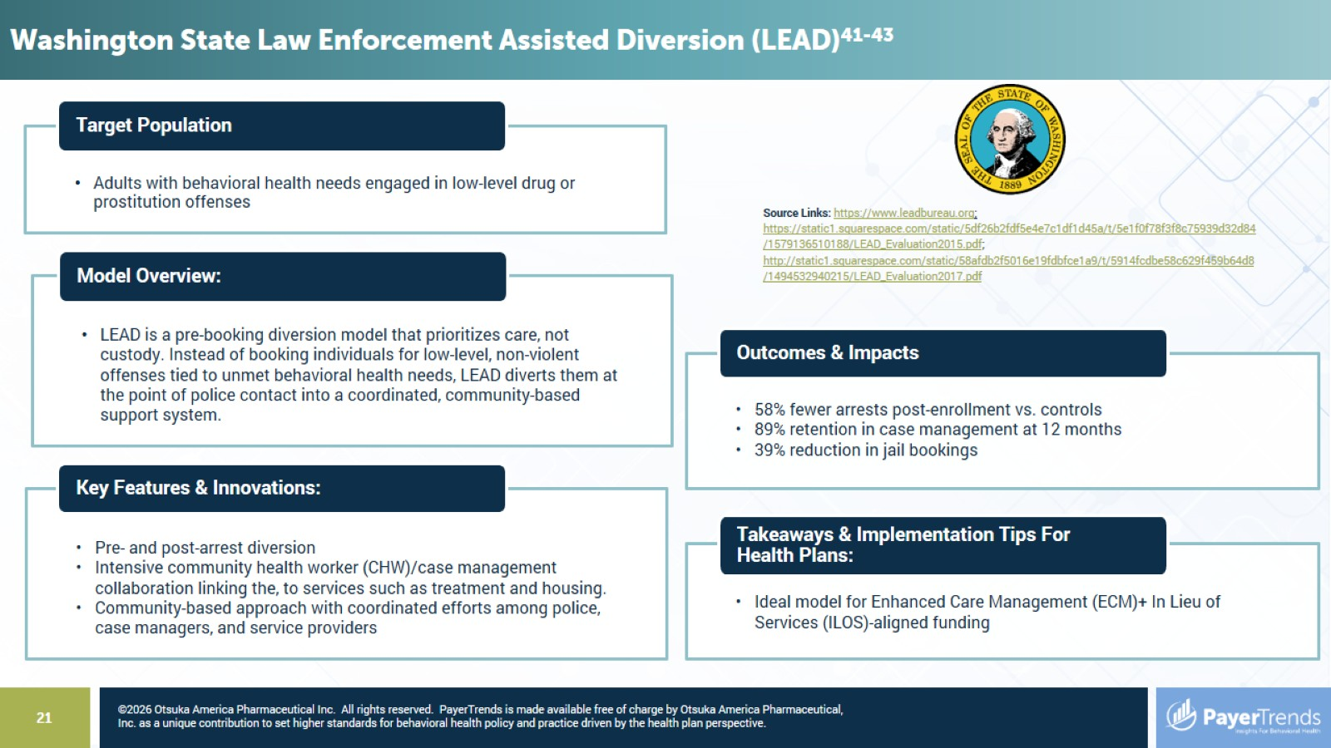

Slide 22
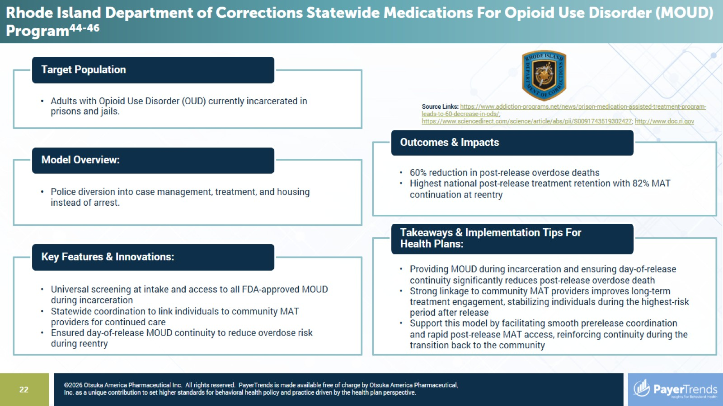

Slide 23
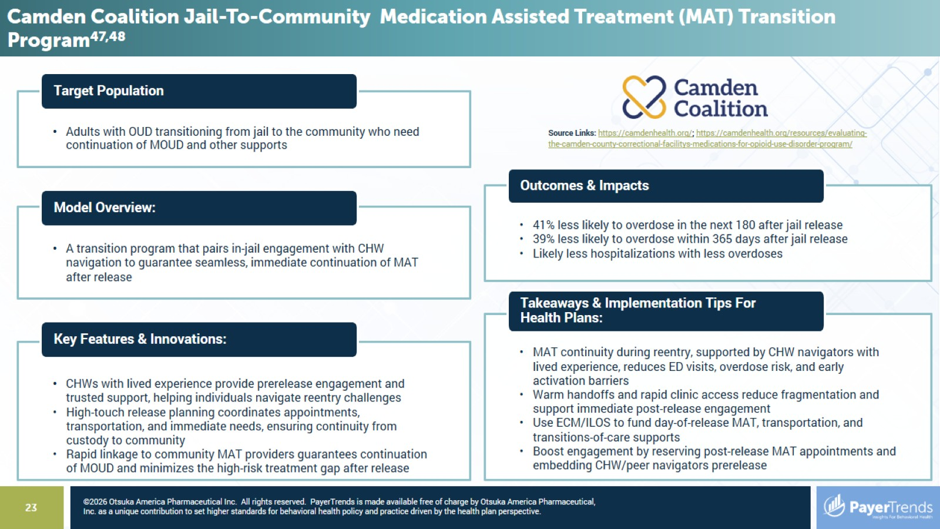

Slide 24
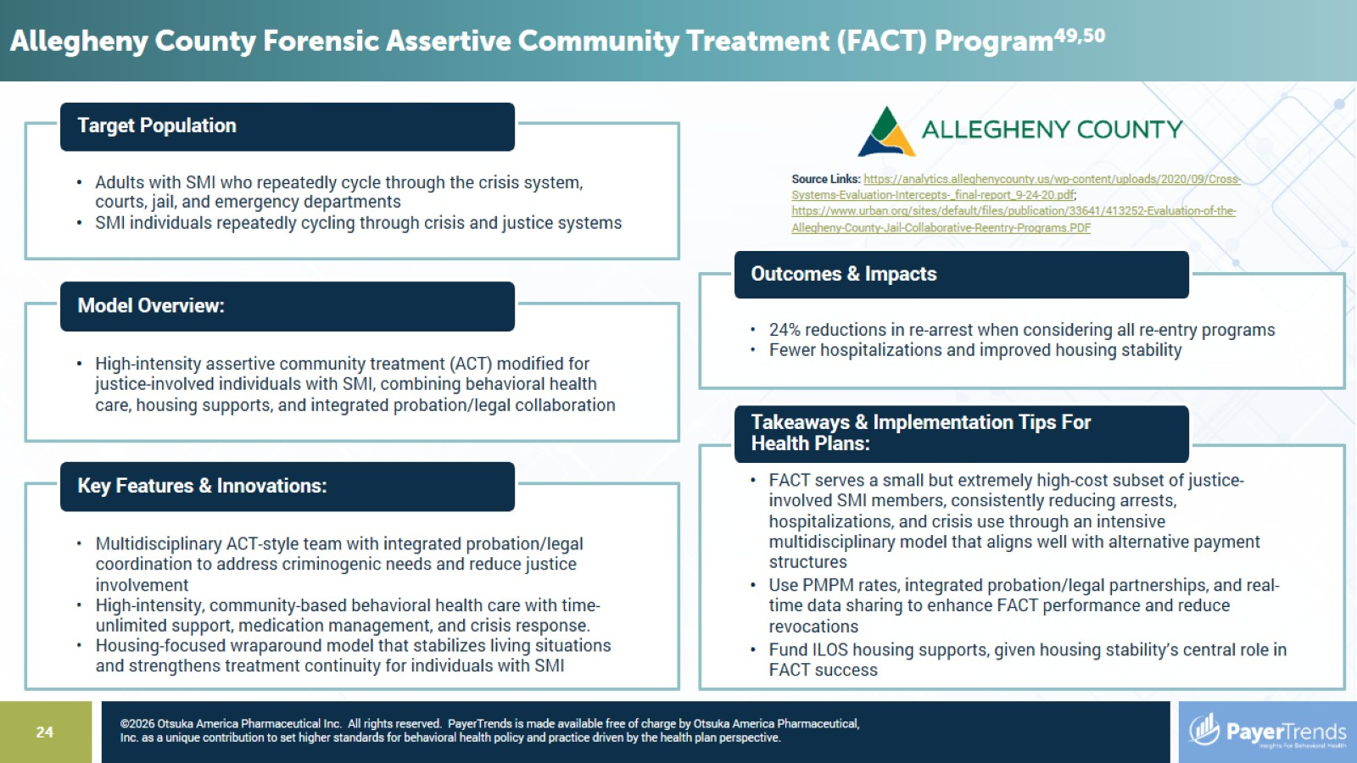

Slide 25
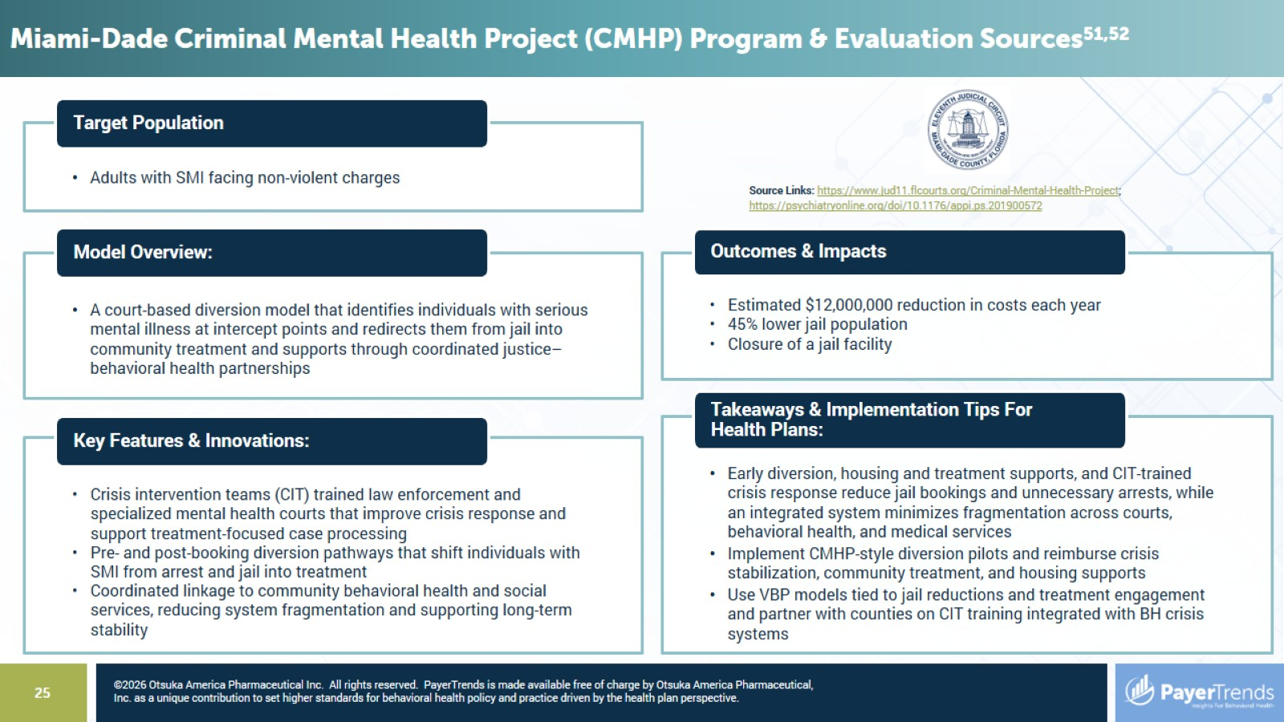

Slide 26
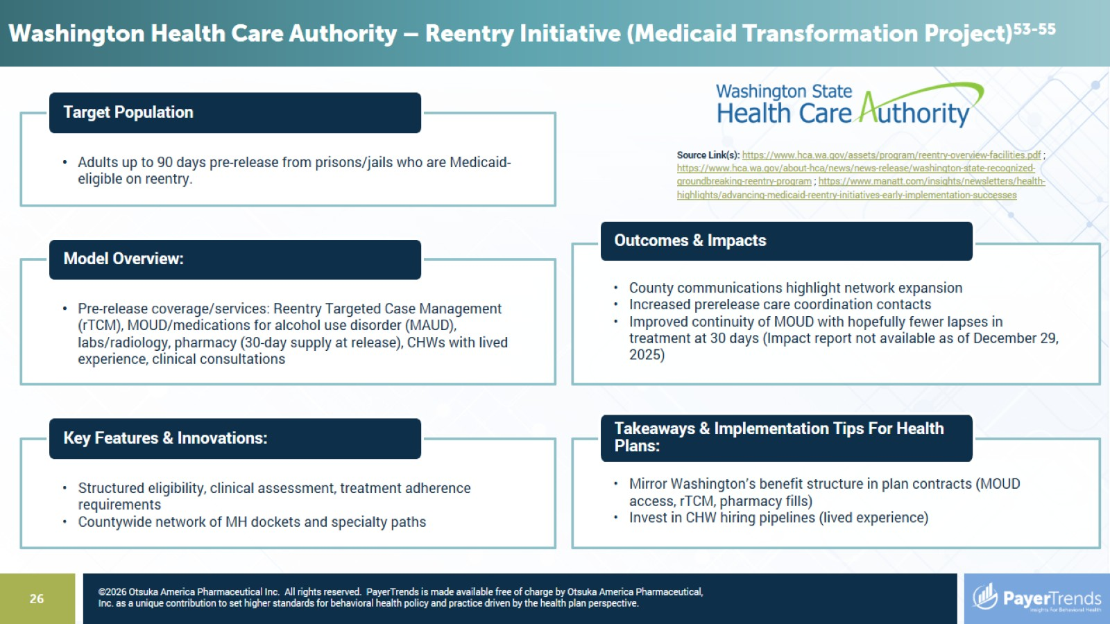

Slide 27
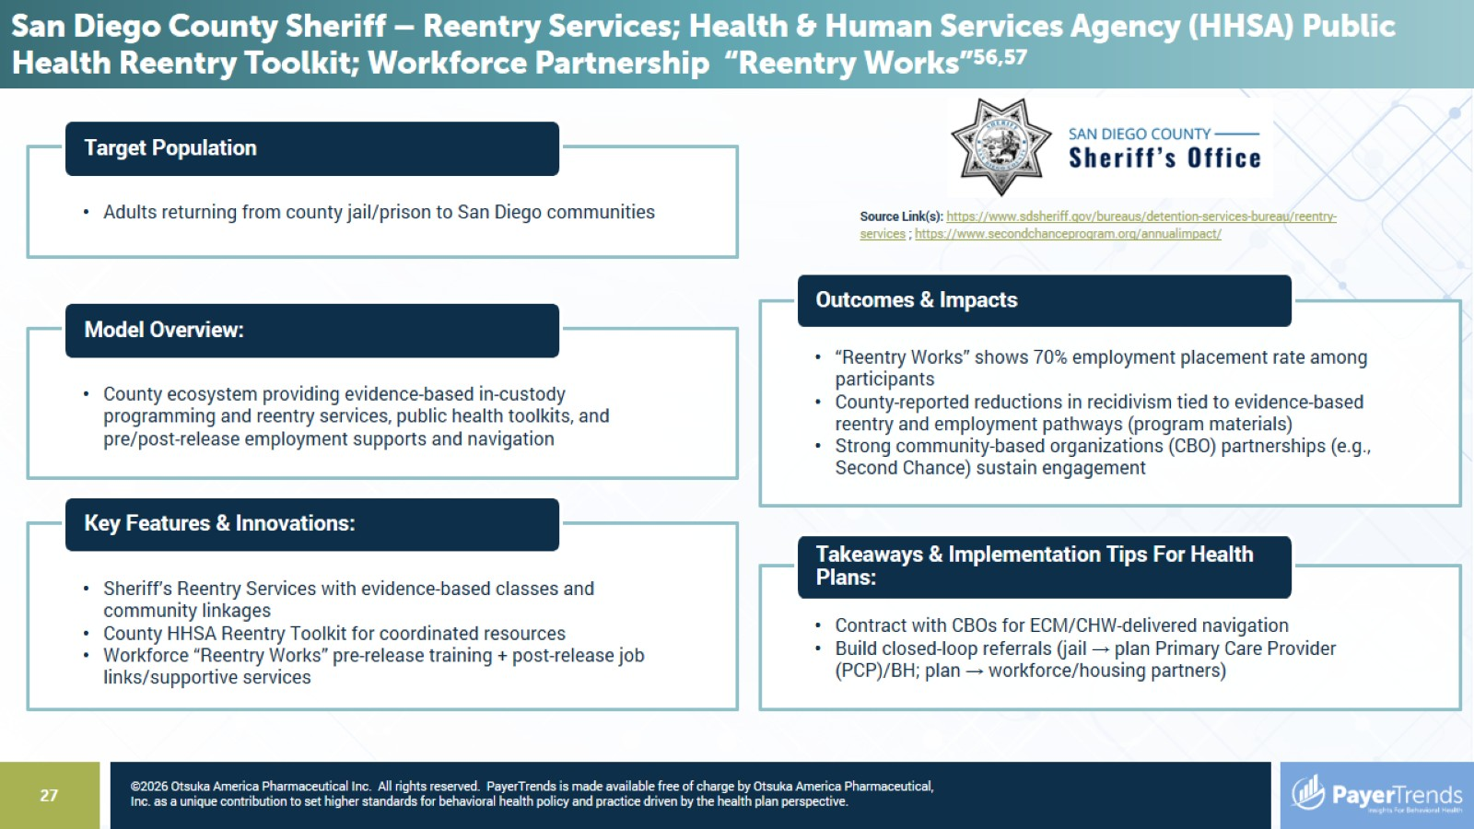

Slide 28
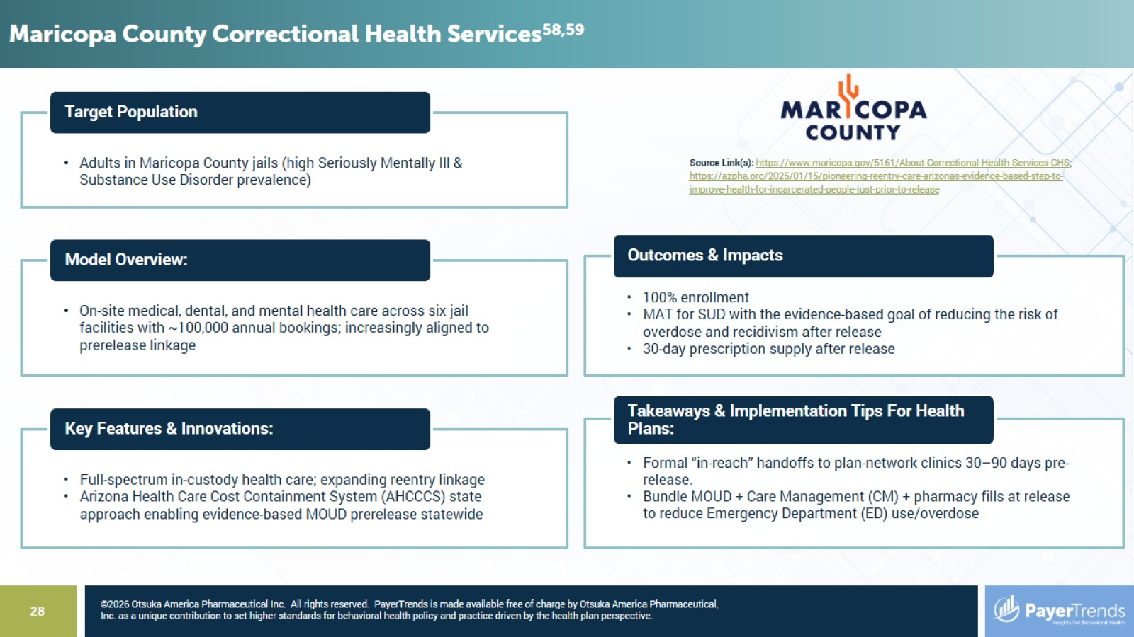

Slide 29
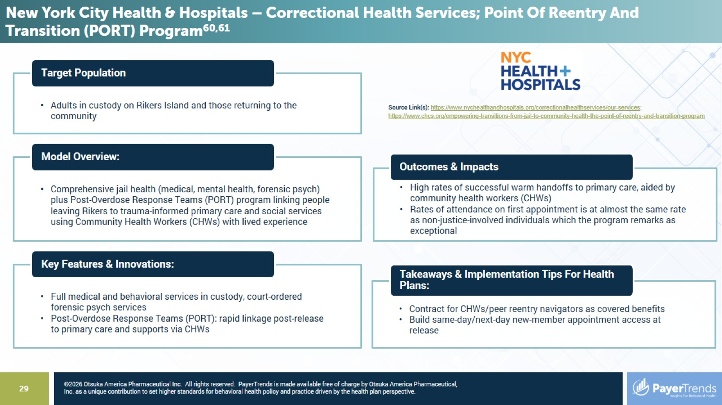

Slide 30
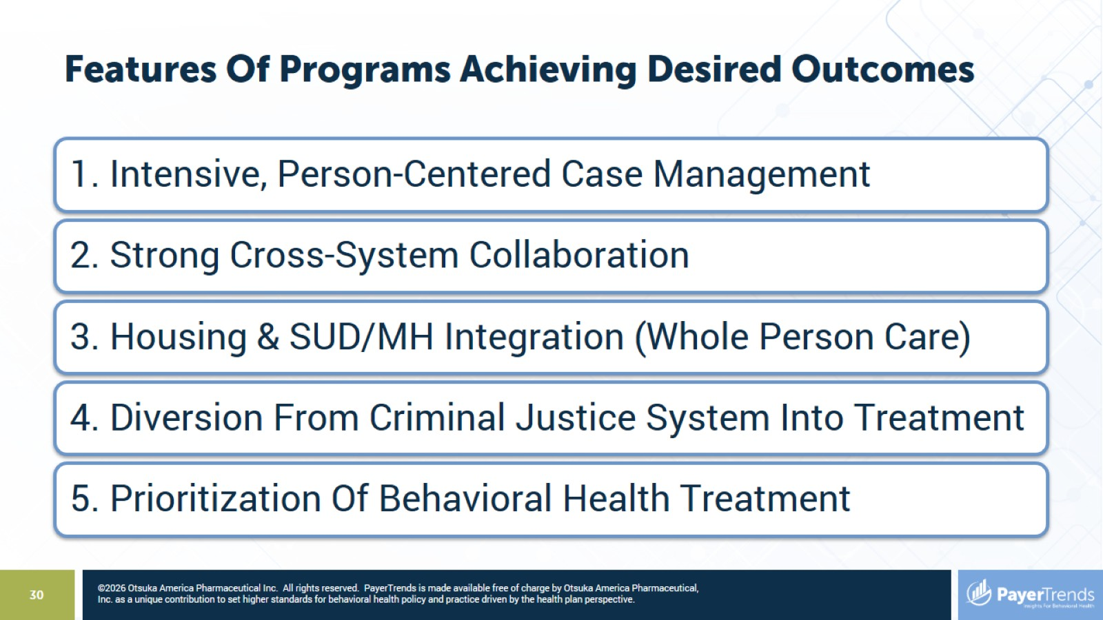
Features Of Programs Achieving Desired Outcomes

Slide 31
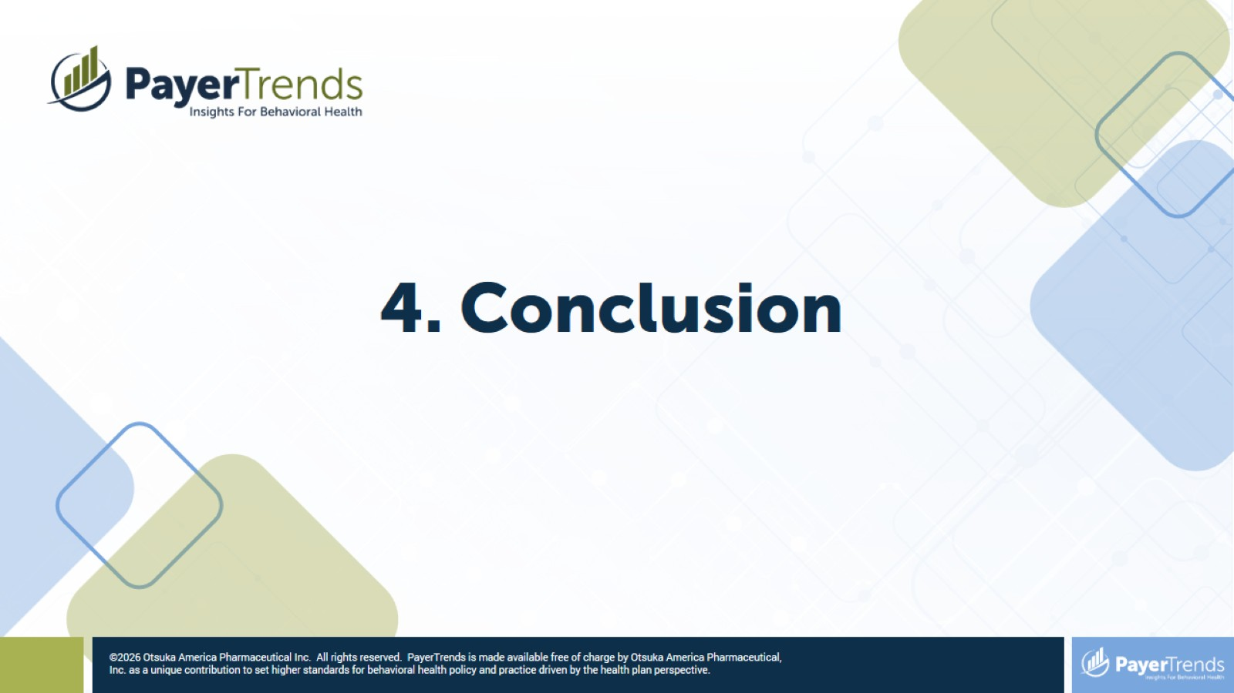

Slide 32
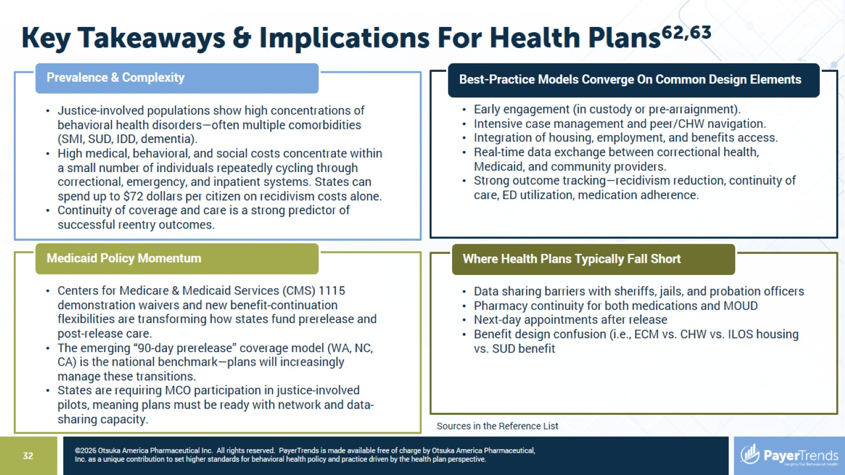
Key Takeaways & Implications For Health Plans^{62,63}

Slide 33
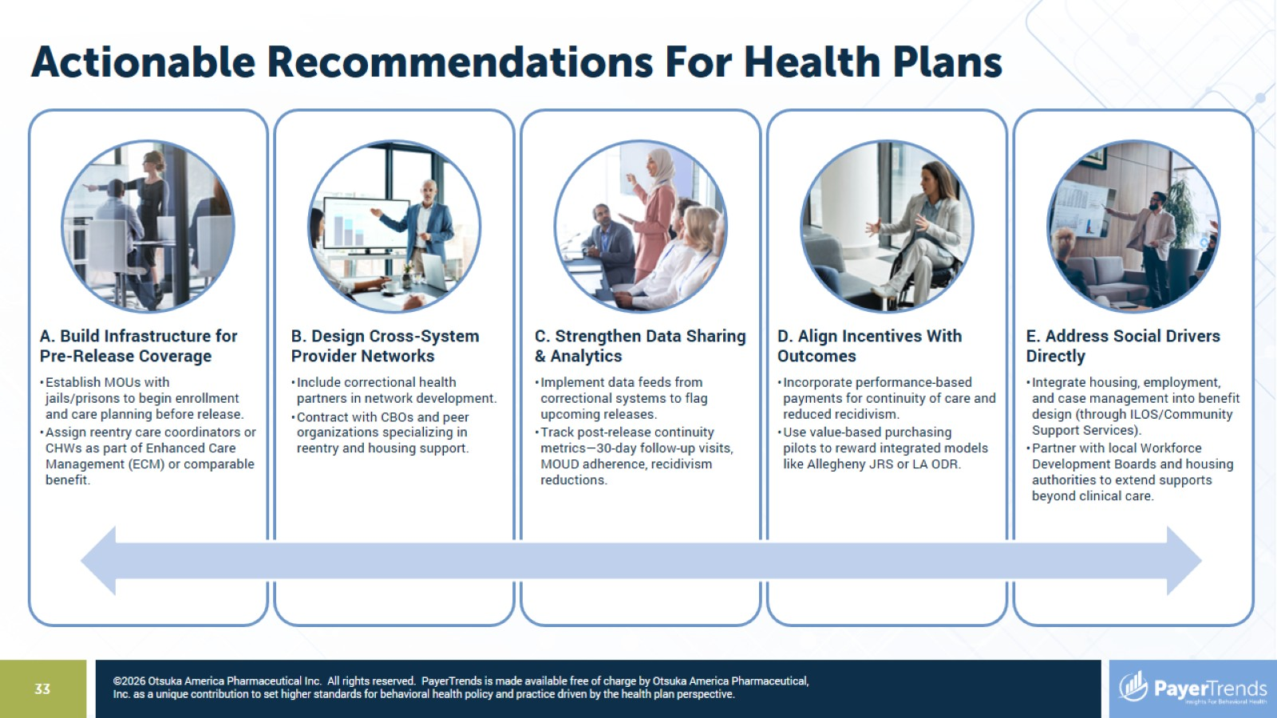
Actionable Recommendations For Health Plans

Slide 34
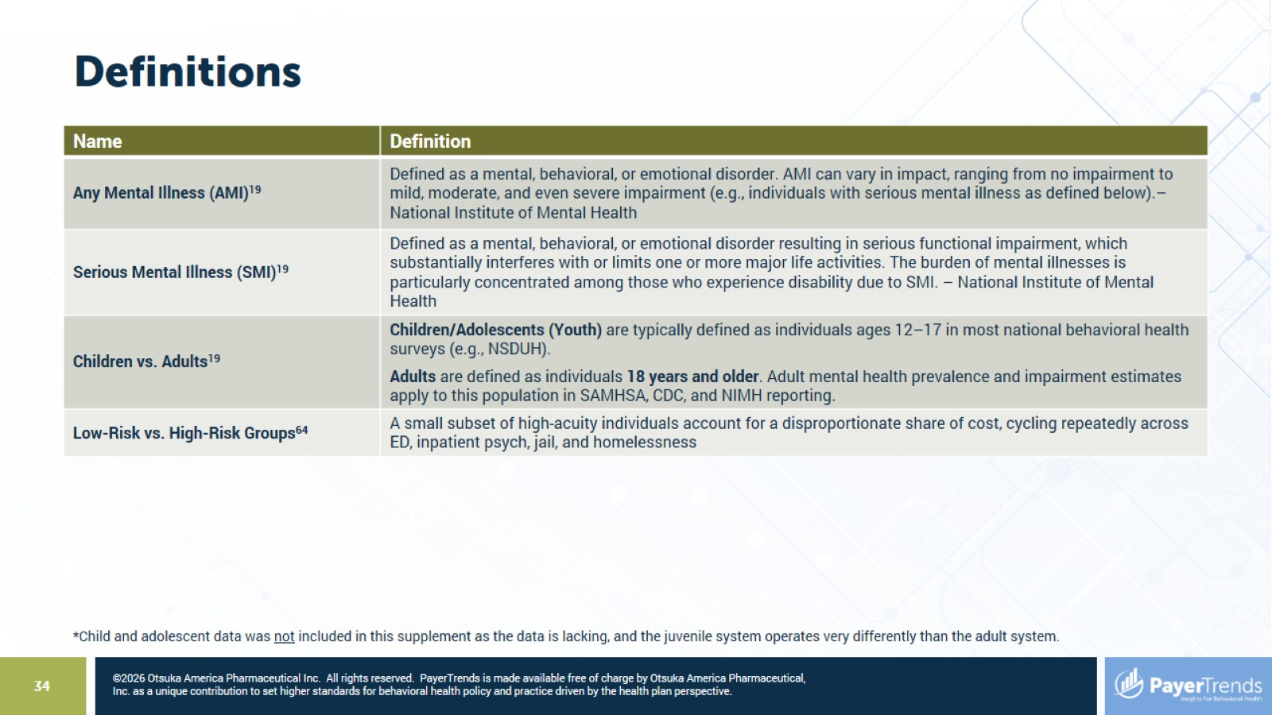
Definitions

Slide 35
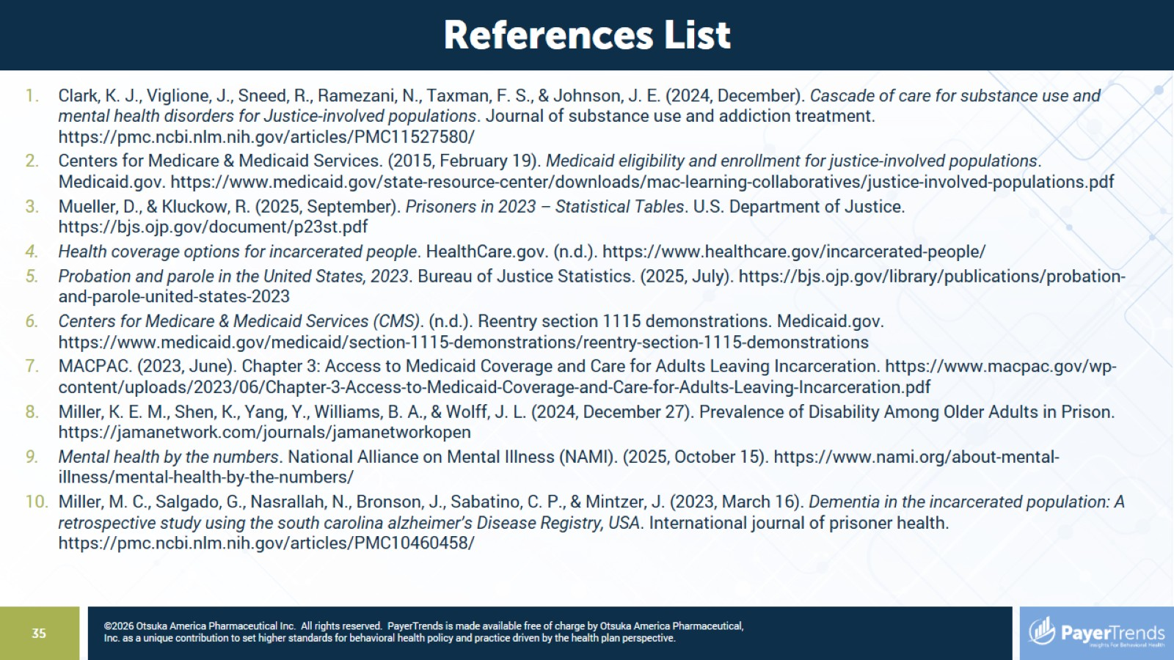

Slide 36
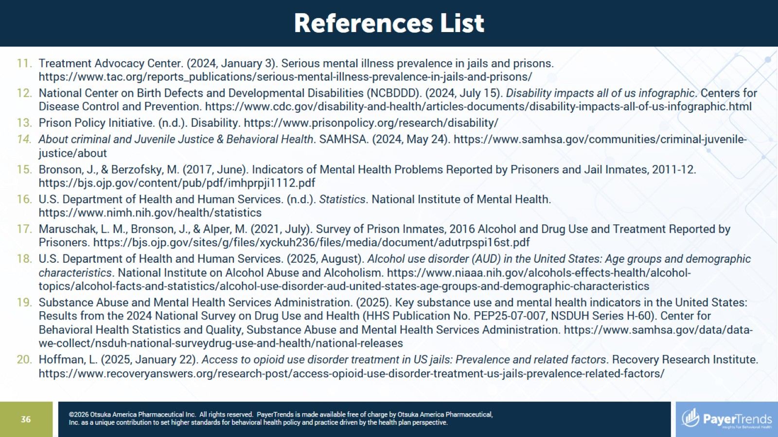

Slide 37
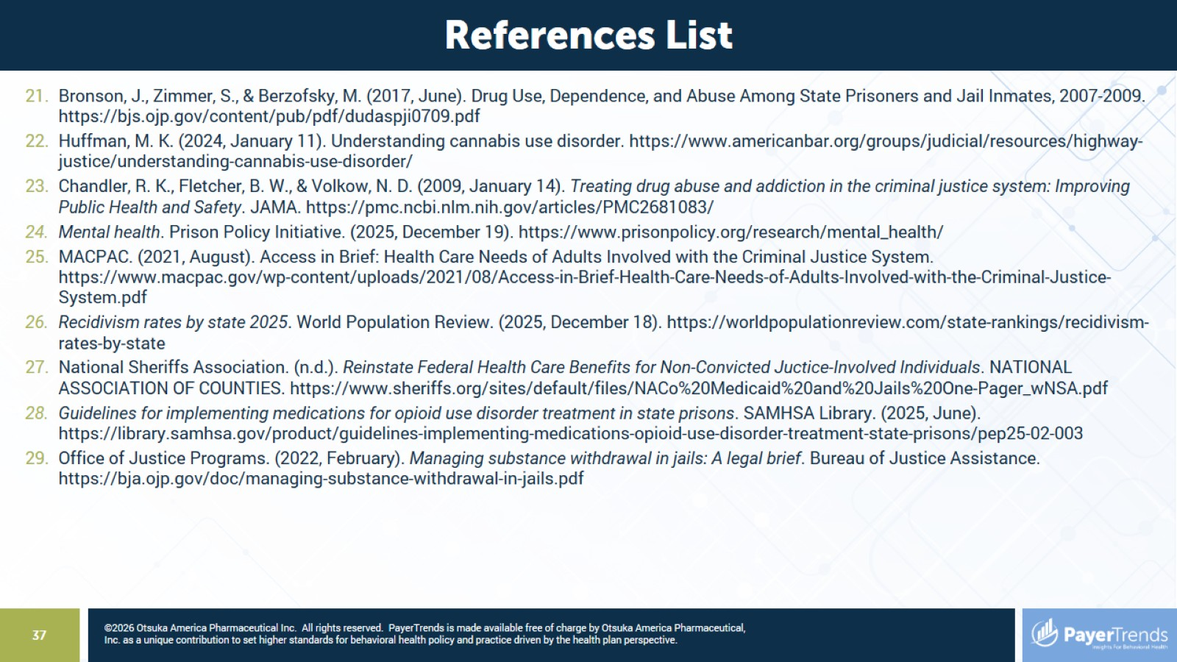

Slide 38
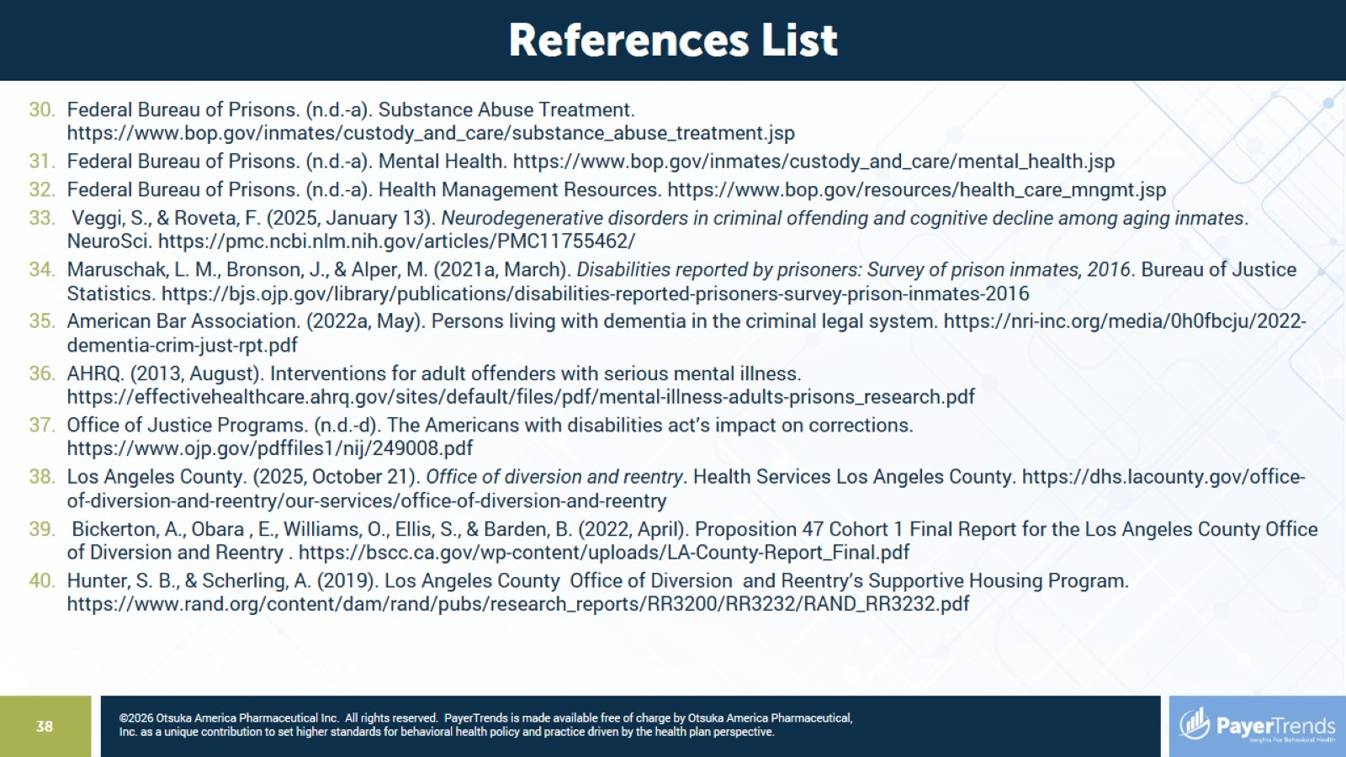

Slide 39
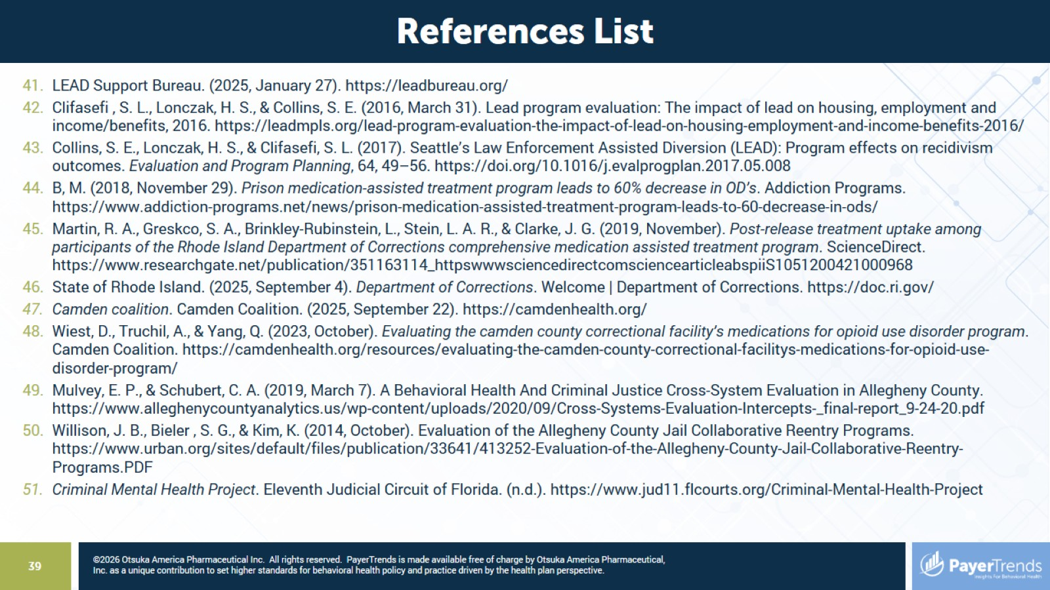

Slide 40
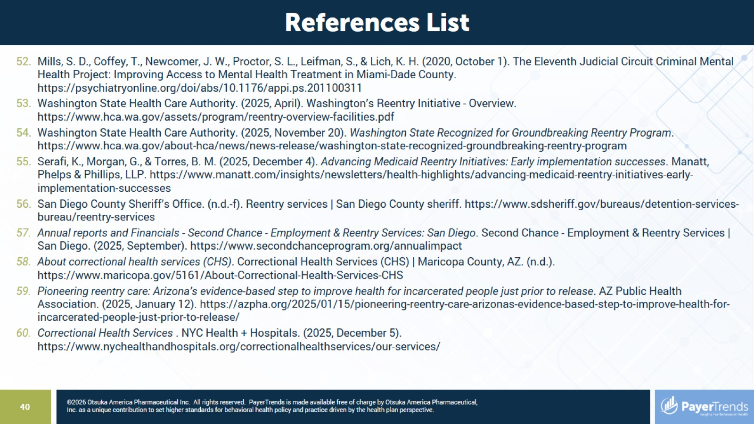

Slide 41
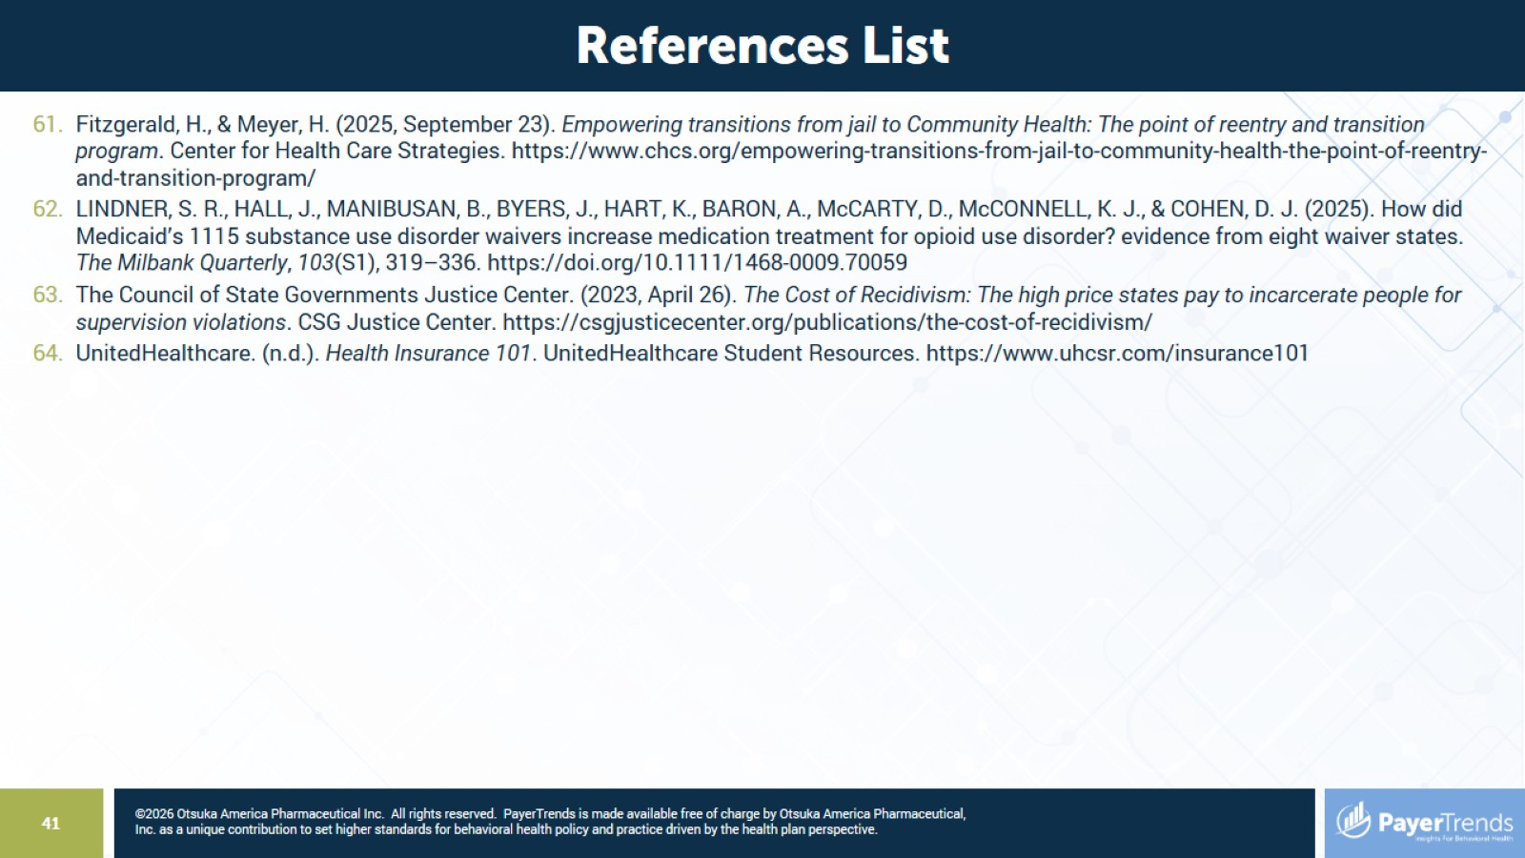

Slide 42


