Slide 1


Slide 2
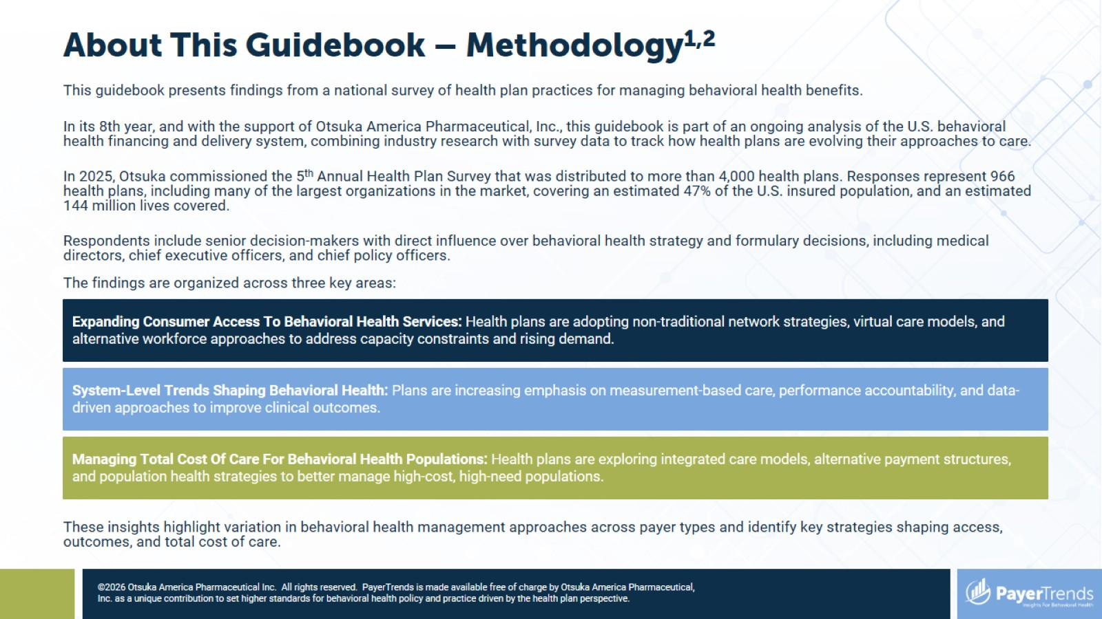
About This Guidebook – Methodology^{1,2}

Slide 3
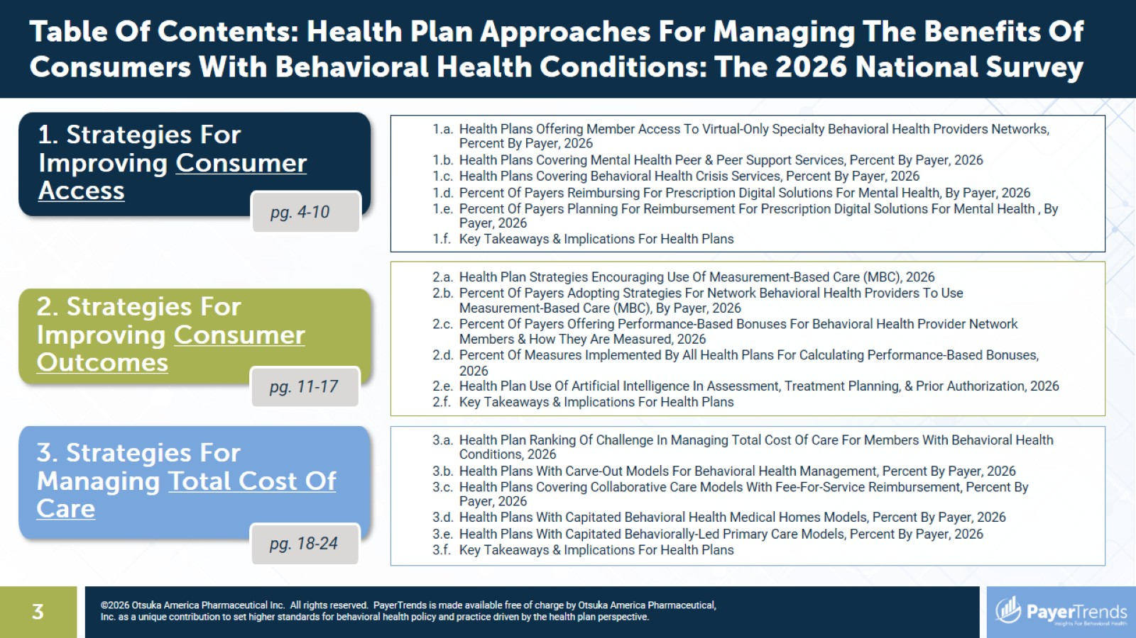

Slide 4


Slide 5
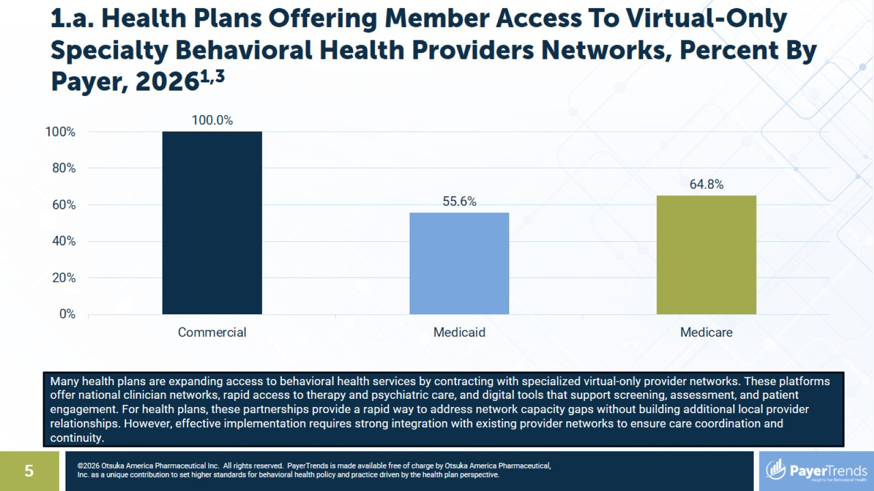
1.a. Health Plans Offering Member Access To Virtual-Only Specialty Behavioral Health Providers Networks, Percent By Payer, 2026^{1,3}

Slide 6
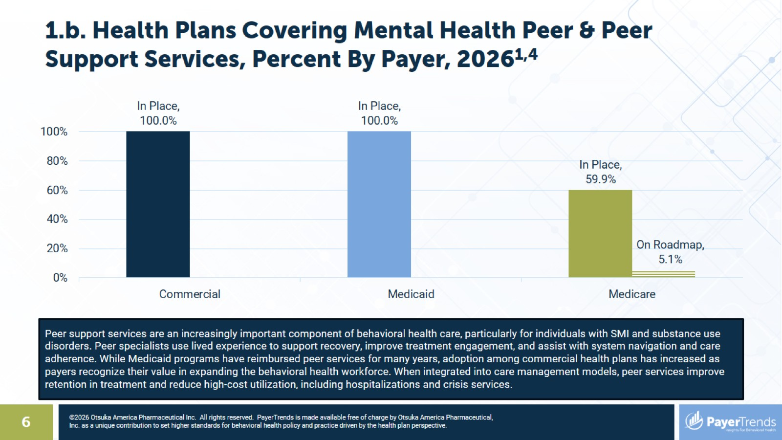
1.b. Health Plans Covering Mental Health Peer & Peer Support Services, Percent By Payer, 2026^{1,4}

Slide 7
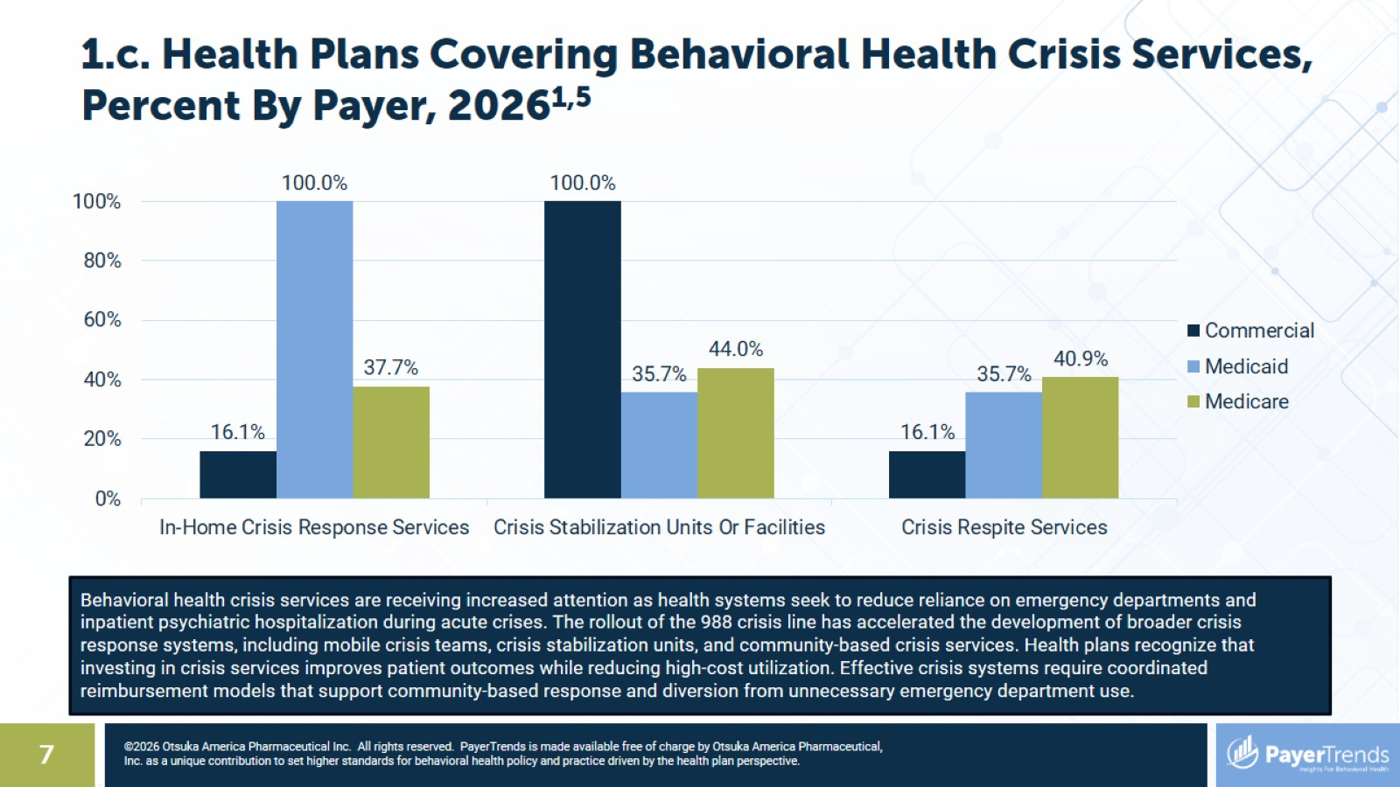
1.c. Health Plans Covering Behavioral Health Crisis Services, Percent By Payer, 2026^{1,5}

Slide 8
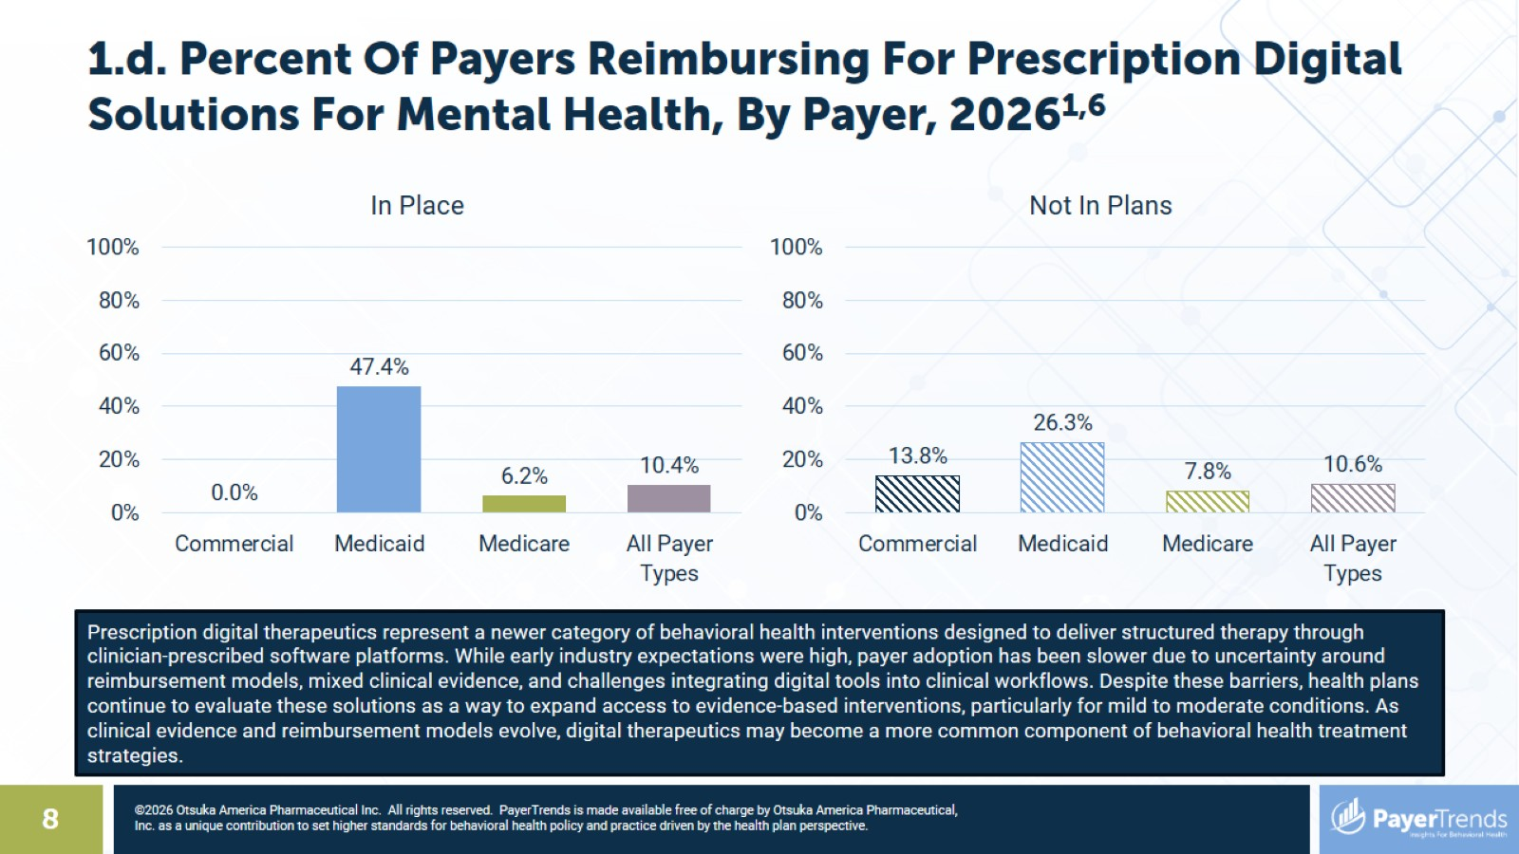
1.d. Percent Of Payers Reimbursing For Prescription Digital Solutions For Mental Health, By Payer, 2026^{1,6}

Slide 9
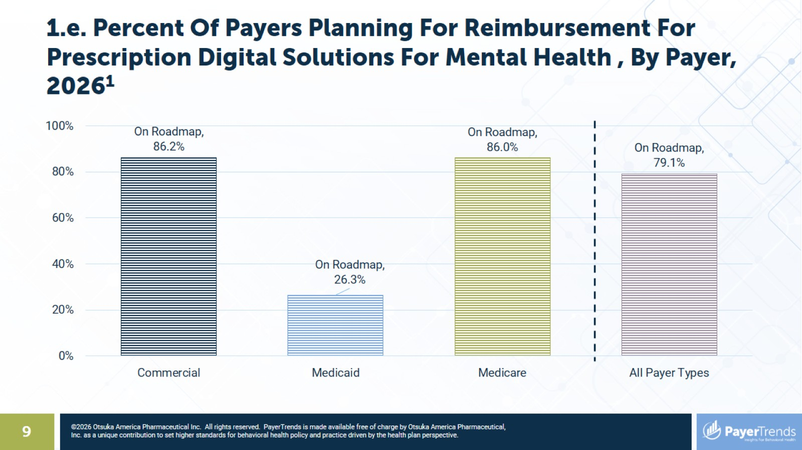
1.e. Percent Of Payers Planning For Reimbursement For Prescription Digital Solutions For Mental Health , By Payer, 2026¹

Slide 10
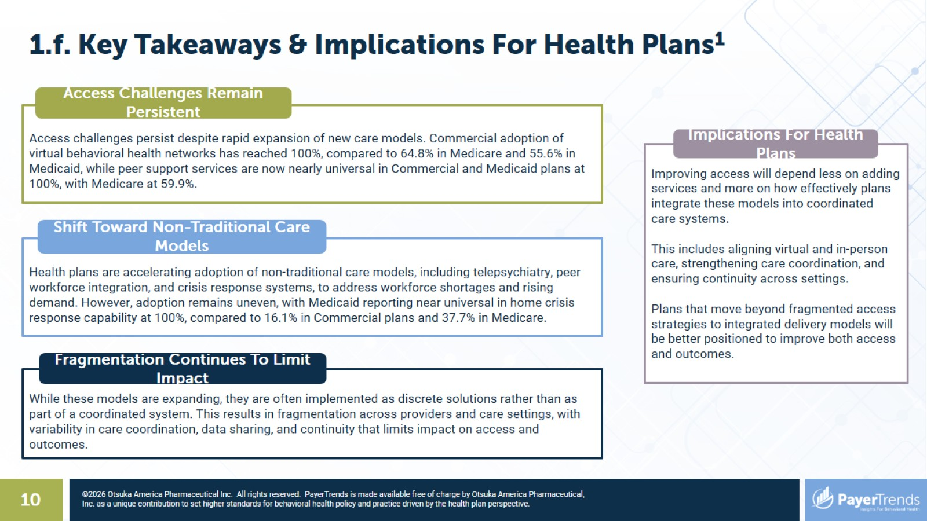

Slide 11


Slide 12
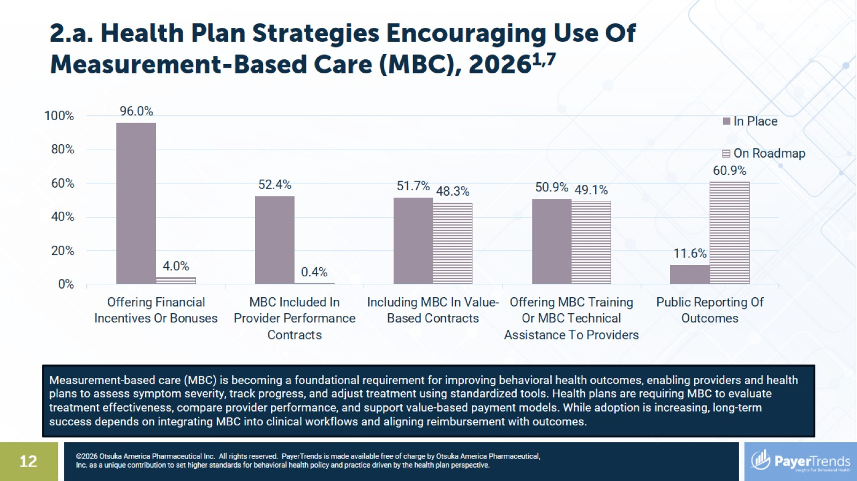
2.a. Health Plan Strategies Encouraging Use Of Measurement-Based Care (MBC), 2026^{1,7}

Slide 13
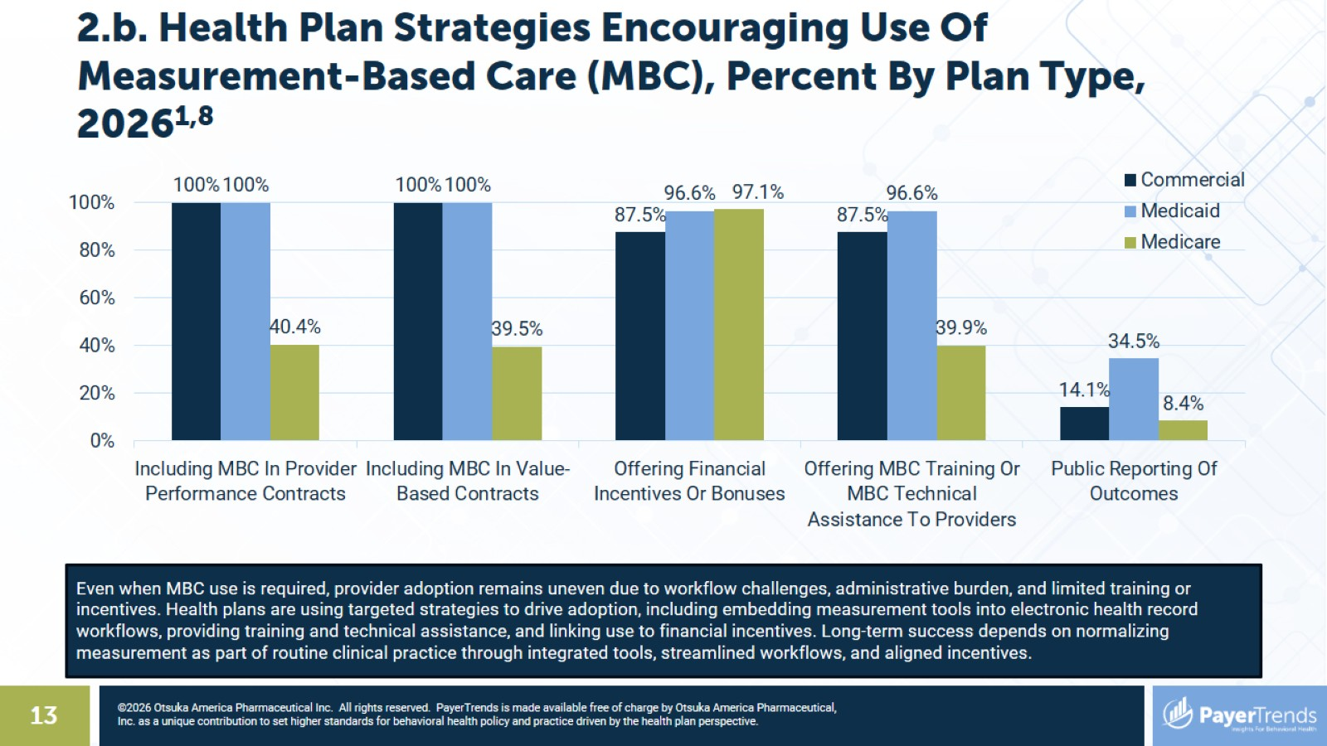
2.b. Health Plan Strategies Encouraging Use Of Measurement-Based Care (MBC), Percent By Plan Type, 2026^{1,8}

Slide 14
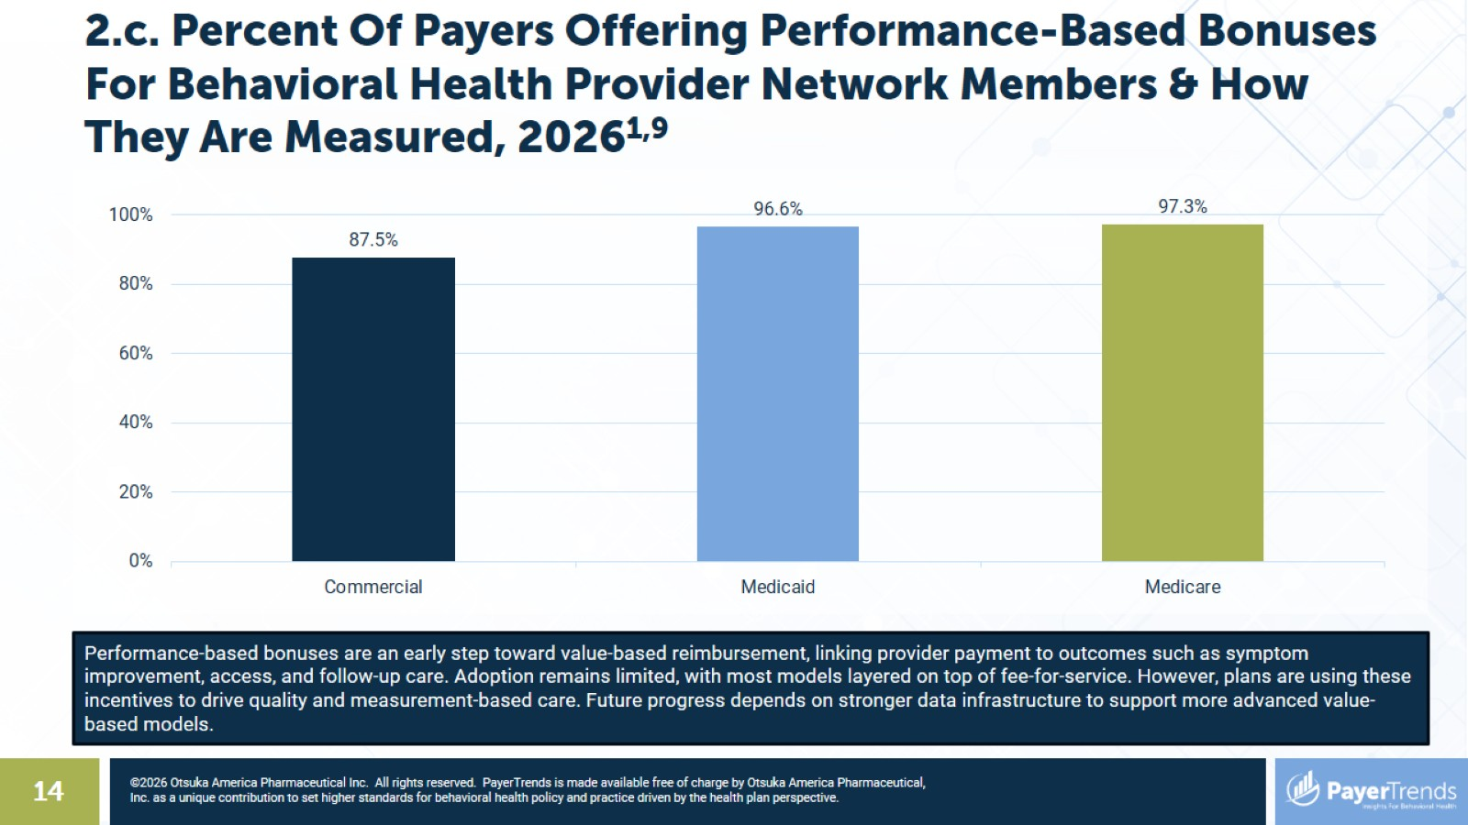
2.c. Percent Of Payers Offering Performance-Based Bonuses For Behavioral Health Provider Network Members & How They Are Measured, 2026^{1,9}

Slide 15
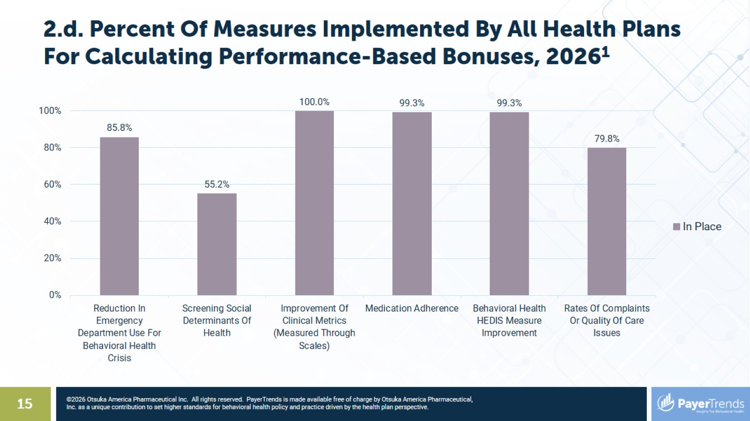
2.d. Percent Of Measures Implemented By All Health Plans For Calculating Performance-Based Bonuses, 2026¹

Slide 16
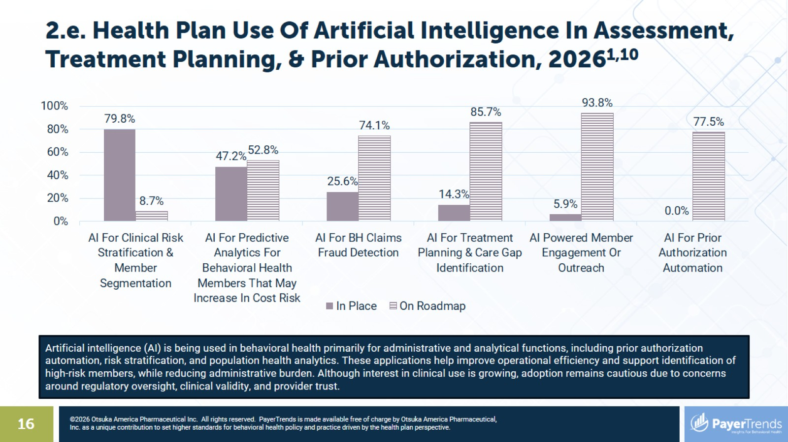
2.e. Health Plan Use Of Artificial Intelligence In Assessment, Treatment Planning, & Prior Authorization, 2026^{1,10}

Slide 17
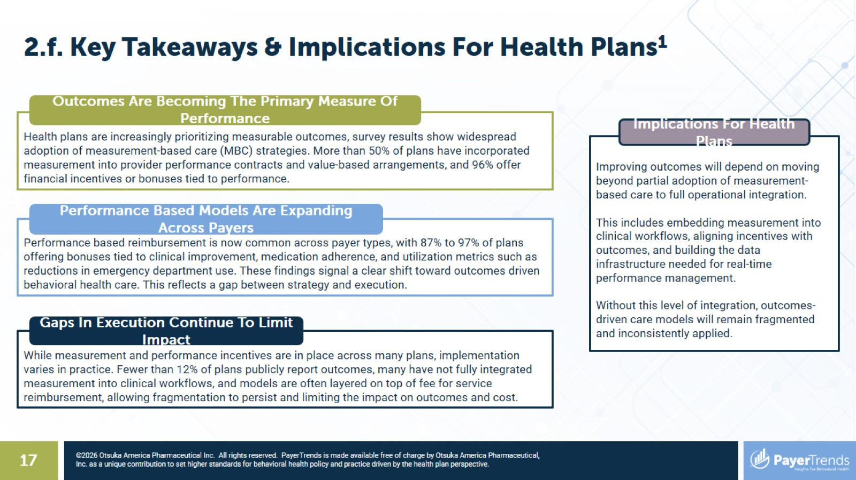

Slide 18
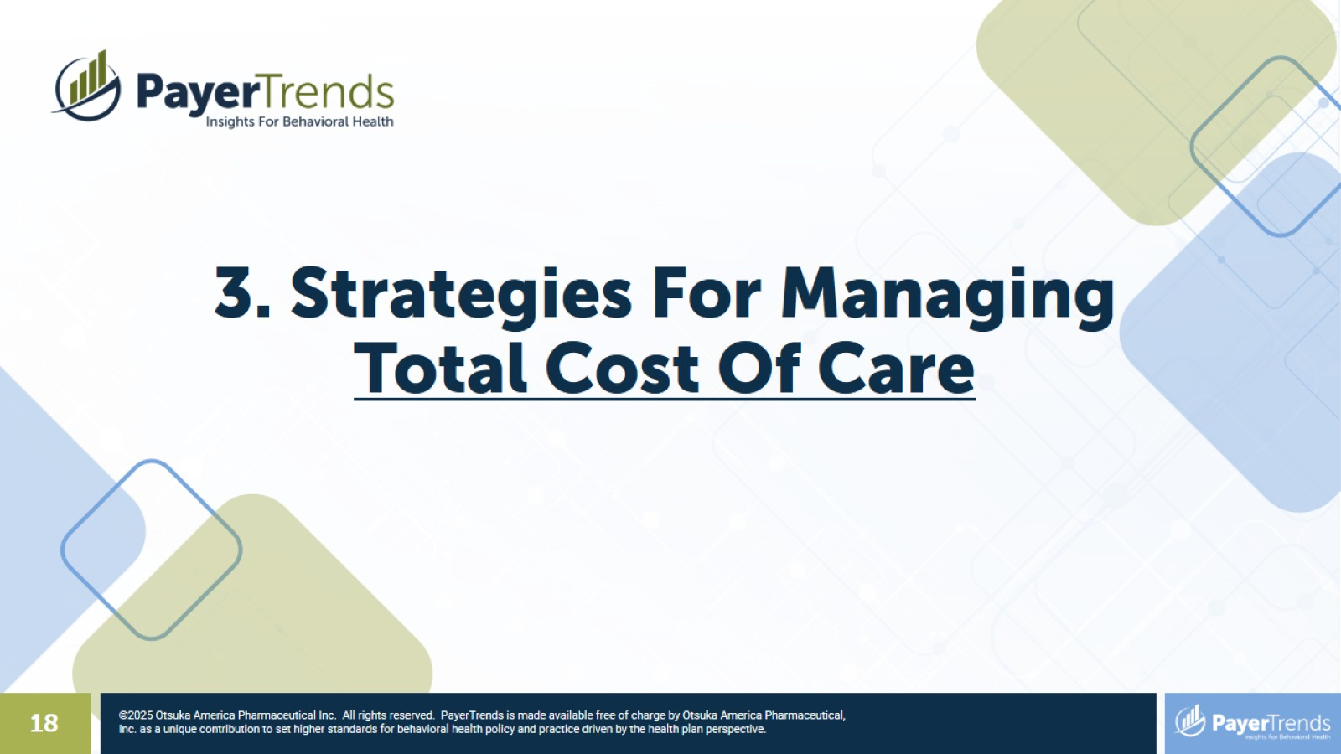

Slide 19
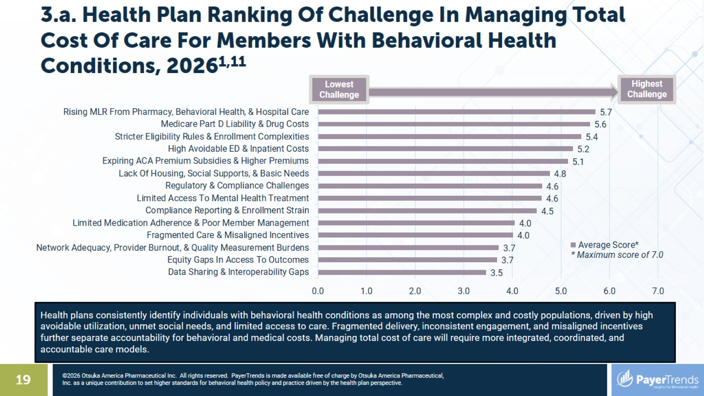
3.a. Health Plan Ranking Of Challenge In Managing Total Cost Of Care For Members With Behavioral Health Conditions, 2026^{1,11}

Slide 20
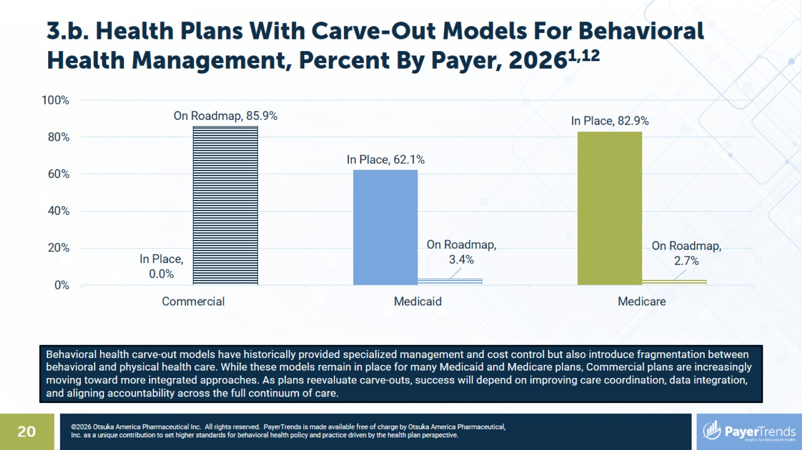
3.b. Health Plans With Carve-Out Models For Behavioral Health Management, Percent By Payer, 2026^{1,12}

Slide 21
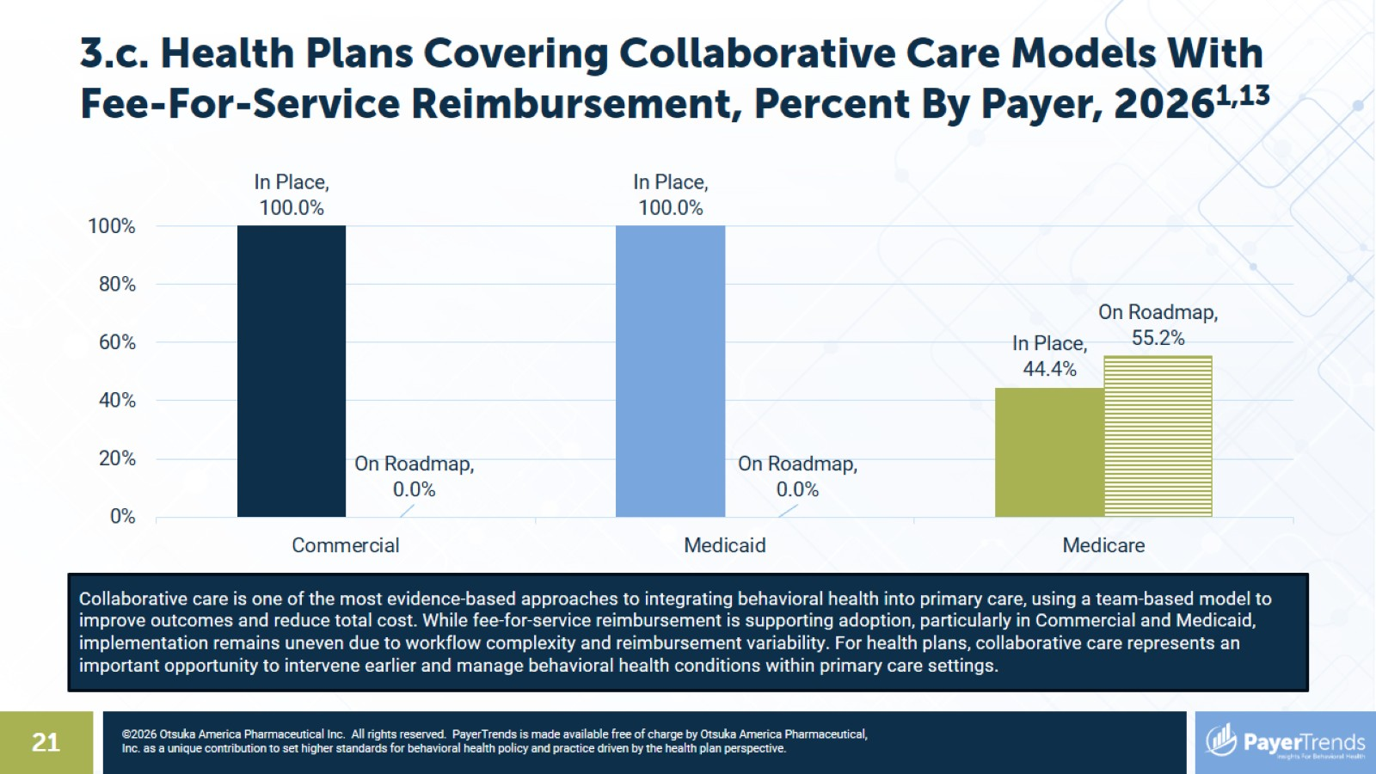
3.c. Health Plans Covering Collaborative Care Models With Fee-For-Service Reimbursement, Percent By Payer, 2026^{1,13}

Slide 22
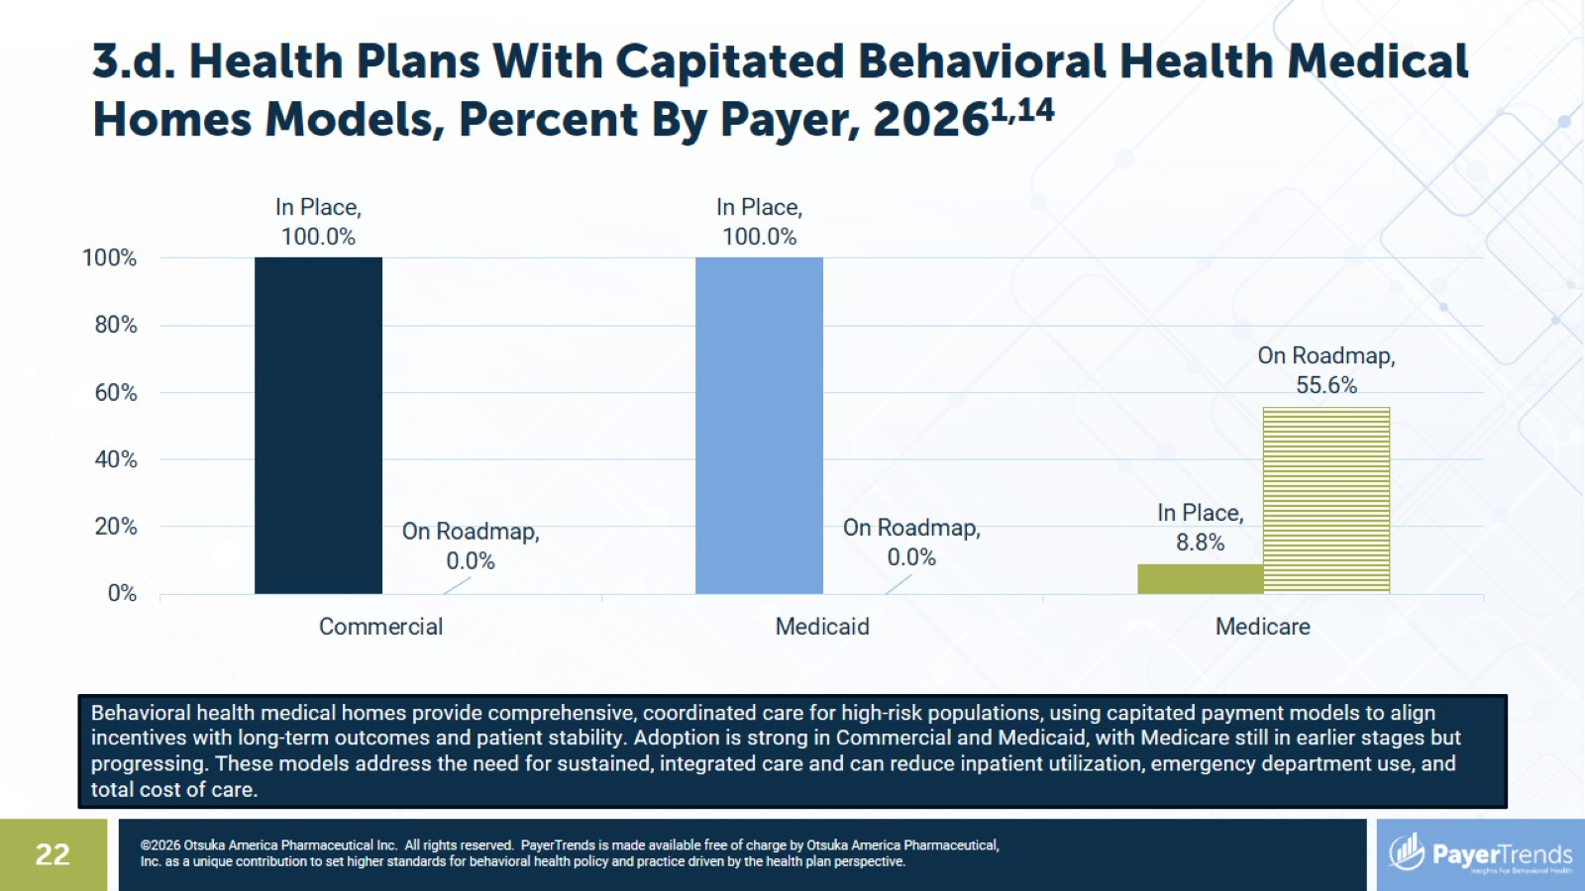
3.d. Health Plans With Capitated Behavioral Health Medical Homes Models, Percent By Payer, 2026^{1,14}

Slide 23
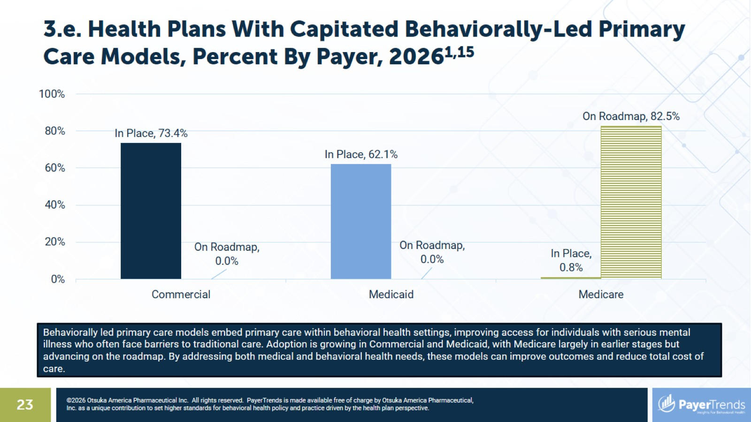
3.e. Health Plans With Capitated Behaviorally-Led Primary Care Models, Percent By Payer, 2026^{1,15}

Slide 24
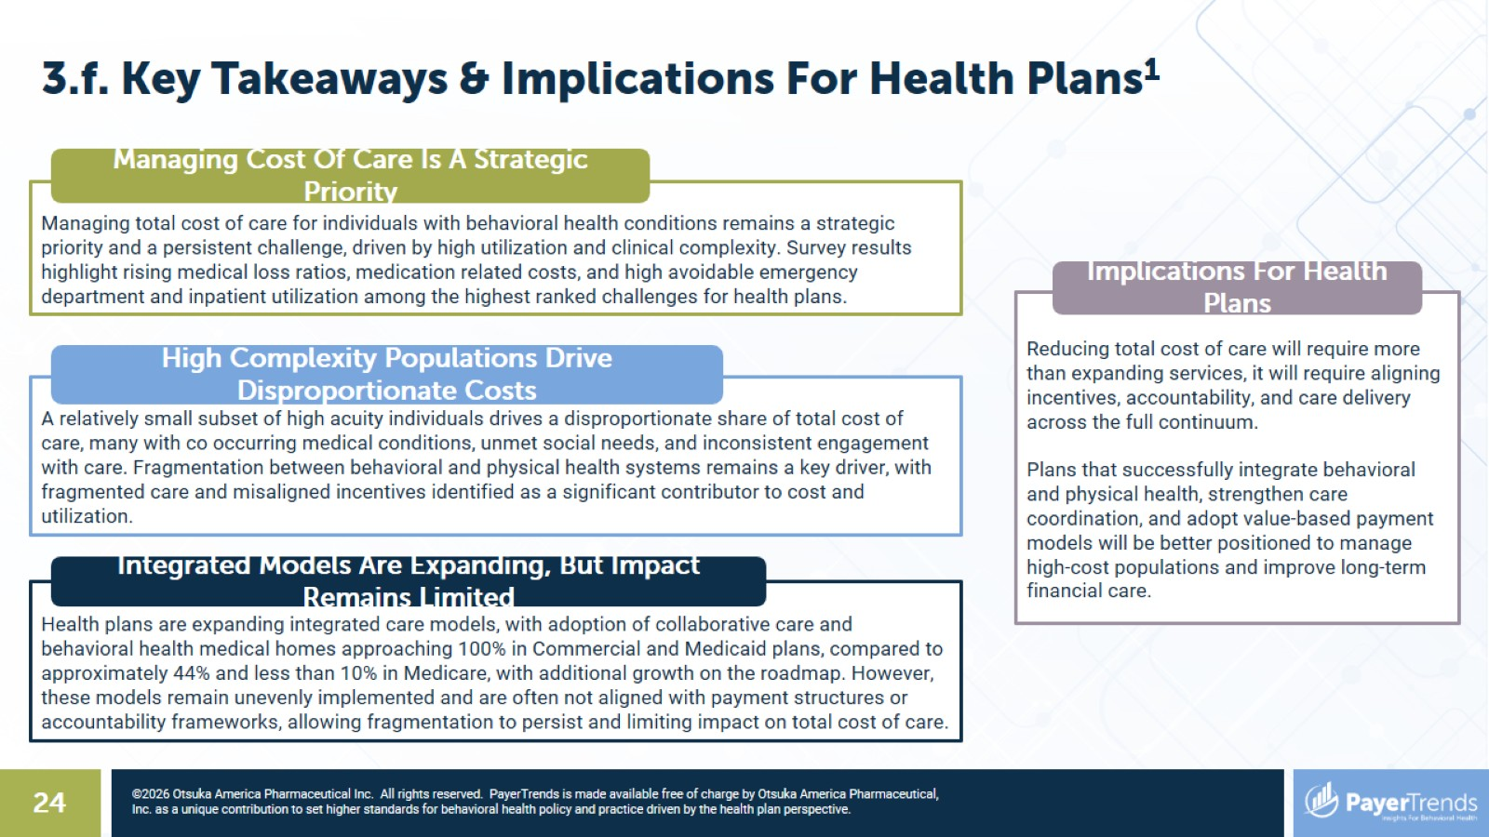

Slide 25
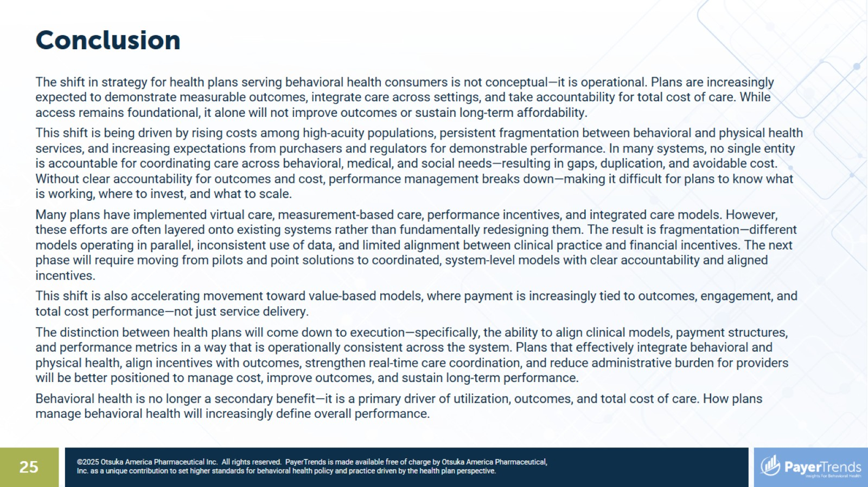
Conclusion

Slide 26
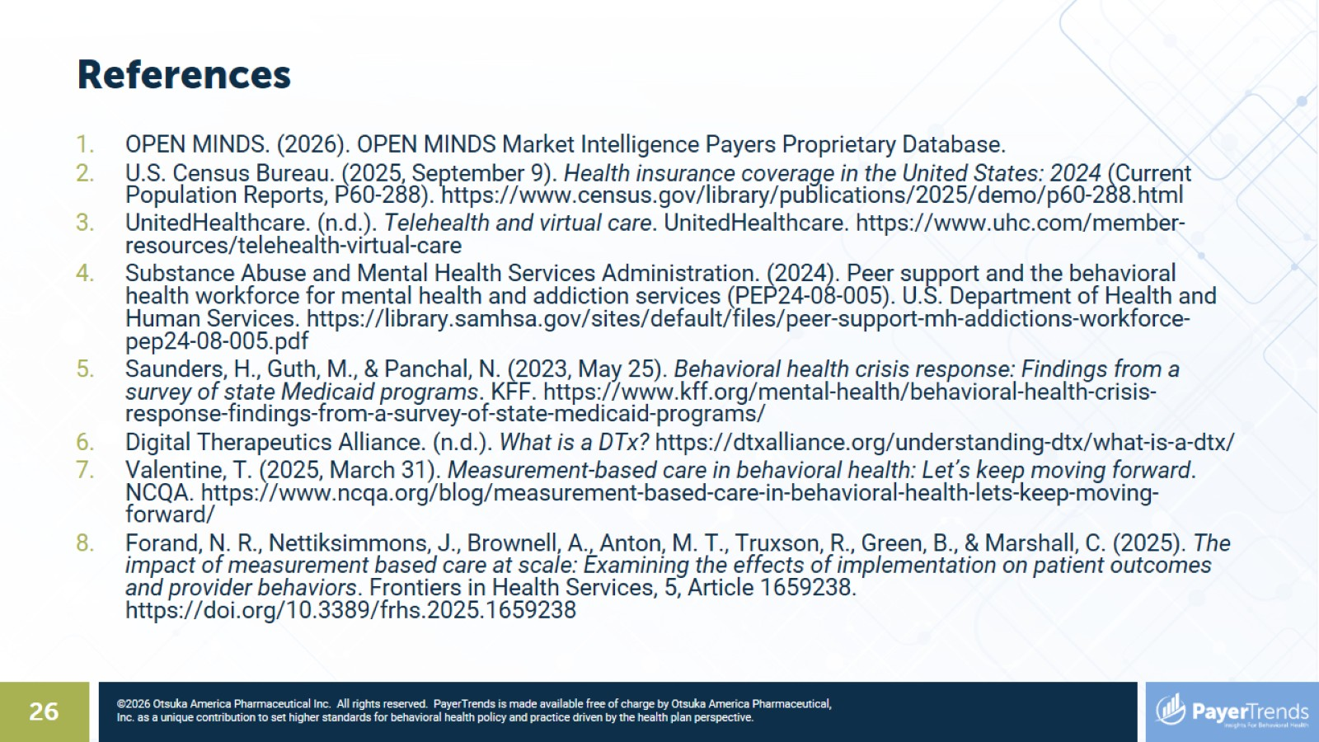
References

Slide 27
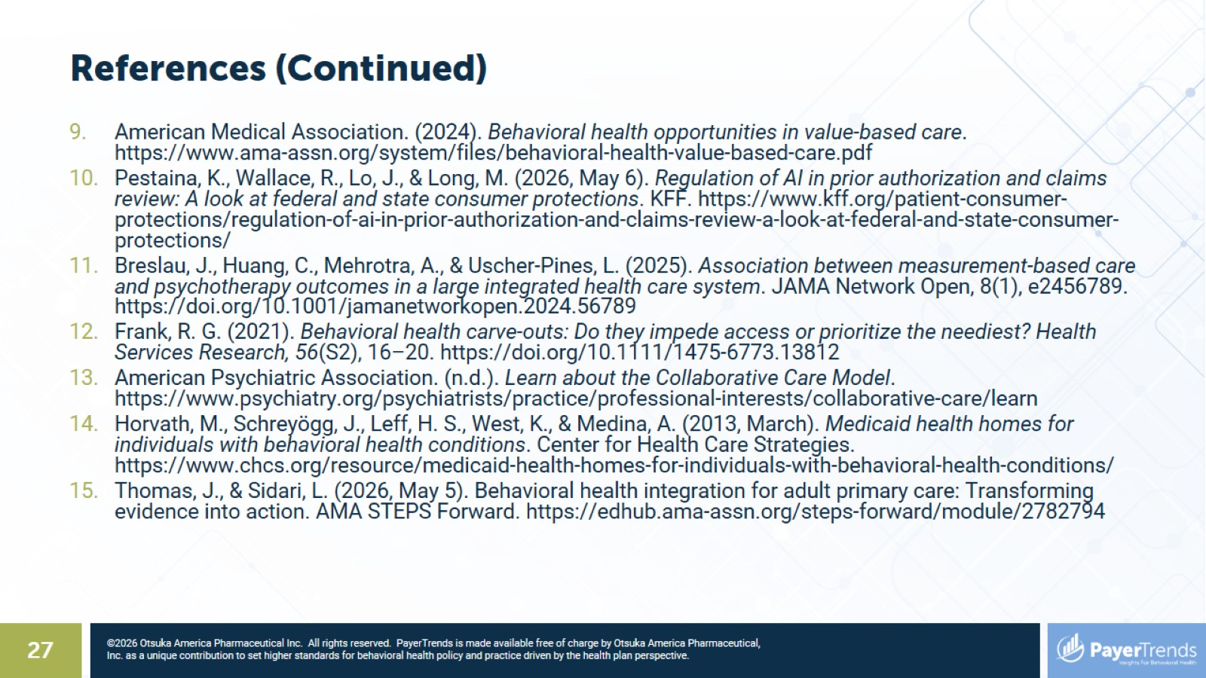
References (Continued)

Slide 28


