Slide 1
2026 PayerTrends Behavioral Health Guidebook
Volume One: Key Trends In Behavioral Health Treatment Demand, Cost & Delivery
Trends Shaping Behavioral Health Cost, Capacity, & Performance
May 2026 00US26EUA0011

Slide 2



Slide 3


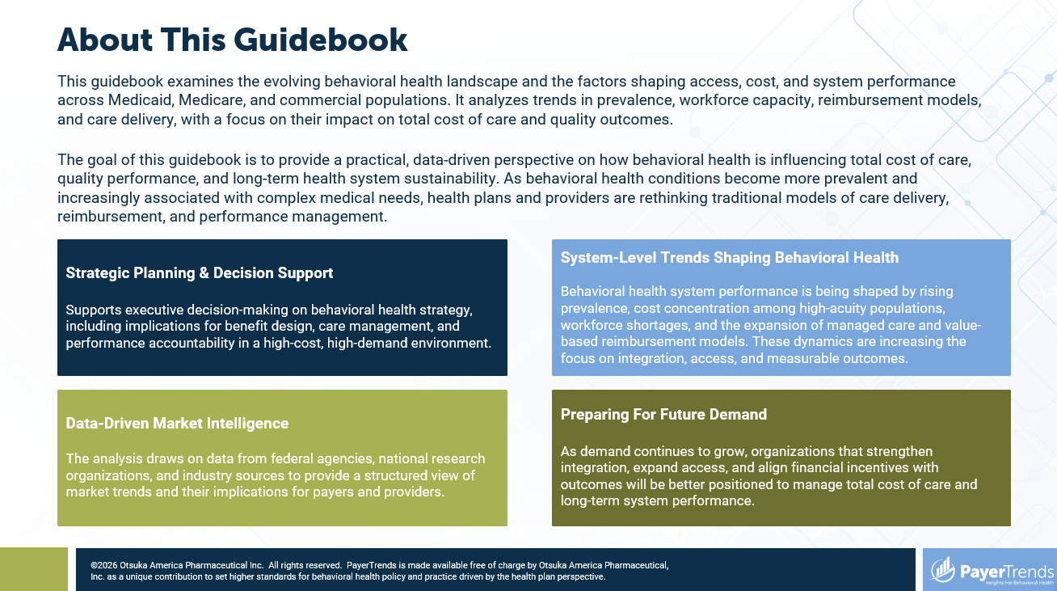
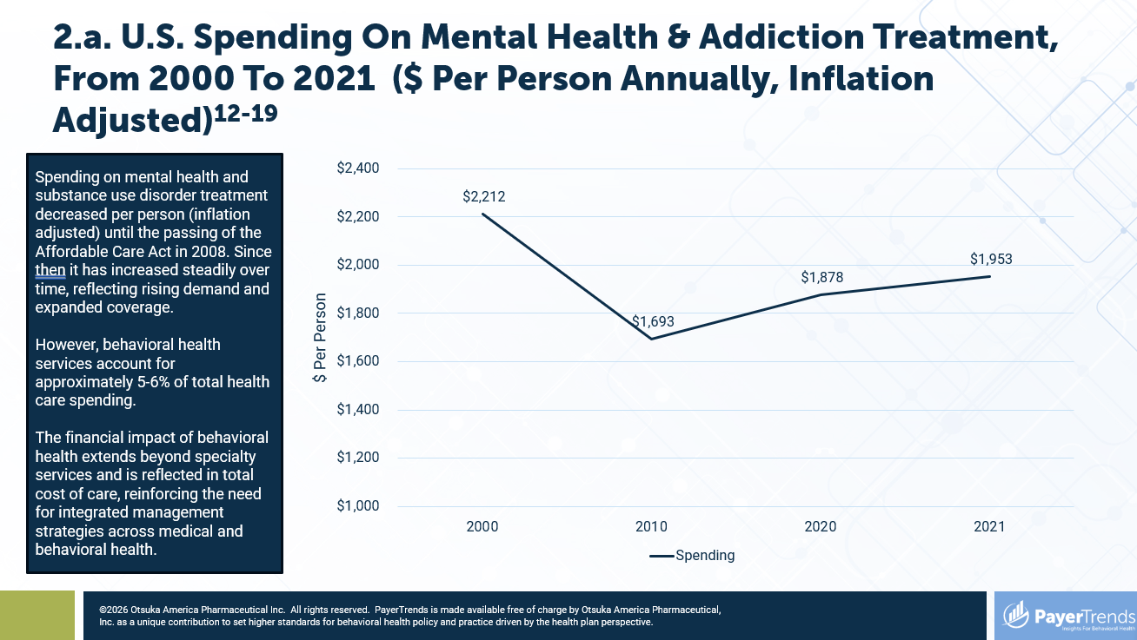
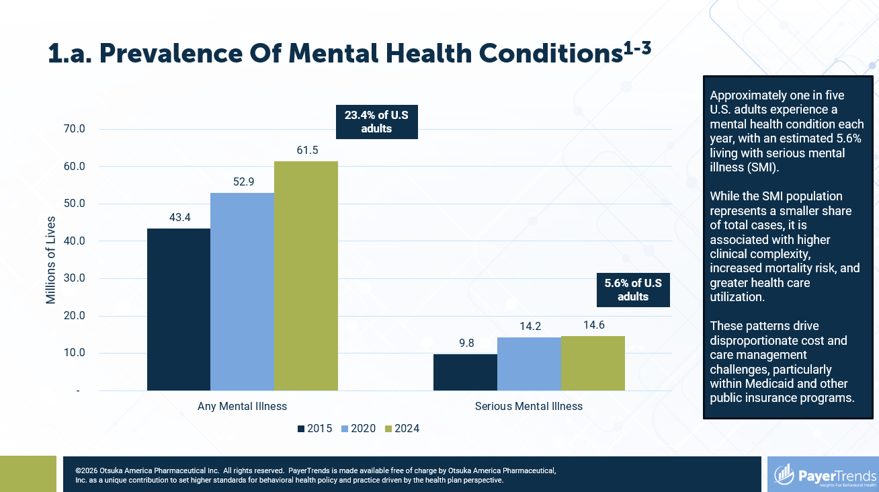
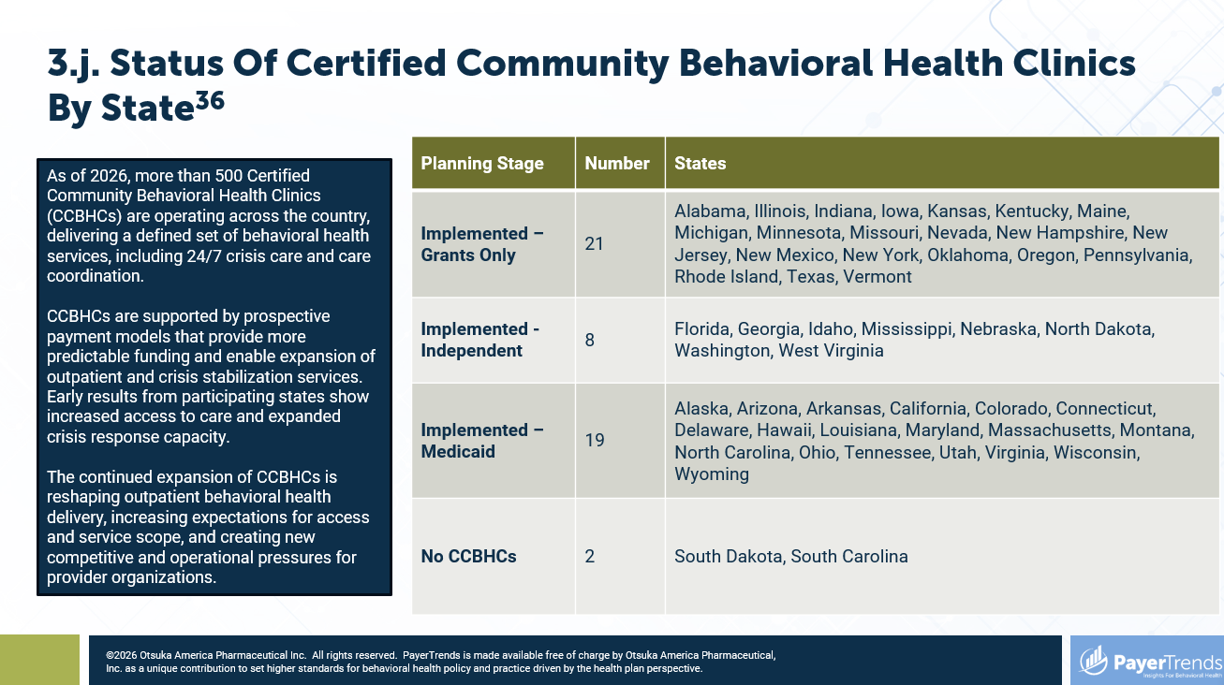

Slide 4
About This Guidebook
This guidebook examines the evolving behavioral health landscape and the factors shaping access, cost, and system performance across Medicaid, Medicare, and commercial populations. It analyzes trends in prevalence, workforce capacity, reimbursement models, and care delivery, with a focus on their impact on total cost of care and quality outcomes.
The goal of this guidebook is to provide a practical, data-driven perspective on how behavioral health is influencing total cost of care, quality performance, and long-term health system sustainability. As behavioral health conditions become more prevalent and increasingly associated with complex medical needs, health plans and providers are rethinking traditional models of care delivery, reimbursement, and performance management.
Strategic Planning & Decision Support
Supports executive decision-making on behavioral health strategy, including implications for benefit design, care management, and performance accountability in a high-cost, high-demand environment.
System-Level Trends Shaping Behavioral Health
Behavioral health system performance is being shaped by rising prevalence, cost concentration among high-acuity populations, workforce shortages, and the expansion of managed care and value-based reimbursement models. These dynamics are increasing the focus on integration, access, and measurable outcomes.
Data-Driven Market Intelligence
The analysis draws on data from federal agencies, national research organizations, and industry sources to provide a structured view of market trends and their implications for payers and providers.
Preparing For Future Demand
As demand continues to grow, organizations that strengthen integration, expand access, and align financial incentives with outcomes will be better positioned to manage total cost of care and long-term system performance.

Slide 5
Table Of Contents
Key Trends In Behavioral Health Treatment Demand, Cost & Delivery
1. The Changing Prevalence Of Behavioral Health Conditions & The Demand For Services
  1.a. Prevalence Of Mental Health Conditions
  1.b. Prevalence Of Mental Health Conditions In Youth
  1.c. Prevalence Of Mental Health Conditions In The 50+ Population
  1.d. Unmet Treatment Needs For Mental Illness Measured As U.S. Adults Who Reported Seeking Or Thinking They Needed Treatment But Not Receiving It
pg. 6-10
2. The Cost Of Care & The Impact Of Behavioral Health Conditions On Total Cost Of Care
2.a. U.S. Spending On Mental Health & Addiction Treatment, From 2000 To 2021
2.b. U.S. Spending On Mental Health & Addiction Treatment, From 2015 To 2024 By Payer
2.c. Estimated Medicare Spending On Mental Health & Addiction Treatment, From 2015 To 2024
2.d. Estimated Medicaid Spending On Mental Health & Addiction Treatment, From 2015 To 2024
2.e. Estimated Commercial Spending On Mental Health & Addiction Treatment, From 2015 To 2024
2.f. Annual Total Cost Of Care With Behavioral Health Comorbidity By Age
2.g. Behavioral Health Impact On High-Cost & Non-High-Cost Groups For Health Plans
pg. 11-18
Table of Contents continued on next page.

Slide 6
Table Of Contents (Continued)
Key Trends In Behavioral Health Treatment Demand, Cost & Delivery
3. U.S. Behavioral Health Service System Design & Performance
  3.a. Insured Population In Managed Care Plans, Percent, By Payer Type
  3.b. Mental Health Parity Act: Impact On Behavioral Health Services Claims From 2007 To 2017
  3.c. NCQA Requirements For Behavioral Health
  3.d. HEDIS Behavioral Health Electronic Reporting Requirements
  3.e. CMS Regulatory Requirements For Behavioral Health
  3.f. Medicare Behavioral Health Coverage: Covered Benefits
  3.g. State Medicaid Plans With Value-Based Purchasing Mandates That Include Behavioral Health
  3.h. State Medicaid Plans With Value-Based Purchasing Mandates That Include Behavioral Health – Included & Partial Behavioral Health Mandates
  3.i. State Medicaid Plans With Value-Based Purchasing Mandates That Include Behavioral Health – Explicit Behavioral Health Mandates
  3.j. Status Of Certified Community Behavioral Health Clinics By State
  3.k. Medicaid Reimbursement For Peer Support Services Across States
pg. 19-31
4. Workforce Challenges: Closing The Behavioral Health Capacity Gap
  4.a. Number Of Psychiatrists & Mental Health Specialist Prescribers, Total & Per 100,000 Population, 2026
  4.b. Number Of Behavioral Health Therapists, Total & Per 100,000 Population, 2026
  4.c. Practices & Technologies As Workforce Extenders
  4.d. Peer Support
  4.e. Telehealth Availability By Type Of Service, 2024
  4.f. Remote Monitoring
  4.g. Digital Therapeutics
  4.h. AI-Enabled Documentation Support, 2025
pg. 32-40

Slide 7
A Look Inside
1. The Changing Prevalence Of Behavioral Health Conditions & The Demand For Services
3. U.S. Behavioral Health Service System Design & Performance
pg. 6-10
pg. 19-31
2. The Cost Of Care & The Impact Of Behavioral Health Conditions On Total Cost Of Care
4. Workforce Challenges: Closing The Behavioral Health Capacity Gap
pg. 11-18
pg. 32-40

Slide 8
Executive Summary
System performance remains uneven, with variation in follow-up care, care coordination, crisis response capacity, and adoption of value-based reimbursement models. Policy initiatives, including CCBHCs and integrated care models, are advancing standardization, but implementation maturity varies across regions.
These dynamics are compounded by persistent workforce shortages, particularly in rural and Medicaid-dominant markets. In response, payers and providers are adopting technology-enabled models, including telebehavioral health, measurement-based care, AI-assisted documentation, digital therapeutics, and remote monitoring.
Across payer types, cost concentration is increasingly driven by members with complex medical and behavioral health needs. Individuals with serious mental illness and substance use disorders experience higher utilization, lower medication adherence, and disproportionate spending.
The behavioral health market is undergoing a structural shift, driven by rising prevalence across youth, working-age adults, and older populations, along with persistent workforce constraints. Increasing cost concentration among high-acuity cohorts is reshaping how payers, providers, and policymakers approach system design.

Slide 9
1. The Changing Prevalence Of Behavioral Health Conditions & The Demand For Services

Slide 10
1.a. Prevalence Of Mental Health Conditions¹⁻³
Approximately one in five U.S. adults experience a mental health condition each year, with an estimated 5.6% living with serious mental illness (SMI).
While the SMI population represents a smaller share of total cases, it is associated with higher clinical complexity, increased mortality risk, and greater health care utilization.
These patterns drive disproportionate cost and care management challenges, particularly within Medicaid and other public insurance programs.
23.4% of U.S adults
5.6% of U.S adults

Slide 11
1.b. Prevalence Of Mental Health Conditions In Youth⁴⁻⁹
Approximately one in five youth ages 12 to 17 experience a mental disorder each year.
The most common conditions include anxiety disorders (approximately 11%), behavioral disorders including ADHD (approximately 8–11%), and depression (approximately 4%).
Indicators of youth distress are high, with 42% of high school students reporting persistent feelings of sadness or hopelessness in 2021.
*Major Depressive Episode with severe impairment

Slide 12
1.c. Prevalence Of Mental Health Conditions In The 50+ Population^{3,6,7,10,11}
Approximately one in seven adults age 50 and older experience a mental health condition often alongside chronic medical illness.
The most prevalent conditions include depression and anxiety disorders, followed by cognitive disorders such as Alzheimer’s disease and related dementias.
Substance use disorders, particularly alcohol use, are also increasing among older adults and contributing to growing clinical complexity.

Slide 13
1.d. Unmet Treatment Needs For Mental Illness^{3,6,7}
Measured As U.S. Adults Who Reported Seeking Or Thinking They Needed Treatment But Not Receiving It
Unmet need refers to individuals with a mental health condition who do not receive treatment, often due to barriers such as cost, provider shortages, coverage limitations, or geographic access challenges.
The population has declined, over 20% of adults with a mental health condition, more than 15 million individuals, still do not receive treatment, reflecting persistent access gaps.

Slide 14
2. The Cost Of Care & The Impact Of Behavioral Health Conditions On Total Cost Of Care

Slide 15
2.a. U.S. Spending On Mental Health & Addiction Treatment, From 2000 To 2021 ($ Per Person Annually, Inflation Adjusted)¹²⁻¹⁹
Spending on mental health and substance use disorder treatment decreased per person (inflation adjusted) until the passing of the Affordable Care Act in 2008. Since then it has increased steadily over time, reflecting rising demand and expanded coverage.
However, behavioral health services account for approximately 5-6% of total health care spending.
The financial impact of behavioral health extends beyond specialty services and is reflected in total cost of care, reinforcing the need for integrated management strategies across medical and behavioral health.

Slide 16
2.b. U.S. Spending On Mental Health & Addiction Treatment, From 2015 To 2024 By Payer¹³⁻¹⁹

Slide 17
2.c. Estimated Medicare Spending On Mental Health & Addiction Treatment, From 2015 To 2024 ($ Per Member Annually, Inflation Adjusted)¹³⁻¹⁷
Medicare behavioral health spending reflects sustained growth in utilization as coverage expands across an aging population with increasing clinical complexity.
With Medicare enrollment exceeding 65 million beneficiaries, behavioral health represents a growing component of total cost of care.
For health plans, this increases exposure to utilization-driven cost growth and reinforces the need to manage outcomes, reduce avoidable acute care use, and improve performance in value-based arrangements.

Slide 18
2.d. Estimated Medicaid Spending On Mental Health & Addiction Treatment, From 2015 To 2024 ($ Per Member Annually, Inflation Adjusted)^{13-16,18}
Medicaid behavioral health spending is shaped by the concentration of high-need populations, including individuals with serious mental illness and substance use disorders, whose care requires higher service intensity and coordination.
Variability in enrollment mix and utilization drives fluctuations in per-member spending.
For health plans, this underscores the need for targeted care management, integrated service delivery, and strategies that address both clinical complexity and social drivers of health to manage total cost of care.

Slide 19
2.e. Estimated Commercial Spending On Mental Health & Addiction Treatment, From 2015 To 2024 ($ Per Member Annually, Inflation Adjusted)^{13-16,19}
Commercial behavioral health spending is driven by benefit design, network structure, and cost-sharing strategies within employer-sponsored coverage.
With employer-sponsored insurance covering nearly half of the U.S. population, these levers play a central role in shaping access and utilization.
For health plans, benefit design and network strategy are critical tools for managing utilization patterns, improving access, and controlling total cost of care.

Slide 20
2.f. Annual Total Cost Of Care With Behavioral Health Comorbidity By Age^{18,20-22}
Among Medicare beneficiaries, the presence of a mental health diagnosis is associated with approximately 40–50% higher total annual healthcare spending.
Costs increase further as behavioral health conditions interact with chronic diseases such as cardiovascular disease, diabetes, and cognitive impairment.
These patterns illustrate the need for coordinated, multidisciplinary care models and strong care management infrastructure, as health plans increasingly target these high-cost population through intensive intervention and risk-based contracting strategies.
176% increase
94% increase
79% increase

Slide 21
2.g. Behavioral Health Impact On High-Cost & Non-High-Cost Groups For Health Plans²³
A small subset of members with behavioral health conditions account for a disproportionate share of total health care spending.
Just 5.7% of members—those in the high-cost group with a behavioral health diagnosis—account for 43.8% of total costs.
This concentration of cost among high-acuity individuals with co-occurring behavioral and medical conditions is a key driver of total cost of care, requiring targeted care management strategies, integrated care models, and advanced risk stratification.
Top 10%
Bottom 90%

Slide 22
3. U.S. Behavioral Health Service System Design & Performance

Slide 23
3.a. Insured Population In Managed Care Plans, Percent,
By Payer Type²⁴⁻²⁸
Approximately 85% of Medicaid beneficiaries are enrolled in managed care arrangements nationally, including the majority of individuals with SMI. This shift represents a structural transition from fee-for-service financing to risk-based accountability.
As managed care penetration increases, payers assume responsibility for total cost of care, quality outcomes, and network adequacy for high-acuity populations. In this environment, provider organizations must demonstrate measurable outcomes and performance, as contracting increasingly favors those with capabilities to manage complex populations and succeed in value-based arrangements.

Slide 24
3.b. Mental Health Parity Act: Impact On Behavioral Health Services Claims From 2007 To 2017²⁹
Parity legislation expanded access to behavioral health services by requiring greater alignment between behavioral and medical coverage.
Utilization increased substantially following implementation, with behavioral health claim lines rising more than 300% from 2007 to 2017, reflecting both improved access and previously unmet need.
This shift increases accountability for access, network adequacy, and benefit design, while driving higher utilization that must be managed through care coordination, quality oversight, and cost management strategies.

Slide 25
3.c. NCQA Requirements For Behavioral Health³⁰⁻³¹
National Committee for Quality Assurance (NCQA) accreditation and rating frameworks incorporate Healthcare Effectiveness Data and Information Set (HEDIS®) measures into overall health plan evaluation, spanning multiple behavioral health conditions, care settings, and populations.
From 2023 to 2024, behavioral health ratings slightly increased with 5 out of the 1,019 rated plans achieving the highest rating. (Three commercial plans and two Medicare).
The volume and scope of these measures create significant operational and performance demands, requiring coordinated investment in data infrastructure, care management, provider engagement, and quality improvement initiatives to achieve and maintain high performance.
Requirements
Initiation and Engagement of Substance Use Disorder Treatment (IET) | Follow-Up After Emergency Department Visit for Mental Illness (FUM) | Follow-Up Care for Children Prescribed ADHD Medication (ADD-E)
Use of First-Line Psychosocial Care for Children and Adolescents on Antipsychotics (APP) | Follow-Up After High-Intensity Care for Substance Use Disorder (FUI) | Metabolic Monitoring for Children and Adolescents on Antipsychotics (APM-E)
Adherence to Antipsychotic Medications for Individuals With Schizophrenia (SAA) | Follow-Up After Hospitalization for Mental Illness (FUH) | Postpartum Depression Screening and Follow-up (PDS-E)
Cardiovascular Monitoring for People With Cardiovascular Disease and Schizophrenia (SMC) | Pharmacotherapy for Opioid Use Disorder (POD) | Prenatal Depression Screening and Follow-up (PND-E)
Diabetes Monitoring for People with Diabetes and Schizophrenia (SMD) | Deprescribing of Benzodiazepines in Older Adults (DBO) | Tobacco Use Screening and Cessation Intervention (TSC-E)
Diabetes Screening for People with Schizophrenia or Bipolar Disorder Who Are Using Antipsychotic Medications (SSD) | Use of Opioids at High Dosage (HDO) | Unhealthy Alcohol Use Screening and Follow-Up (ASF-E)
Diagnosed Mental Health Disorders (DMH) | Use of Opioids from Multiple Providers (UOP) | Utilization of PHQ-9 to Monitor Depression Symptoms for Adolescents and Adults (DMS-E)
Diagnosed Substance Use Disorders (DSU) | Depression Remission or Response for Adolescents and Adults (DRR-E)
Follow-Up After Emergency Department Visit for Substance Use (FUA) | Depression Screening and Follow-Up for Adolescents and Adults (DSF-E)

Slide 26
3.d. HEDIS Behavioral Health Electronic Reporting Requirements³²
Measures that use HEDIS ECDS Reporting Method | 2022 | 2023 | 2024 | 2025 | 2026
Depression Remission or Response for Adolescents and Adults |  | X | X | X | X
Depression Screening and Follow-Up for Adolescents and Adults |  | X | X | X | X
Follow-up Care for Children Prescribed ADHD Medication |  | X | X | X | X
Metabolic Monitoring For Children and Adolescents on Antipsychotics |  | X | X | X | X
Postpartum Depression Screening and Follow-Up | X | X | X | X | X
Prenatal Depression Screening and Follow-Up | X | X | X | X | X
Unhealthy Alcohol Use Screening and Follow-Up |  | X | X | X | X
Utilization of the PHQ-9 to Monitor Depression Symptoms for Adolescents and Adults |  | X | X | X | X
The HEDIS Electronic Clinical Data Systems (ECDS) Reporting Method is a newer way for health plans to report on quality measures that uses a broader range of data sources over the more cumbersome claim-based reporting of the past. As more behavioral health measures are moved to this kind of reporting, the hope is that quality can be measured more quickly and reliably so strategy can be adjusted almost real-time.

Slide 27
3.e. CMS Regulatory Requirements For Behavioral Health³³
Federal oversight of behavioral health access and infrastructure has intensified in recent years.
CMS policies establish expectations related to appointment wait time standards, network adequacy transparency, and digital prior authorization processes.
Health plans and provider networks must strengthen operational and data infrastructure to meet evolving compliance requirements.
Requirements That Influence Quality Performance
Behavioral Health Integration within primary care settings supported through reimbursement policies and collaborative care models
Telebehavioral Health Coverage and reimbursement policies expanding access to remote psychiatric and counseling services
Federal support for crisis response systems and community-based behavioral health infrastructure
Alignment of behavioral health services with value-based purchasing and quality performance programs
Expectations for coordination between behavioral health and physical health providers for high-need populations
Standardized reporting of behavioral health quality and utilization measures across CMS programs
Network adequacy and access standards for behavioral health providers within Medicare and Medicaid programs
Data integration and electronic reporting requirements supporting quality measurement and care coordination

Slide 28
3.f. Medicare Behavioral Health Coverage: Covered Benefits³⁴
Benefit Area | What Is Covered | Key Implications For Access & Payment
Outpatient & Integration Services | Psychotherapy, screening, substance use treatment, partial hospitalization, and Behavioral Health Integration (BHI) services, including Collaborative Care Model (CoCM) | CMS reimbursement for BHI and CoCM services supports integration into primary care, with payment tied to care management activities and documentation requirements.
Inpatient Services | Psychiatric hospitalization, including room, nursing, medications, and hospital-based treatment services | Coverage supports treatment of acute behavioral health needs within Medicare.
Prescription Drug Coverage (Part D) | Coverage for antidepressants, antipsychotics, anticonvulsants, and medications for opioid use disorder, with limited formulary exclusions | Medicare Part D plans are required to cover these medication classes, influencing access to pharmacologic treatment.
Cost-Sharing & Medicare Advantage Variation | Cost-sharing varies across Medicare Advantage plans and traditional Medicare, including copays and coinsurance. | Variation in cost-sharing and plan design affects access to behavioral health services and utilization across Medicare populations.
Medicare covers a range of behavioral health services, including outpatient psychotherapy, inpatient psychiatric care, and behavioral health integration services. Behavioral Health Integration (BHI) codes support collaborative care models within primary care settings. Variations in cost-sharing and provider participation across Medicare Advantage plans continue to influence access and utilization. To fully leverage these benefits, providers must align care delivery models with documentation, billing, and integration capabilities to support participation in these services.

Slide 29

3.g. State Medicaid Plans With Value-Based Purchasing Mandates That Include Behavioral Health³⁵
States vary in how they implement value-based purchasing (VBP) requirements within Medicaid managed care.
Explicit mandates require managed care organizations to implement value-based payment arrangements or meet defined performance thresholds.
Included mandates incorporate value-based reimbursement expectations within contracts or guidance, while partial mandates apply requirements to specific populations, service lines, or pilot programs rather than statewide implementation.
 | Number | States
Explicit Mandate | 8 | Arizona, California, Colorado, Massachusetts, North Carolina, New York, Oregon, Tennessee
Included Mandate | 7 | Maryland, Michigan, Minnesota, Pennsylvania, Rhode Island, Vermont, Washington
Partial Mandate | 6 | Florida, Georgia, Illinois, New Jersey, Ohio, Texas
No Mandate | 29 | Alaska, Alabama, Arkansas, Connecticut, Delaware, Hawaii, Idaho, Indiana, Iowa, Kansas, Kentucky, Louisiana, Maine, Mississippi, Missouri, Montana, North Dakota, Nebraska, New Hampshire, New Mexico, Nevada, Oklahoma, South Carolina, South Dakota, Utah, Virginia, Wisconsin, West Virginia, Wyoming

Slide 30
3.h. State Medicaid Plans With Value-Based Purchasing Mandates That Include Behavioral Health – Included & Partial Behavioral Health Mandates³⁵
State | VBP Requirement | Behavioral Health Inclusion
Florida | Partial | Managed care incentives + BH integration pilots
Georgia | Partial | APM requirements in MCO contracts (growing BH inclusion)
Illinois | Partial | BH transformation + VBP pilots
Maryland | Total Cost of Care / AHEAD model | Includes population health + BH integration
Michigan | Specialty PIHP system + VBP pilots | BH orgs moving toward risk-based payment
Minnesota | Integrated Health Partnerships (IHPs) | Includes BH in shared savings
New Jersey | Partial | VBP roadmap with BH integration focus
Ohio | Partial | BH redesign + VBP expansion
Pennsylvania | Behavioral HealthChoices + VBP pilots | Increasing BH VBP contracting
Rhode Island | Affordability standards + APM targets | Includes BH investment + integration
Texas | Partial | DSRIP transition - directed payments with BH elements
Vermont | All-Payer ACO model | Includes BH via global budgets
Washington | Fully integrated managed care | BH included in capitation + crisis system focus

Slide 31
3.i. State Medicaid Plans With Value-Based Purchasing Mandates That Include Behavioral Health – Explicit Behavioral Health Mandates³⁵
State | VBP Requirement | Behavioral Health Inclusion
Arizona | RBHA system (capitated regional plans) | Behavioral health fully integrated + risk-based
California | CalAIM + Enhanced Care Management | Strong VBP push + BH integration
Colorado | Accountable Care Collaborative (ACC) Phase III | BH integrated into regional accountability
Massachusetts | ACO + primary care sub-capitation | Explicit BH integration + MBHO alignment
New York | ≥80–90% of MCO payments in VBP | Includes BH, SUD, and integrated bundles
North Carolina | Tailored Plans + PHPs | Mandated BH + physical health integration
Oregon | CCO global budgets | BH fully carved into capitation
Tennessee | Episodes of care + shared savings | Includes BH episodes + integration
States are increasingly incorporating value-based purchasing (VBP) requirements into Medicaid managed care contracts.
However, the inclusion of behavioral health in alternative payment models remains uneven across states.
In markets with established integration infrastructure and data capacity, value-based approaches are more likely to drive measurable improvements in outcomes and cost management.

Slide 32

3.j. Status Of Certified Community Behavioral Health Clinics By State³⁶
Planning Stage | Number | States
Implemented – Grants Only | 21 | Alabama, Illinois, Indiana, Iowa, Kansas, Kentucky, Maine, Michigan, Minnesota, Missouri, Nevada, New Hampshire, New Jersey, New Mexico, New York, Oklahoma, Oregon, Pennsylvania, Rhode Island, Texas, Vermont
Implemented - Independent | 8 | Florida, Georgia, Idaho, Mississippi, Nebraska, North Dakota, Washington, West Virginia
Implemented – Medicaid | 19 | Alaska, Arizona, Arkansas, California, Colorado, Connecticut, Delaware, Hawaii, Louisiana, Maryland, Massachusetts, Montana, North Carolina, Ohio, Tennessee, Utah, Virginia, Wisconsin, Wyoming
No CCBHCs | 2 | South Dakota, South Carolina
As of 2026, more than 500 Certified Community Behavioral Health Clinics (CCBHCs) are operating across the country, delivering a defined set of behavioral health services, including 24/7 crisis care and care coordination.
CCBHCs are supported by prospective payment models that provide more predictable funding and enable expansion of outpatient and crisis stabilization services. Early results from participating states show increased access to care and expanded crisis response capacity.
The continued expansion of CCBHCs is reshaping outpatient behavioral health delivery, increasing expectations for access and service scope, and creating new competitive and operational pressures for provider organizations.

Slide 33
3.k. Medicaid Reimbursement For Peer Support Services Across States³⁷
State | Copayment? | Limits On Services?
Alabama | Yes - not specified | No
Alaska | No | 100-hour limit for any combination of individual services; 180-hour limit for group services
Arizona | Not reported | No
California | No | No
Colorado | No | No
District of Columbia | No | Yes - not specified
Florida | No | Limit of 1 unit per day for 365/366 days per state fiscal year
Hawaii | No | No
Idaho | No | No
Indiana | No | Not reported
Iowa | No | No
Kansas | No | No
Kentucky | No | Not reported
Louisiana | No | Not reported
Maryland | No | Yes - not specified
Massachusetts | No | No
Michigan | No | No
All 40 states in this analysis reimburse Medicaid for mental health peer support services.
However, differences in credentialing, supervision, and payment structures affect implementation, scalability, and consistency.
As workforce shortages persist, peer support is increasingly used to extend care for serious mental illness and substance use disorders, expanding access while raising considerations around quality oversight and integration into care teams.

Slide 34
3.l. State Medicaid Plans Requiring Peer Service Reimbursement (Continued)³⁷
State | Copayment? | Limits On Services?
Mississippi | No | For community mental health centers only, limit of 6 per day; 15 minutes unit; 200 per state fiscal year
Missouri | No | No
Montana | No | Yes - not specified
Nebraska | No | No
Nevada | No | Prior authorization is required; limits vary by level of care
New Jersey | No | No
New Mexico | No | No
New York | No | No
North Carolina | No | Limit of 24 unmanaged visits once per episode of care per state fiscal year; prior authorization is required for up to 270 units of service per 90 days - additional units may be authorized if clinically appropriate
North Dakota | No | Only covered for individuals eligible for 1915(i)
Ohio | No | Covered for individuals enrolled in 1915(i) Specialized Recovery Services Program, and for Substance Use Disorder
Oklahoma | $3 | No
State | Copayment? | Limits On Services?
Oregon | No | Limit of 96 units, with a 15 minute unit max
Pennsylvania | $.65 per unit of service | No
Rhode Island | No | No
South Carolina | No | Limit of 16 15-minute units per day; only provided by SC Department of Mental Health and Department of Alcohol and Other Drug Abuse Services
Tennessee | No | No
Texas | No | Limit of 104 units in a rolling 6 month period; the limit may be exceeded with documentation of medical necessity for the additional services
Virginia | No | Registration is required
Washington | No | No
West Virginia | No | Based on medical necessity
Wisconsin | No | Limited to programs that include peer supports in the State Plan (psychosocial rehab, residential SUD treatment, SUD health home)
Wyoming | No | No

Slide 35
4. Workforce Challenges: Closing The Behavioral Health Capacity Gap

Slide 36
4.a. Number Of Psychiatrists & Mental Health Specialist Prescribers, Total & Per 100,000 Population, 2026^{15,38}
Occupation | Number of Providers | Number of Providers Per 100,000
Psychiatric Nurse Practitioners | 25,520 | 7.5
Child & Adolescent Psychiatry | 10,920 | 3.2
Psychiatric Physician Assistants | 3,830 | 1.1
The behavioral health prescriber workforce remains limited relative to population need, with particularly low supply in specialized areas such as child and adolescent psychiatry. While psychiatric nurse practitioners represent the largest share of prescribers, overall capacity remains constrained across disciplines.
This imbalance contributes to access challenges, extended wait times, and uneven geographic distribution, reinforcing the need for multidisciplinary care models, expanded scope of practice, and strategies that optimize the effective use of available prescriber capacity.

Slide 37
4.b. Number Of Behavioral Health Therapists, Total & Per 100,000 Population, 2026^{15,38}
Occupation | Number of Providers | Number of Providers Per 100,000
School Counselors | 139,080 | 40.9
Mental Health Counselors | 135,960 | 40.0
Child, Family, and School Social Workers | 132,060 | 38.8
Psychologists | 115,580 | 34.0
Mental Health and Substance Abuse Social Workers | 77,060 | 22.7
Healthcare Social Workers | 74,710 | 22.0
Addiction Counselors (MA) | 58,340 | 17.2
Marriage & Family Therapists | 52,000 | 15.3
Workforce projections indicate a widening structural gap between behavioral health provider capacity, as workforce growth continues to lag rising need and service utilization.
This constraint limits access across outpatient, crisis, and specialty care settings particularly in Medicaid and rural markets, and creates operational and financial exposure for health plans, including network adequacy risk, increased emergency utilization, and higher total cost of care.

Slide 38
4.c. Practices & Technologies As Workforce Extenders
Persistent workforce shortages have shifted behavioral health strategy from workforce expansion to productivity enhancement, as demand continues to outpace provider supply. Technology is now a structural component of access strategy rather than a temporary solution.
Technology-enabled workforce extension operates through both expanding access and increasing clinician productivity. Increasingly, these tools are tied to measurable clinical outcomes, quality performance, and value-based reimbursement, making their impact central to health plan performance and cost management. These initiatives include:
Peer Support: Extends workforce capacity by leveraging lived experience to improve engagement, retention, and care coordination for high-need populations.
Remote Monitoring: Enables earlier intervention through ongoing symptom tracking, supporting proactive management of behavioral health conditions.
AI-Enabled Documentation Support: Improves clinician productivity by reducing administrative burden and enhancing documentation accuracy for quality reporting and risk adjustment.
Telebehavioral Health: Expands access by increasing geographic reach and reducing barriers to care while maintaining comparable clinical outcomes.
Digital Therapeutics: Delivers evidence-based interventions that augment clinical care and improve outcomes, particularly for substance use and lower-acuity population

Slide 39
4.d. Peer Support^{39,40}
Peer support services are widely reimbursed across Medicaid and represent a key workforce strategy for individuals with serious mental illness and substance use disorders.
Adoption of digital tools among peer specialists is increasing, expanding their ability to support care delivery across settings.
By improving engagement, retention, and patient experience, peer services extend workforce capacity and support access expansion, though variation in credentialing, supervision, and reimbursement continues to affect scalability across markets.

Slide 40
4.e. Telehealth Availability By Type Of Service, 2024^{41,42}
Telebehavioral health has expanded access to care by reducing geographic and logistical barriers, with behavioral health consistently representing one of the highest-utilizing telehealth service lines. Adoption varies by service type, with greater use in outpatient care settings.
In 2024, Telehealth accounted for 44% of behavioral health visits among the Medicare population.
Evidence shows telebehavioral health is associated with improved access and visit adherence, supporting its continued role in care delivery.

Slide 41
4.f. Remote Monitoring⁴³
Use of remote monitoring services has increased substantially in recent years, reflecting growing adoption of technology-enabled approaches to behavioral health care delivery.
Remote monitoring supports continuous tracking of patient status between visits, improving engagement and enabling earlier identification of changes in condition, with evidence linking these tools to improved adherence and patient experience.
This approach extends care beyond traditional visit-based models and supports more proactive, continuous management of behavioral health conditions.

Slide 42
4.g. Digital Therapeutics^{44,45}
Digital therapeutics represent a rapidly expanding segment of behavioral health care, with the market projected to grow to more than $70 billion by 2034, reflecting increasing adoption of software-based, evidence-based interventions.
These solutions deliver structured therapeutic interventions outside of traditional clinical settings, supporting treatment, symptom management, and ongoing patient engagement.
As adoption increases, digital therapeutics are becoming an important component of care delivery models, extending access and complementing clinician-led services.

Slide 43
4.h. AI-Enabled Documentation Support, 2025^{46,47}
AI-enabled documentation tools are being rapidly adopted across health systems, with all surveyed organizations reporting implementation activity in ambient note generation and more than half indicating a high degree of success in use.
These tools automate documentation workflows and reduce administrative burden, with a study showing clinicians can reduce burnout by 13.1% through use of ambient AI technologies.
By improving efficiency and reducing time spent on documentation, AI-enabled solutions increase available clinical capacity and enable greater focus on direct patient care.
*Numbers may not add to 100% due to rounding.

Slide 44
References
Park-Lee, E., Lipari, R. N., Hedden, S. L., Copello, E. A. P., & Kroutil, L. A. (2016, September). Receipt of services for substance use and mental health issues among adults: Results from the 2015 National Survey on Drug Use and Health. Substance Abuse and Mental Health Services Administration. https://www.samhsa.gov/data/sites/default/files/NSDUH-ServiceUseAdult-2015/NSDUH-ServiceUseAdult-2015/NSDUH-ServiceUseAdult-2015.htm
Substance Abuse and Mental Health Services Administration. (2021). Highlights for the 2020 National Survey on Drug Use and Health. U.S. Department of Health and Human Services. https://www.samhsa.gov/data/sites/default/files/2021-10/2020_NSDUH_Highlights.pdf
Substance Abuse and Mental Health Services Administration. (2025). 2024 National Survey on Drug Use and Health: Annual national report. U.S. Department of Health and Human Services. https://www.samhsa.gov/data/sites/default/files/reports/rpt56287/2024-nsduh-annual-national-report.pdf
Sappenfield, O., Alberto, C., Minnaert, J., Donney, J., Lebrun-Harris, L., & Ghandour, R. (2024, October). Adolescent mental and behavioral health, 2023. In National Survey of Children’s Health data briefs. Health Resources and Services Administration. https://www.ncbi.nlm.nih.gov/books/NBK608531/
Substance Abuse and Mental Health Services Administration. (2023). 2021 National Survey on Drug Use and Health: Annual national report. U.S. Department of Health and Human Services. https://www.samhsa.gov/data/sites/default/files/reports/rpt39443/2021NSDUHFFRRev010323.pdf
Substance Abuse and Mental Health Services Administration. (2023). Key substance use and mental health indicators in the United States: Results from the 2022 National Survey on Drug Use and Health (HHS Publication No. PEP23-07-01-006, NSDUH Series H-58). Center for Behavioral Health Statistics and Quality. https://www.samhsa.gov/data/sites/default/files/reports/rpt42731/2022-nsduh-nnr.pdf

Slide 45
References (Continued)
Substance Abuse and Mental Health Services Administration. (2024, July). Key substance use and mental health indicators in the United States: Results from the 2023 National Survey on Drug Use and Health. U.S. Department of Health and Human Services. https://www.samhsa.gov/data/sites/default/files/reports/rpt47095/National%20Report/National%20Report/2023-nsduh-annual-national.pdf
Centers for Disease Control and Prevention. (2025, June 5). Data and statistics on children’s mental health. U.S. Department of Health and Human Services. https://www.cdc.gov/children-mental-health/data-research/index.html
Centers for Disease Control and Prevention. (2024, June 14). 2021 Youth Risk Behavior Survey results. U.S. Department of Health and Human Services. https://www.cdc.gov/yrbs/results/2021-yrbs-results.html
Alzheimer’s Association. (2026). 2026 Alzheimer’s disease facts and figures. Alzheimer’s & Dementia, 22. https://www.alz.org/getmedia/ef8f48f9-ad36-48ea-87f9-b74034635c1e/alzheimers-facts-and-figures.pdf
Reynolds, C. F., III, Jeste, D. V., Sachdev, P. S., & Blazer, D. G. (2022). Mental health care for older adults: Recent advances and new directions in clinical practice and research. World Psychiatry, 21(3), 336–363. https://doi.org/10.1002/wps.20996
Mark, T. L., Fernando, L., Shieh, P., & Dunn, A. (2026). US national spending on mental health and substance use disorder treatment driven by case growth, 2000–21. Health Affairs, 45(4). https://doi.org/10.1377/hlthaff.2025.01351

Slide 46
References (Continued – 2)
OPEN MINDS (2026). OPEN MINDS Market Intelligence Payer Proprietary Database.
Centers for Medicare & Medicaid Services. (2026, January 14). Historical. U.S. Department of Health and Human Services. https://www.cms.gov/data-research/statistics-trends-and-reports/national-health-expenditure-data/historical
Macrotrends. (n.d.). U.S. population 1950–2025. https://www.macrotrends.net/global-metrics/countries/usa/united-states/population
U.S. Inflation Calculator. (n.d.). Current U.S. inflation rates: 2000–2026. https://www.usinflationcalculator.com/inflation/current-inflation-rates/
Figueroa, J. F., Phelan, J., Orav, E. J., Patel, V., & Jha, A. K. (2020). Association of mental health disorders with health care spending in the Medicare population. JAMA Network Open, 3(3), Article e201210. https://doi.org/10.1001/jamanetworkopen.2020.1210
Substance Abuse and Mental Health Services Administration. (2019). Behavioral health spending and use accounts, 2006–2015 (HHS Publication No. SMA 19-5095). U.S. Department of Health and Human Services. https://library.samhsa.gov/sites/default/files/bhsua-2006-2015-508.pdf
Soni, A. (2022, February). Healthcare expenditures for treatment of mental disorders: Estimates for adults ages 18 and older, U.S. civilian noninstitutionalized population, 2019 (Statistical Brief No. 539). Agency for Healthcare Research and Quality. https://meps.ahrq.gov/data_files/publications/st539/stat539.shtml
Suryavanshi, M. S., & Yang, Y. (2016). Clinical and economic burden of mental disorders among children with chronic physical conditions, United States, 2008–2013. Preventing Chronic Disease, 13, Article 150535. https://doi.org/10.5888/pcd13.150535

Slide 47
References (Continued – 3)
American Hospital Association. (2019, May). Increasing access to behavioral health care advances value for patients, providers and communities. https://www.aha.org/system/files/media/file/2019/05/aha-trendwatch-behavioral-health-2019.pdf
Joyce, G. F., Keeler, E. B., Shang, B., & Goldman, D. P. (2005). The lifetime burden of chronic disease among the elderly. Health Affairs, 24(Suppl. 2), W5R18–W5R29. https://doi.org/10.1377/hlthaff.w5.r18
Davenport, S., Gray, T., & Melek, S. (2020, August 13). How do individuals with behavioral health conditions contribute to physical and total healthcare spending? Milliman. https://media.milliman.com/v1/media/edge/images/millimaninc5660-milliman6442-prod27d5-0001/media/Milliman/PDFs/Articles/Milliman-High-Cost-Patient-Study-2020.pdf
National Managed Care Penetration. (n.d.). Retrieved March 08, 2023, from https://www.mcol.com/managed_care_penetration
Freed, M., Fuglesten Biniek, J., Damico, A., & Neuman, T. (2024, August 8). Medicare Advantage in 2024: Enrollment update and key trends. KFF. https://www.kff.org/medicare/medicare-advantage-in-2024-enrollment-update-and-key-trends/
Centers for Medicare & Medicaid Services. (2025). Medicaid managed care enrollment and program characteristics: 2024. U.S. Department of Health and Human Services. https://www.medicaid.gov/medicaid/managed-care/downloads/2024-medicaid-managed-care-enrollment-report.pdf
TRICARE.com. (2026). TRICARE demographics: Population & enrollment guide. https://tricare.com/demographics

Slide 48
References (Continued – 4)
Defense Health Agency. (n.d.). TRICARE by the numbers. U.S. Department of Defense. https://www.dha.mil/About-DHA/TRICARE-Numbers
Gelburd, R. (2018, November 22). The Mental Health Parity Act: 10 years later. The American Journal of Managed Care. https://www.ajmc.com/view/the-mental-health-parity-act-10-years-later
National Committee for Quality Assurance. (n.d.). HEDIS measure library & historical data. https://www.ncqa.org/report-cards/health-plans/state-of-health-care-quality-report/
National Committee for Quality Assurance. (2024, September 16). NCQA unveils 2024 health plan ratings. https://www.ncqa.org/news/ncqa-unveils-2024-health-plan-ratings/
National Committee for Quality Assurance. (n.d.). HEDIS Electronic Clinical Data Systems (ECDS) reporting. https://www.ncqa.org/resources/hedis-electronic-clinical-data-systems-ecds-reporting/
Centers for Medicare & Medicaid Services. (2024, April 22). Ensuring access to Medicaid services final rule (CMS-2442-F). U.S. Department of Health and Human Services. https://www.cms.gov/newsroom/fact-sheets/ensuring-access-medicaid-services-final-rule-cms-2442-f
Centers for Medicare & Medicaid Services. (2025). Medicare & your mental health benefits. U.S. Department of Health and Human Services. https://www.medicare.gov/publications/10184-medicare-and-your-mental-health-benefits.pdf
National Academy for State Health Policy. (2025, June 2). How states leverage Medicaid managed care to foster behavioral health integration. https://nashp.org/states-leverage-medicaid-managed-care-to-foster-behavioral-health-integration/

Slide 49
References (Continued – 5)
National Council for Mental Wellbeing. (n.d.). Find a CCBHC. https://www.thenationalcouncil.org/program/ccbhc-success-center/ccbhc-locator/
KFF. (n.d.). Medicaid behavioral health services: Peer support services. https://www.kff.org/medicaid/state-indicator/medicaid-behavioral-health-services-peer-support-services/
Health Resources and Services Administration. (2025). Workforce projections. U.S. Department of Health and Human Services. https://data.hrsa.gov/topics/health-workforce/nchwa/workforce-projections
Fortuna, K., Hill, J., Chalker, S., & Ferron, J. (2022). Certified peer support specialists training in technology and delivery of digital peer support services: Cross-sectional study. JMIR Formative Research, 6(12), Article e40065. https://doi.org/10.2196/40065
Yu, J., Luo, C. L., Tormohlen, K. N., Adler, D. A., Bao, Y., & McGinty, B. (2025). Telehealth delivery of peer support services for Medicaid beneficiaries with substance use disorders. Journal of General Internal Medicine. Advance online publication. https://doi.org/10.1007/s11606-025-10005-x
Fleddermann, K., Chwastiak, L., Fortier, A., Gotham, H., Murphy, A., Navarro, R., Tapscott, S., & Molfenter, T. (2025). Levels of telehealth use, perceived usefulness, and ease of use in behavioral healthcare organizations after the COVID-19 pandemic. The Journal of Behavioral Health Services & Research, 52(1), 48–63. https://doi.org/10.1007/s11414-024-09902-6
Ruder, E. (2026, January 16). Behavioral health leads Medicare telehealth use: Study. Becker’s Behavioral Health. https://www.beckersbehavioralhealth.com/research-analysis/behavioral-health-leads-medicare-telehealth-use-study/

Slide 50
References (Continued – 6)
Joo, J. H., Lieu, N., Tang, Y., Browne, D. S., Agusala, B., & Liao, J. M. (2025). Trends in utilization of remote monitoring in the United States. Health Affairs Scholar, 3(6), Article qxaf115. https://doi.org/10.1093/haschl/qxaf115
China Digital Therapeutics and Intelligence Health Alliance. (n.d.). Digital therapeutics database [Database]. Retrieved May 27, 2026, from https://chinadtx.org/chartIndex
Global Market Insights. (2025, October). Digital therapeutics market size & share 2025–2034 (Report ID: GMI5408). https://www.gminsights.com/industry-analysis/digital-therapeutics-market
Poon, E. G., Lemak, C. H., Rojas, J. C., Guptill, J., & Classen, D. (2025). Adoption of artificial intelligence in healthcare: Survey of health system priorities, successes, and challenges. Journal of the American Medical Informatics Association, 32(7), 1093–1100. https://doi.org/10.1093/jamia/ocaf065
Olson, K. D., Meeker, D., Troup, M., Barker, T. D., Nguyen, V. H., Manders, J. B., Stults, C. D., Jones, V. G., Shah, S. D., Shah, T., & Schwamm, L. H. (2025). Use of ambient AI scribes to reduce administrative burden and professional burnout. JAMA Network Open, 8(10), Article e2534976. https://doi.org/10.1001/jamanetworkopen.2025.34976

Slide 51
Key Trends In Behavioral Health Treatment Demand, Cost & Delivery
May 2026 00US26EUA0011

